Slide 1
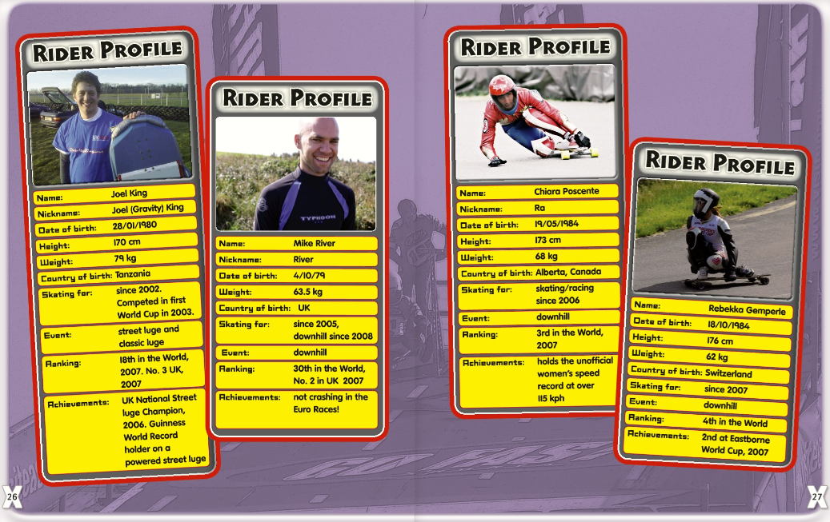
Write your own questions to give these answers:
170cm
4th October 1979
Canada
Rebekka Gemperte

Slide 2
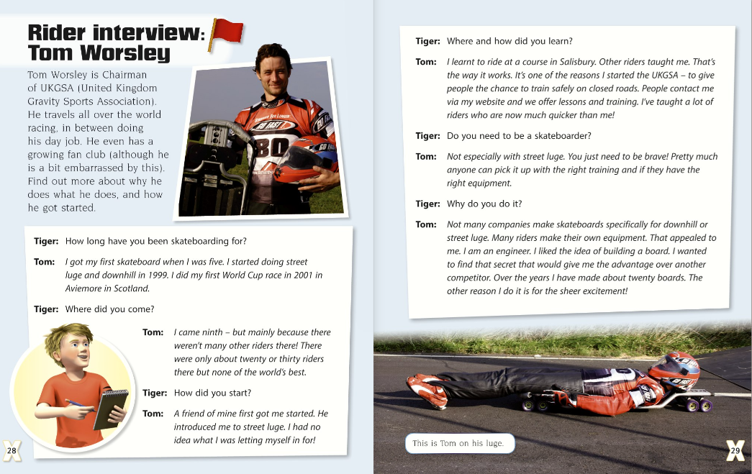

Slide 3
