Slide 1
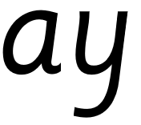

Focus: ay
a - make a curve, go up to the top, come back down and flick. y - start at the top, come all the way down and curve. Go back up, come all the way down and curve to the left.

Slide 2
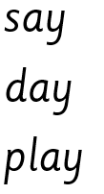
Your turn! Write ay in your book using the lines.
Then try:

