Slide 1
Year 1 Geography Comparing locations

Slide 2
A location is a place or where something is. We are going to have a look at some different locations and talk about what we can see.

Slide 3
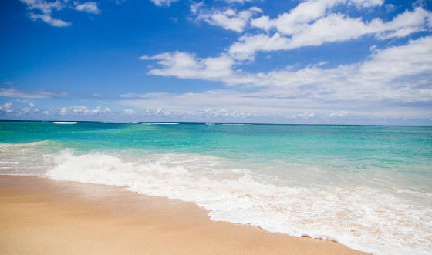
A beach
Where is this location?
What can you see?
Do you think any animals live here?
Have you been somewhere like this before?

Slide 4
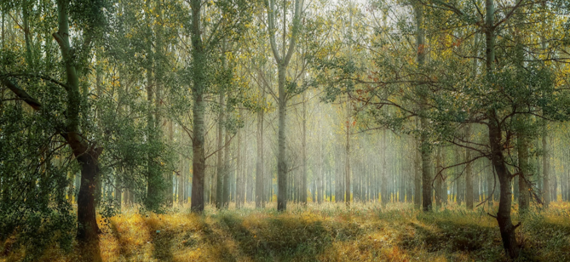
A forest
Where is this location?
What can you see?
Do you think any animals live here?
Have you been somewhere like this before?

Slide 5
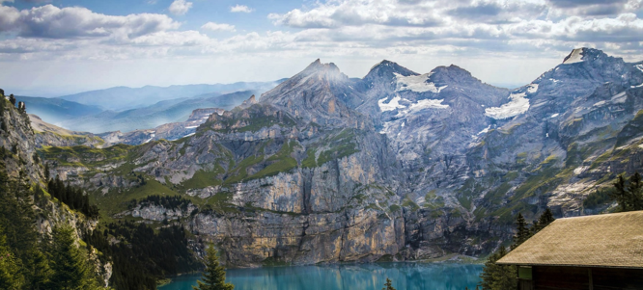
Mountains
Where is this location?
What can you see?
Do you think any animals live here?
Have you been somewhere like this before?

Slide 6
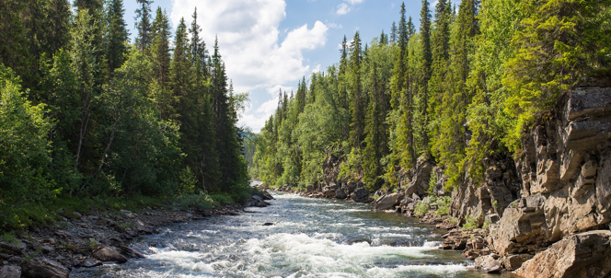
A river
Where is this location?
What can you see?
Do you think any animals live here?
Have you been somewhere like this before?

Slide 7
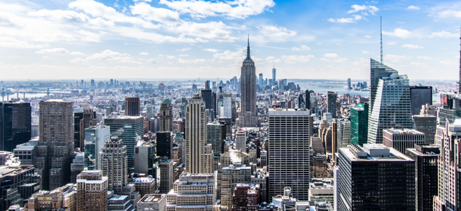
A city
Where is this location?
What can you see?
Who do you think might live here?
Have you been somewhere like this before?

Slide 8
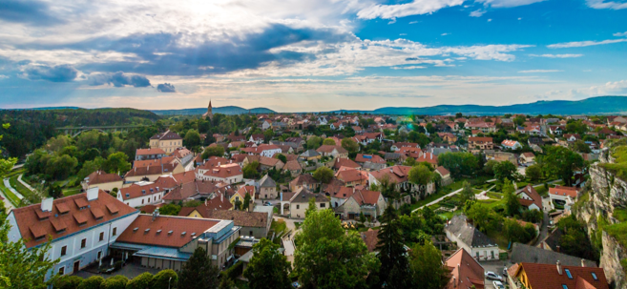
A town
Where is this location?
What can you see?
Who do you think might live here?
Have you been somewhere like this before?

Slide 9
Now we are going to look at some similarities and differences between some of the locations. What is the same and what is different?

Slide 10
A beach and a river.
What is the same?
What is different?

Slide 11
A town and a city.
What is the same?
What is different?

Slide 12
A forest and the mountains.
What is the same?
What is different?

