Slide 1
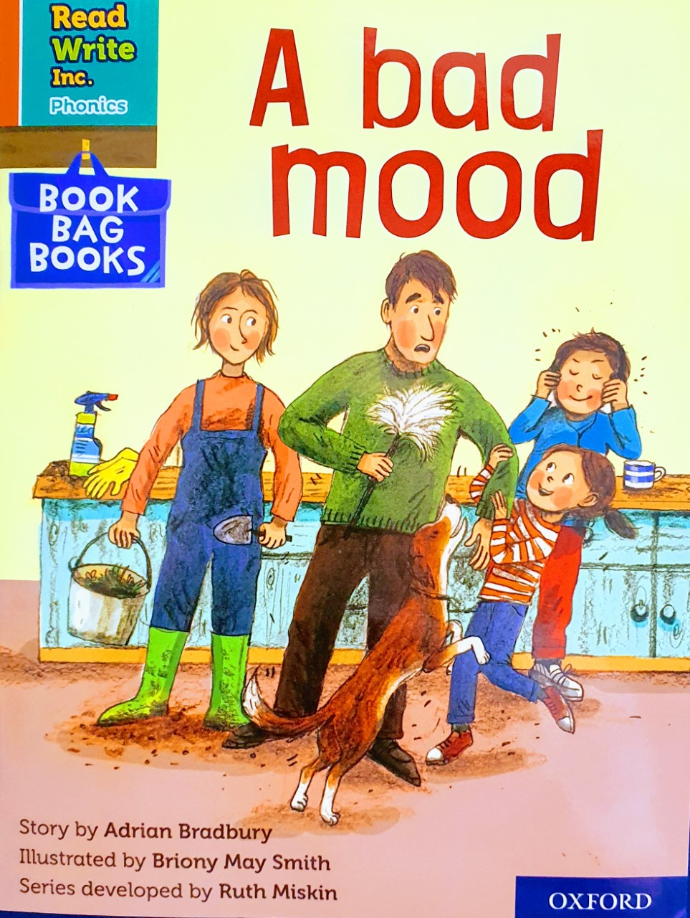

You are going to read the story ‘A Bad Mood’
In this story you will hear words with the sound:
oo
The oo sound is in the words:
spoon
moon
Can you write two words with the oo sound in?
Look at the picture. What can you see? What will happen in the story?

Slide 2
Let’s read these words together. These are words you will come across in the story.
Green Words
mood
flicks
spoon
stomps
doodle
Red Words
he
I
the
we

Slide 3
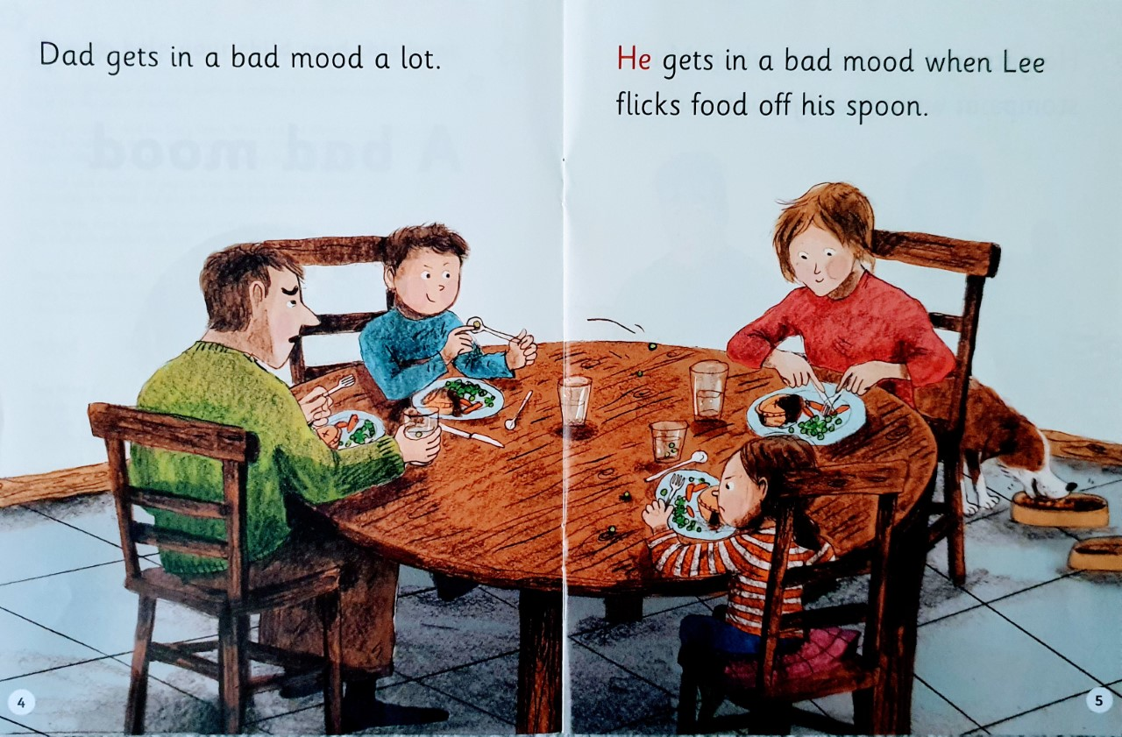
Write down all of the words you can see with the oo sound we are learning today.
What does Dad do a lot?
What is Lee doing?

Slide 4
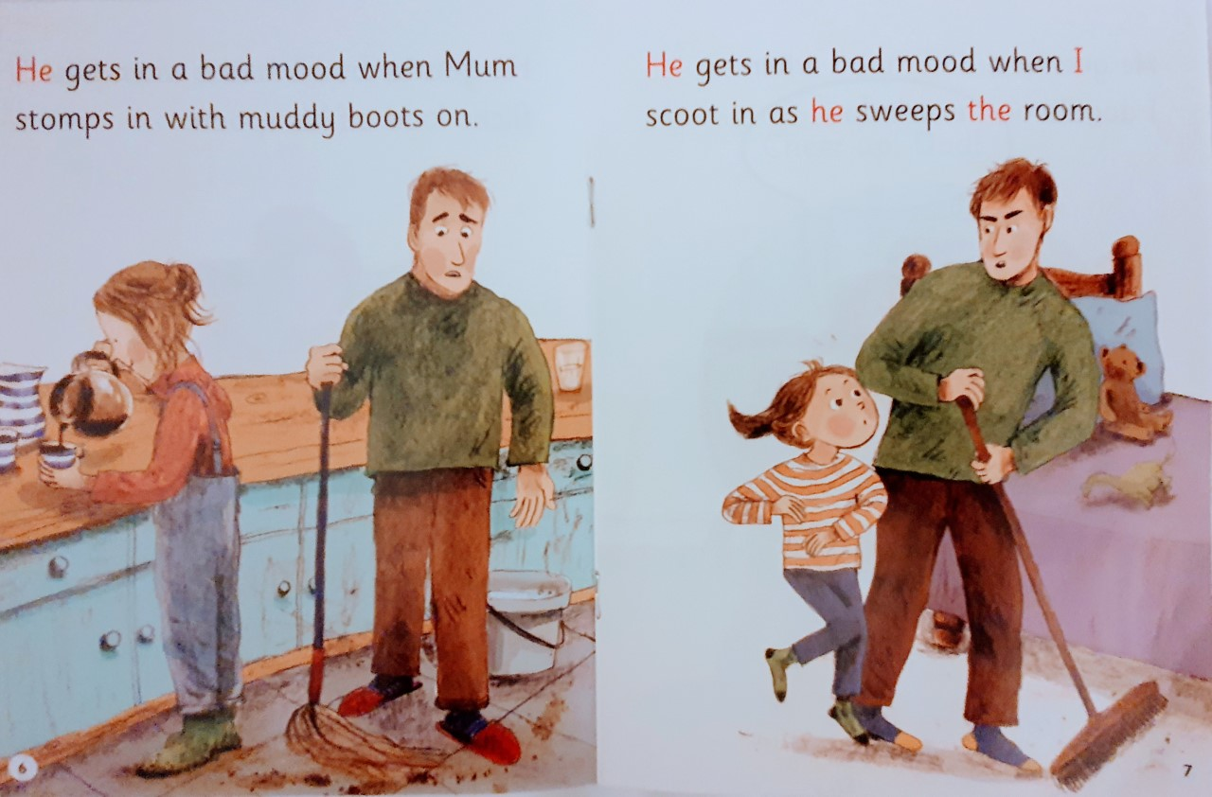
Why does he get in a mood with Mum?
What do you think scoot means ?
What does Dad sweep?

Slide 5
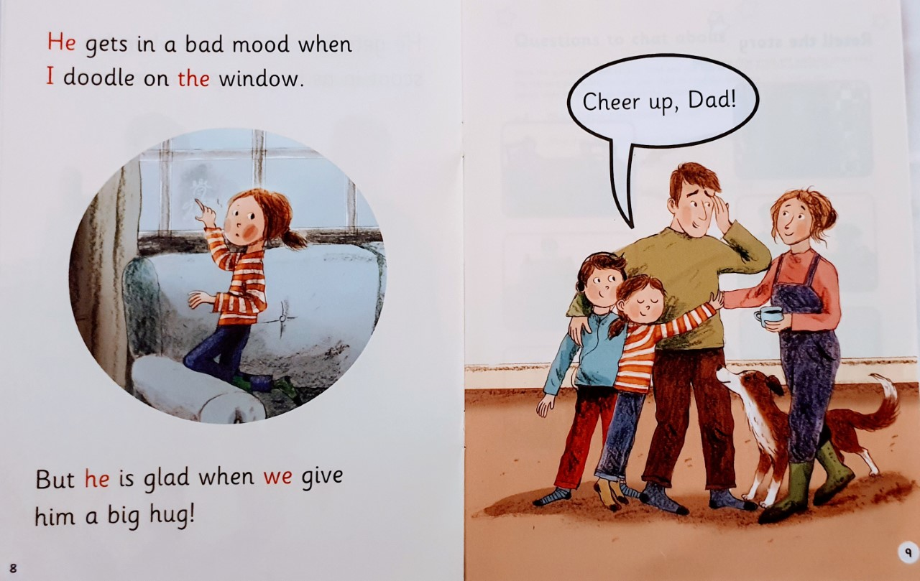
What is the girl doing on page 8?
What makes Dad feel glad?

Slide 6
Recap questions
p. 5 Why is Dad in a bad mood with Lee?
p.6 What does Mum do that gets Dad in a bad mood?
p.9 When is Dad not in a bad mood?
p.4 Why do you think Dad gets in a mood a lot?

