Slide 1
The Highwayman
A glossary

Slide 2
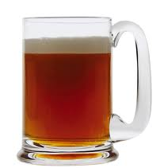
ale They said no word to the landlord, they drank his ale instead
noun
A strong and heavy kind of beer.
‘He ordered a pint of ale from the bar.’
back to word list

Slide 3
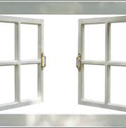
casement Two of them knelt at her casement, with muskets at their side!
noun
A window that opens with hinges at the sides.
‘I opened the casement to let in fresh air.’
back to word list

Slide 4
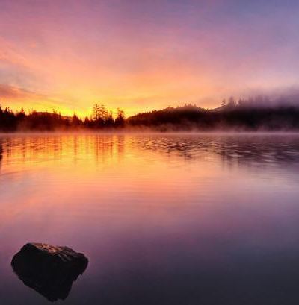
dawning he did not come in the dawning; he did not come at noon
noun
The first sight of sun in the morning.
‘The birds woke up at the dawning of the day.’
back to word list

Slide 5
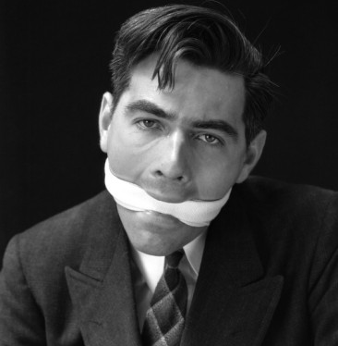
gagged But they gagged his daughter and bound her to the foot of her narrow bed
verb
Put something in the mouth to stop speech.
‘He was gagged with a cloth.’
back to word list

Slide 6
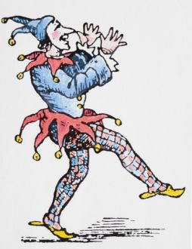
jest They had tied her up to attention, with many a sniggering jest
noun
A joke.
‘He played a good jest on us and made us laugh.’
back to word list

Slide 7
musket They had bound a musket beside her, with the barrel beneath her breast!
noun
A long-barrelled gun fired from the shoulder.
‘The soldier fired a musket.’
back to word list

Slide 8
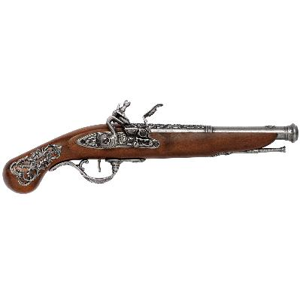
pistol His pistol butts a-twinkle
noun
A small gun that can be fired with one hand.
‘She shot at him with a pistol.’
back to word list

Slide 10
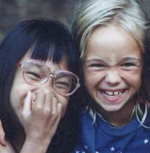
sniggering They had tied her up to attention, with many a sniggering jest
adjective
Laughing at someone in a mean way.
‘The girls played tricks with a sniggering laugh.’
back to word list

Slide 11
tawny And out o’ the tawny sunset, before the rise o’ the moon
adjective
A warm sandy orange colour.
‘The tawny coloured deer ran through the fields.’
back to word list

Slide 12
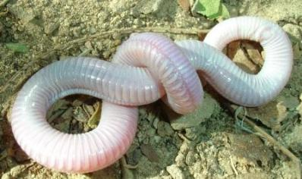
writhed She writhed her hands till her fingers were wet with sweat or blood!
verb
Twisting or squirming.
‘The fisherman had a tub of writhing maggots.’
back to word list

