Slide 1
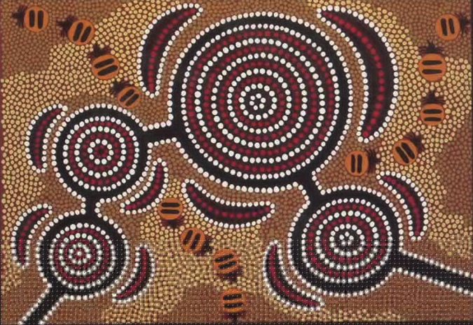
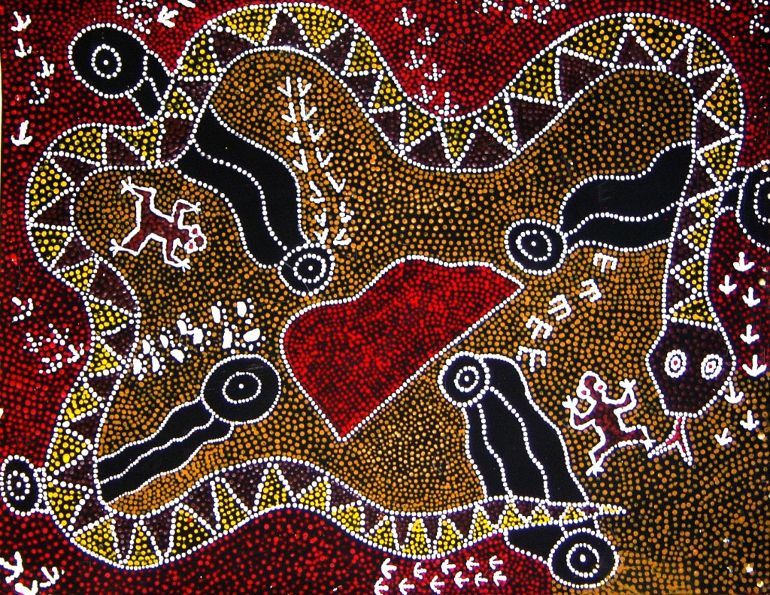

Aboriginal Art

Slide 2
Key vocabulary
Design a plan or drawing of your ideas
Pattern a repeated decorative design.
Symbols a mark, sign or word that represents an idea or object
Technique the way you create your artwork e.g. drawing, painting,

Slide 3
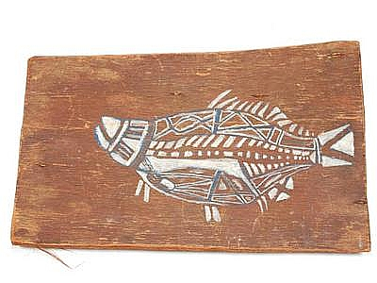
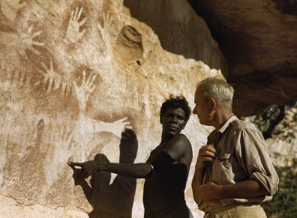
Recapping from last week
Three types of Aboriginal Art
Bark painting- X-ray fish
Negative printing - Simple figures
Geometrical

Slide 4
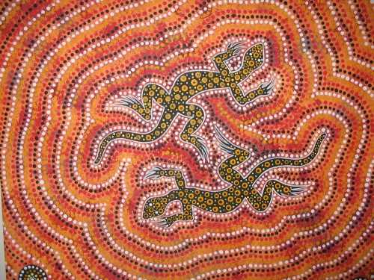
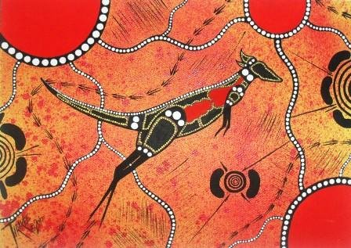
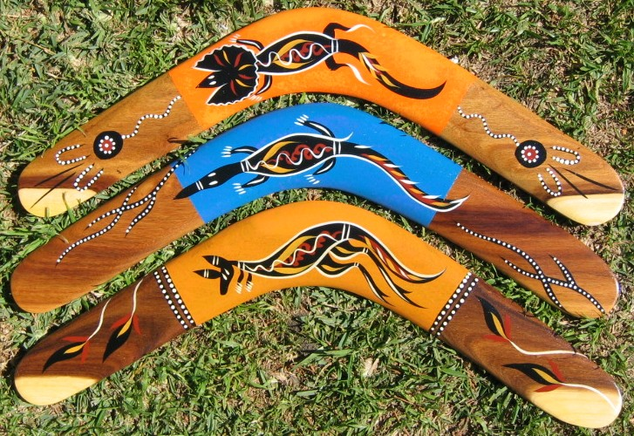
Animals in Aboriginal Art
Objects in Aboriginal Art

Slide 5
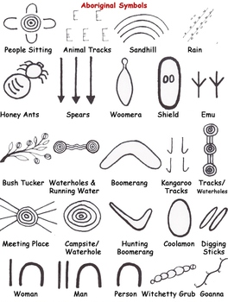
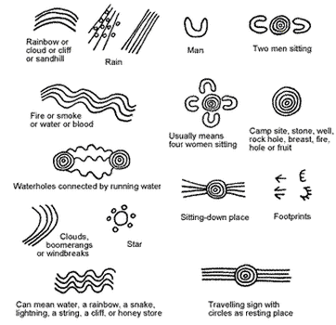

Slide 6
Now it’s your turn
Last week you pretended you were living thousands of years ago and used symbols to create a plan for your own design for a piece of art work that you will pass down to your ancestors.
Use your plan where you
Use three symbols that will use to create your storyline and art work.
Remember to create a repeated pattern.
You can draw your design. If you have colours or paint then could add this to your own design.

