Slide 1
1. Which came first the Ice Age or the Stone Age?
2. Name something that didn’t exist in the Stone Age.

Slide 2
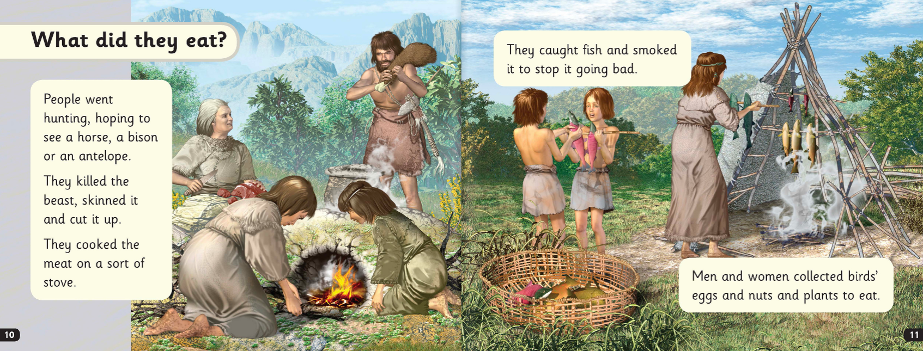
3. Name two animals people would hunt for food.

Slide 3
4. Where did people sleep in the Stone Age?

Slide 4
5. True or false? Sometimes they made tools like knives out of bone.

Slide 5
6. What did they make using animal’s teeth?

