Slide 1
To be able to show 5 minutes later

Slide 2
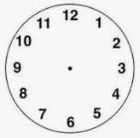
What does 5 minutes look like on a clock?
Each of these sections on a clock represent an hour for the small hard or 5 minutes for the big hand.

Slide 3
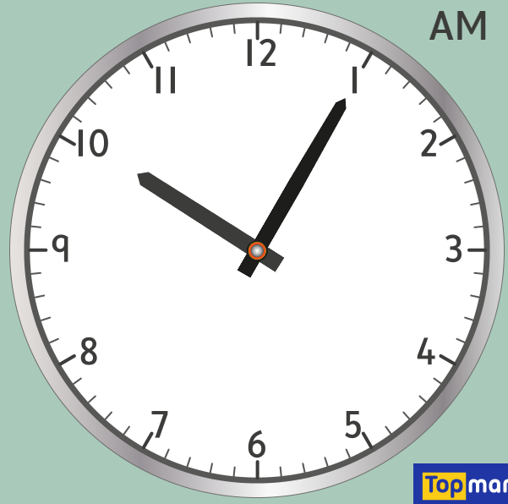
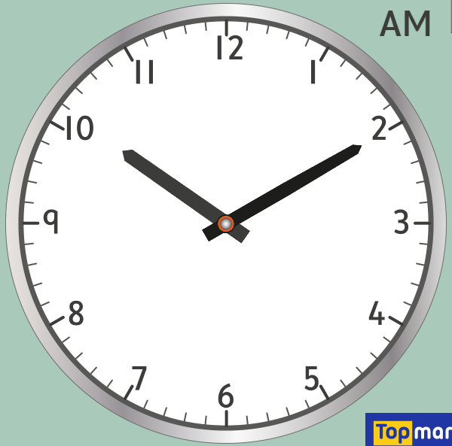
Showing 5 minutes later
When we show five minutes later the minutes hand (the big hand) moves 1 section clockwise around the clock.
5 minutes later
5 past 10 10 past 10

Slide 4
Your turn
Now it is your turn to try and show 5 minutes later. For each question I would like you to draw the new time on the clock and try to write in words what the time is.
Good luck.

