Slide 1
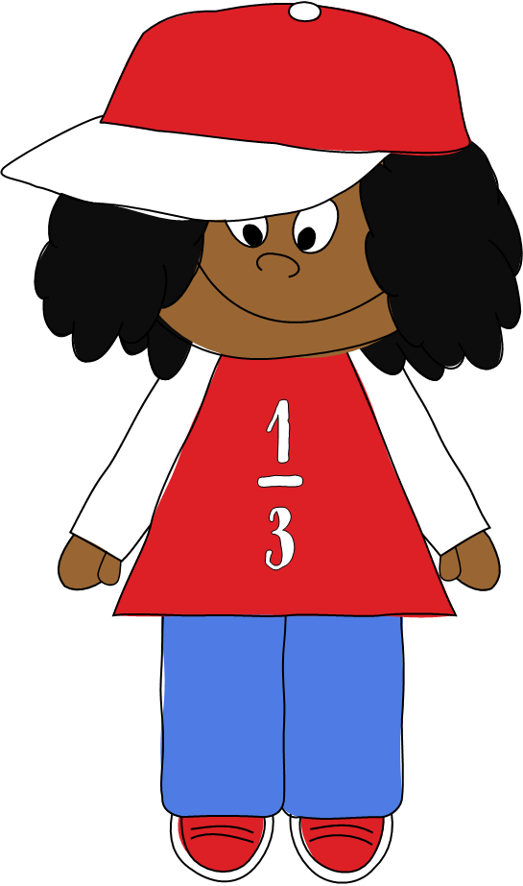
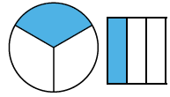

Recognising a third

Slide 2
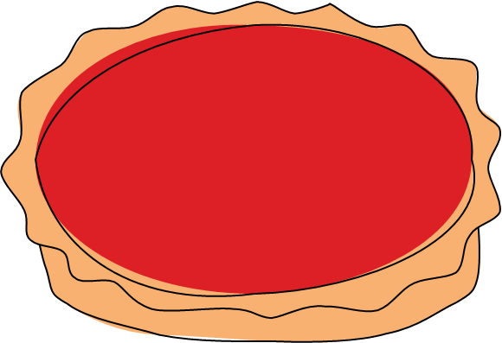
What is a third?
To third something is to split a whole into 3 equal parts.
The whole pie has been split into equal parts.
Each part is worth a third .

Slide 3

A third can be written as:
1
The top number tells us how many parts we are talking about.
3
The bottom number tells us how many equal parts the whole has been split into.

Slide 4
Which picture on each slide represents thirds?

Slide 5
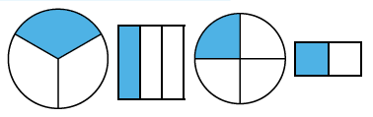
Which shape represents a third?

Slide 6
Which shape represents a third?

Slide 7
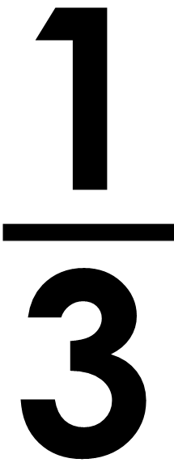
Is the statement below true or false?
of the shape is shaded.

Slide 8
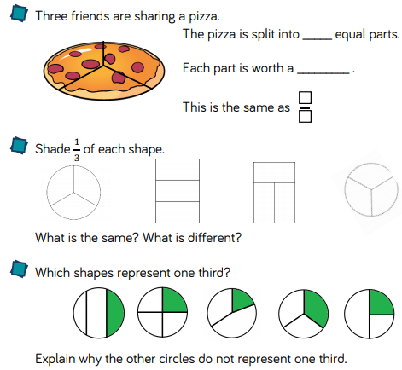
Now it’s your turn

