Slide 1

22.1.21
Hansel and Gretel
Part One
Listen to the first part of the story.
I have underlined some words for you to think about - what do they mean? Check if you are right at the end.

Slide 2
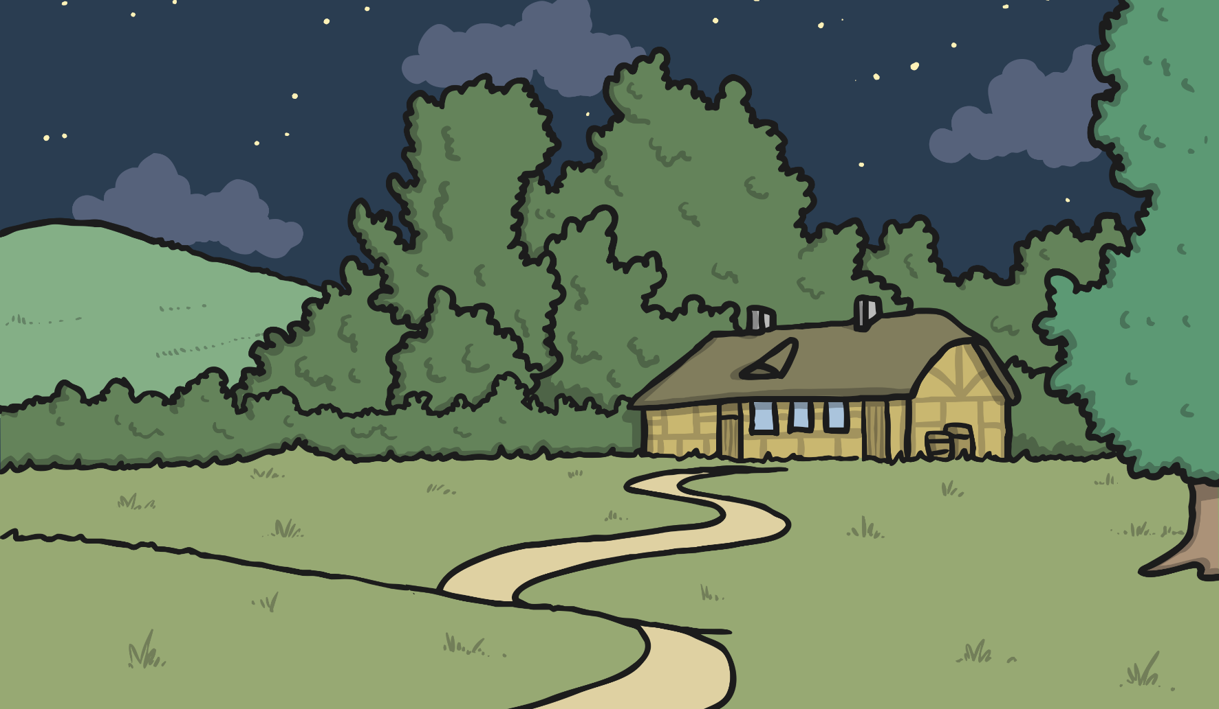
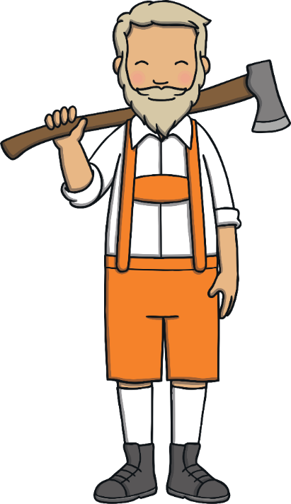



Once upon a time, there lived two children called Hansel and Gretel. They lived with their father and stepmother in a house in the woods. Their father was a woodcutter.

Slide 3
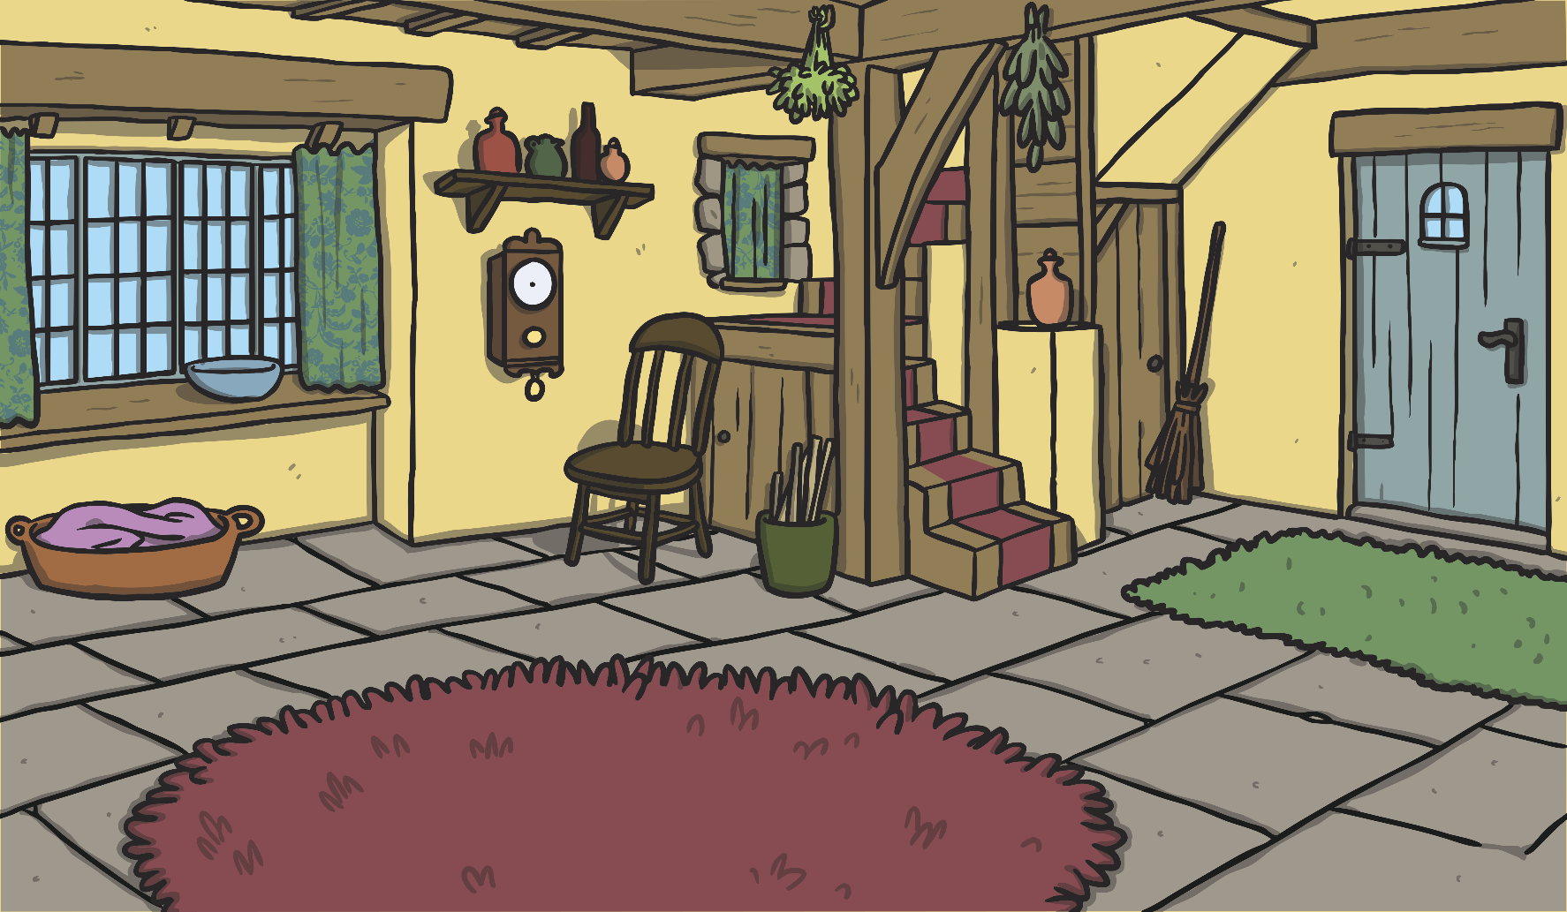

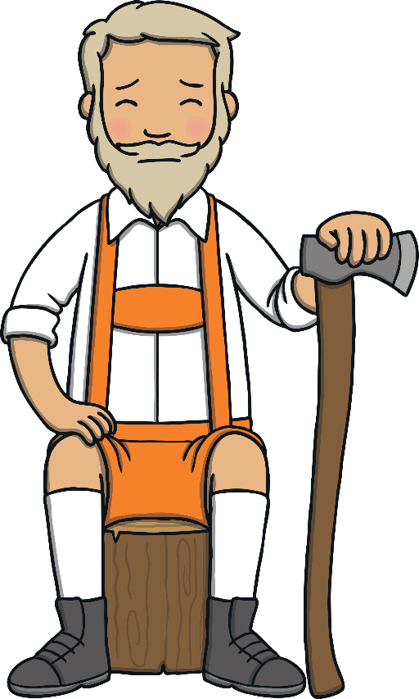
The woodcutter was very poor. He could no longer provide food for his family. One night, his wife suggested that they take the children into the forest and leave them there.

Slide 4


Hansel and Gretel overheard what their stepmother had said.
They were very sad.

Slide 5




Hansel crept outside and found some white pebbles. They shone brightly in the moonlight. He filled his pockets with the pebbles and crept back inside.

Slide 6
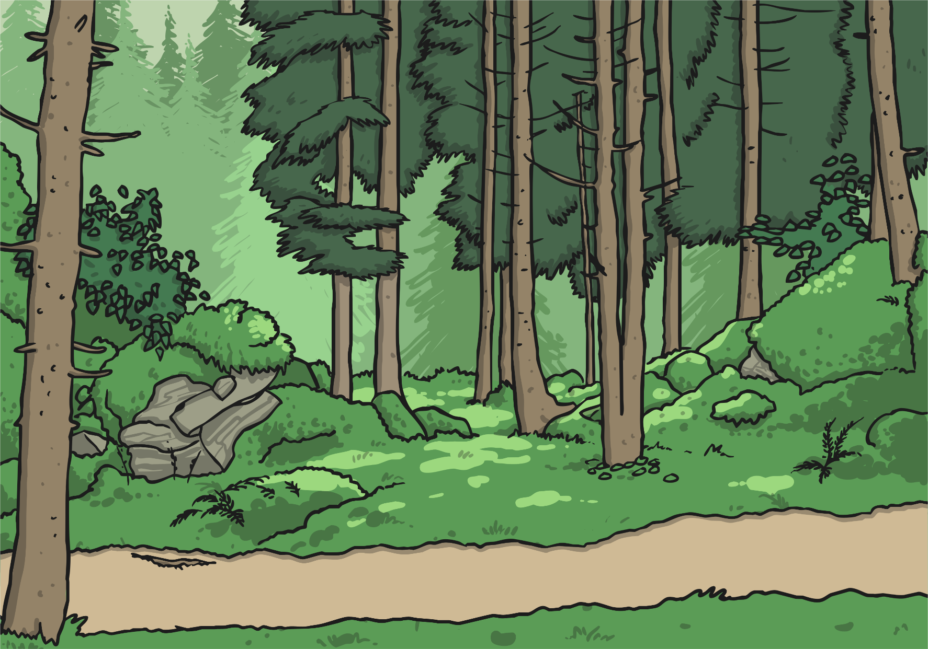

The next morning, they all went for a walk in the forest. As they walked, Hansel dropped the pebbles along the path.

Slide 7
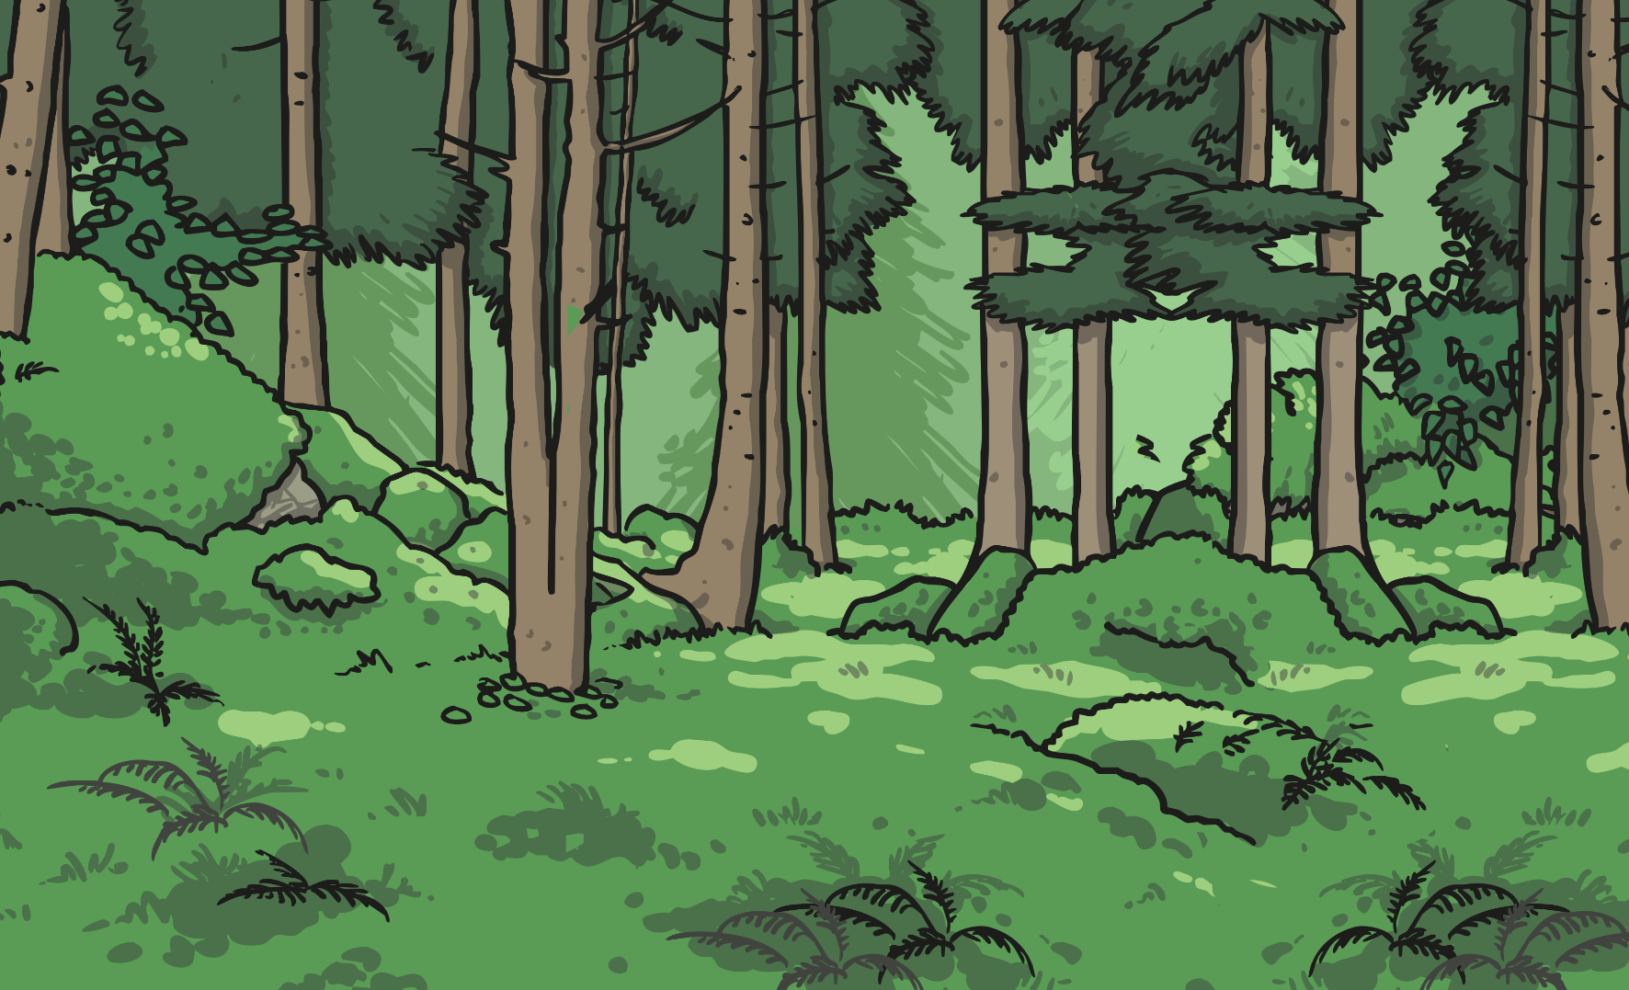
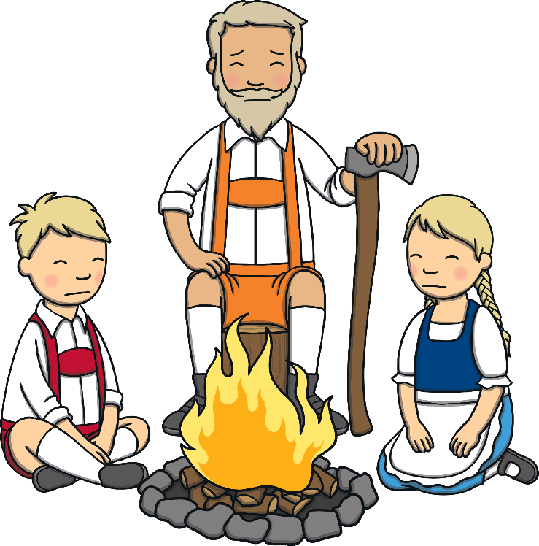
They went further and further into the forest. Hansel and Gretel grew tired, so the woodcutter made a fire and told them to rest here.

Slide 8


When they awoke, they were all alone. But Hansel’s plan had worked! They could follow the stones all the way home.

Slide 9



When they arrived home the woodcutter was overjoyed! However, their stepmother was very cross. Later that night, she told the woodcutter that he must get rid of the children again.

Slide 10

The next day, the stepmother gave Hansel and Gretel two slices of bread for their breakfast. They set out into the forest again.

Slide 11

This time, they walked a lot further into the heart of the forest. As they walked along, Hansel dropped breadcrumbs along the path.

Slide 12

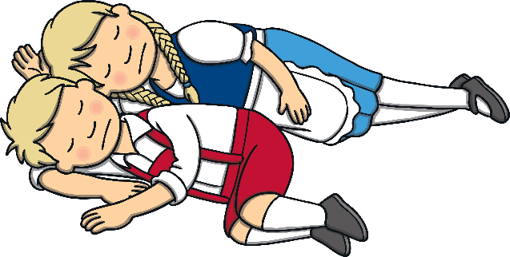

When the children were tired, the woodcutter told them to gather wood so that he could build them a fire. He told them to rest by the fire, and once again they fell asleep.

Slide 13


When they awoke, they found themselves alone again.

Slide 14
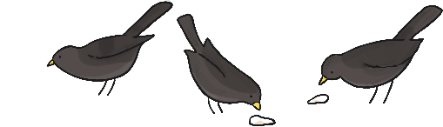
Hansel was not worried. He told Gretel about the breadcrumbs, but when they looked along the path they found they had been eaten by the birds and animals in the forest!

Slide 15
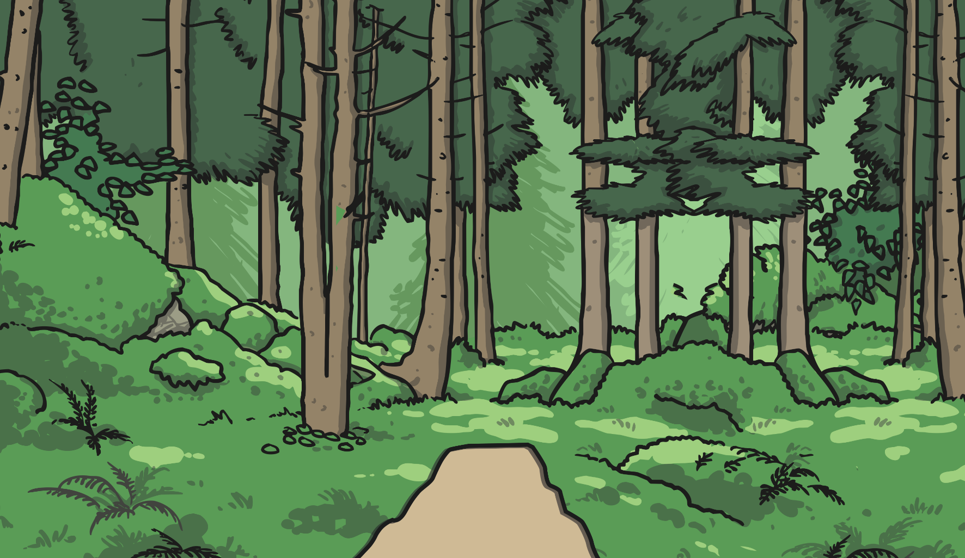
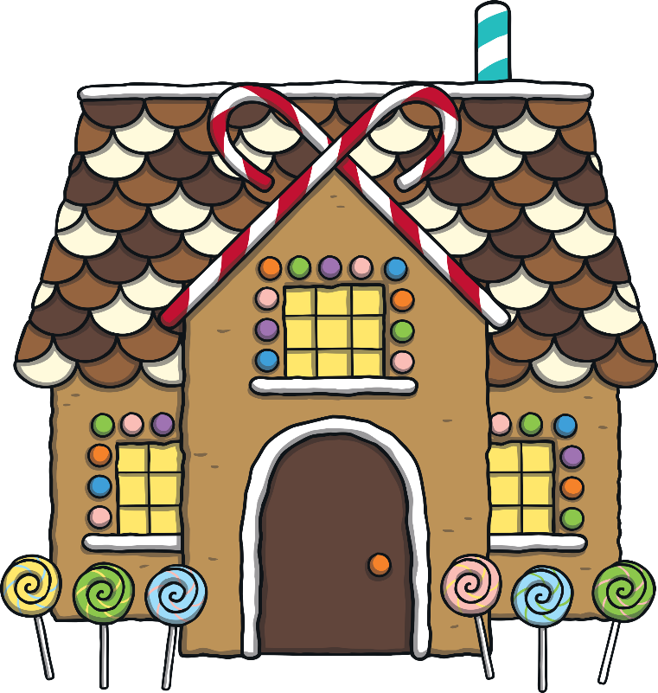
Hansel and Gretel walked and walked, through the forest. Eventually they came across an amazing house! It was made of gingerbread and decorated with sweets, icing and lollipops.

Slide 16
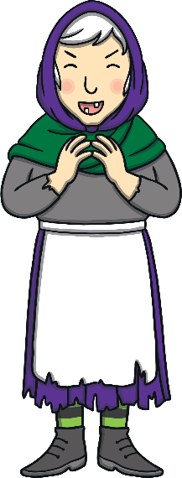
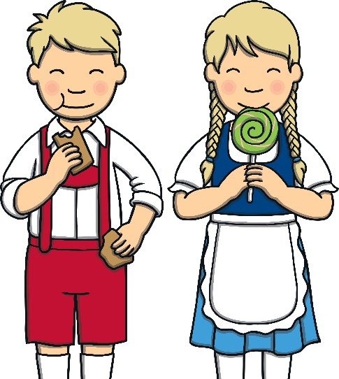
Hansel and Gretel began to eat the sweets. Then, all of a sudden, an old woman came out of the gingerbread house. She invited
them both inside.

Slide 17
Word check:
Once upon a time - a long time ago. Used in fairy tales.
Stepmother - the father’s wife who is not the children’s mum. In real life these can be nice people just like another mum, but in fairy tales they are often bad.
Woodcutter - a job that is to cut wood.
Poor - when someone does not have a lot of money.
Overjoyed - very very happy.
Heart of the forest - the middle of the forest.

Slide 18
Points to think / talk about:
Have you heard this story before?
Do you think the old woman is a good or evil character?
What do you think happens next in the story?

