Slide 1
Learning Intention: To find unknown angles.

Slide 2
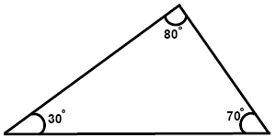
Angles in a triangle always add up to 180 degrees.

Slide 3
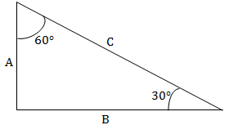
To work out unknown angles in a triangle:
First add the angles together
60 + 30 = 90
Then subtract the answer from 180
180 – 90 = 90.
The unknown angle is 90 degrees.

Slide 4
What is the unknown angle in this triangle?

Slide 5
First we add the two angles together
70 + 70 = 140
Then we take the answer away from 180
180 – 140 = 40.
The unknown angle is 40 degrees.

