Slide 1
Explore the meaning of scientific key vocabulary

Slide 2
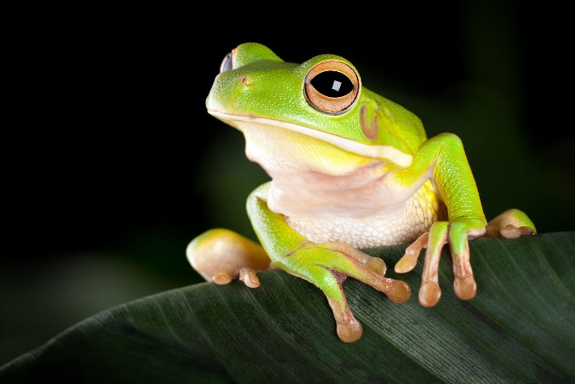
Amphibian
A cold blooded animal that can live on both land and water.
They are vertebrates.
They have moist, scale less skin.

Slide 3
Mammal
A warm blooded animal, which feeds her young (babies) on milk from her own body.
Most mammals give birth to live young, not eggs.

Slide 4
Life Processes
Life processes are the basic functions performed by living organisms.
There are seven life processes. Can you remember what they are from last weeks revision?
Movement, Respiration, Sensitivity, Nutrition, Excretion, Reproduction and Growth.

Slide 5
Invertebrates
Invertebrates are animals that do not have a backbone.
More than 90% of all living animal species are invertebrates.

Slide 6
Vertebrates
Invertebrates are animals that have a backbone.

Slide 7
Microorganisms
Microorganisms can only been seen through a microscope.
They can be found everywhere such as: in soil, rivers, plants, animals, tap water, on your keyboard and in your body.
Some microorganisms are harmful to humans and cause germs. These are called diseases. However, some microorganisms are helpful. They live inside humans and help humans to digest food.
There are many different types of microorganisms such as viruses, bacteria and fungi.

