Slide 1
LI SLIDE

Slide 2
1
2
3
5

Slide 3
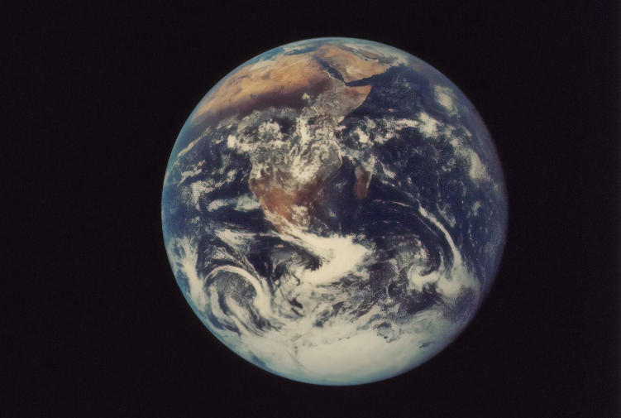
How many?
1

Slide 4
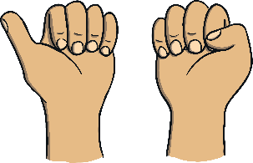
1

Slide 5
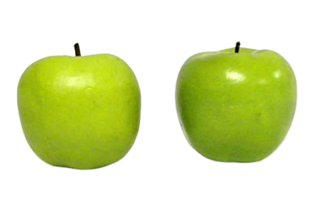
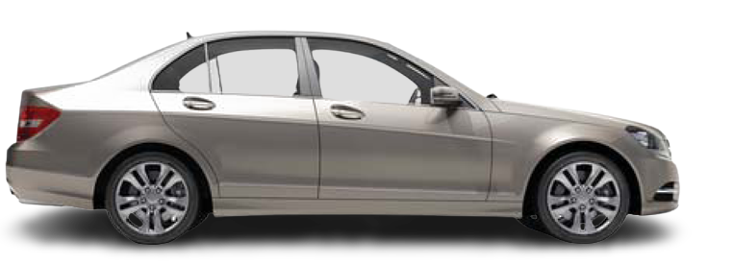
How many objects can you see in these pictures?
2

Slide 6
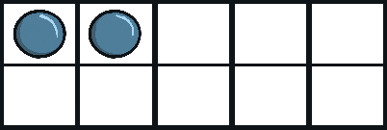
2
2

Slide 7
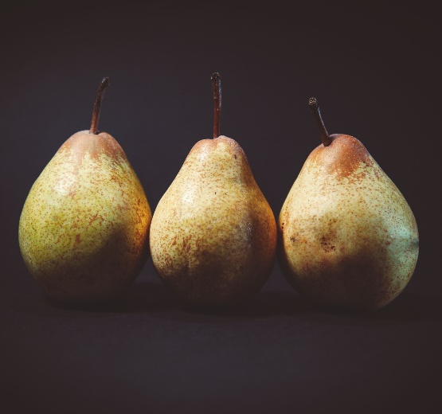
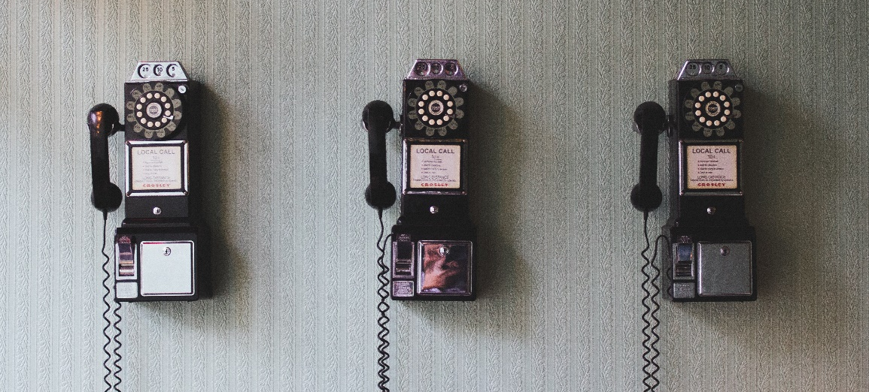
How many?
3

Slide 8
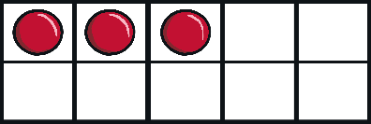
3
3

Slide 9
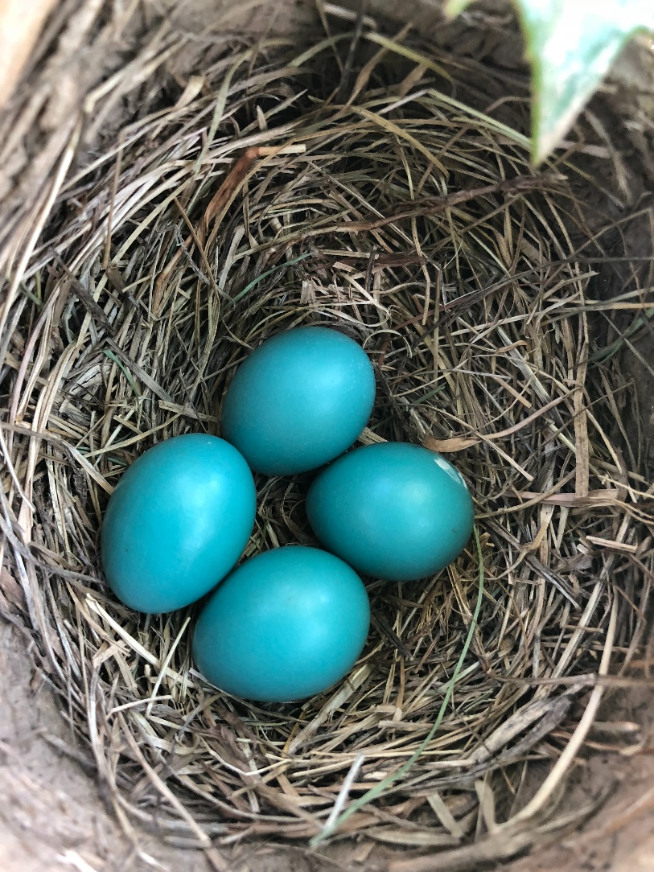
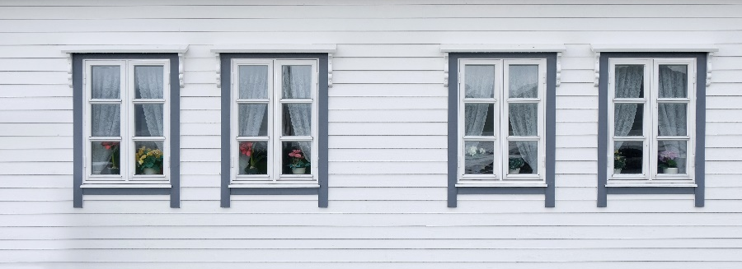
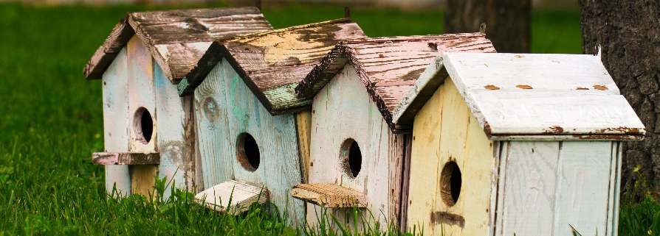
How many?

Slide 10
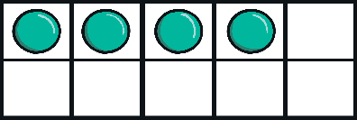
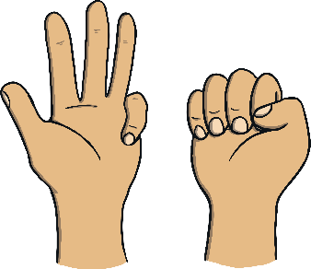

Slide 11
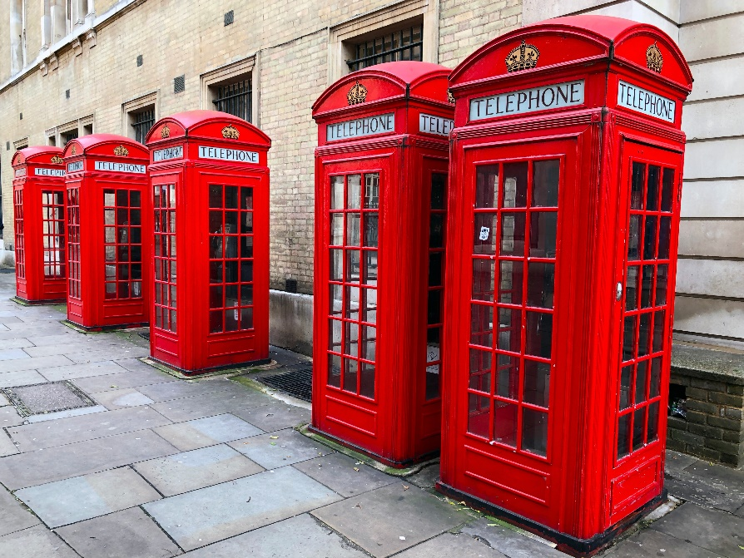
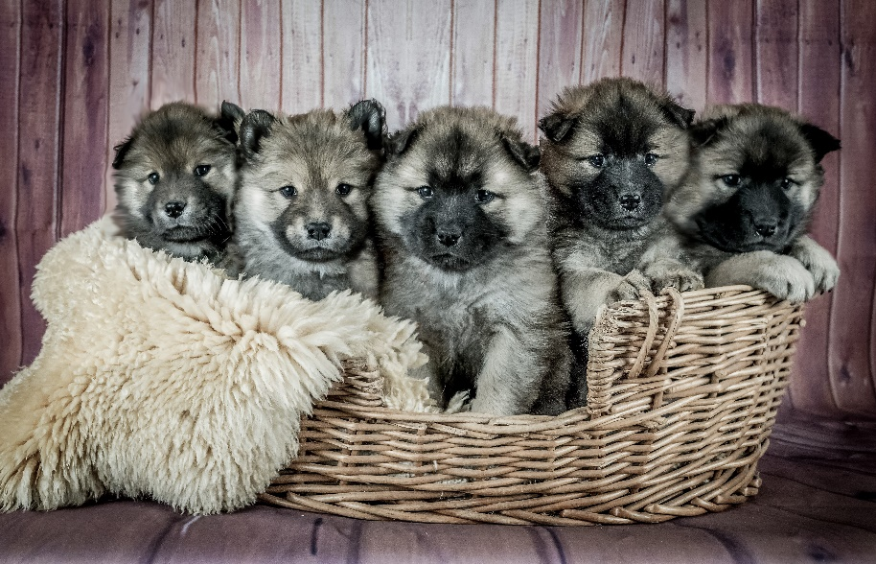
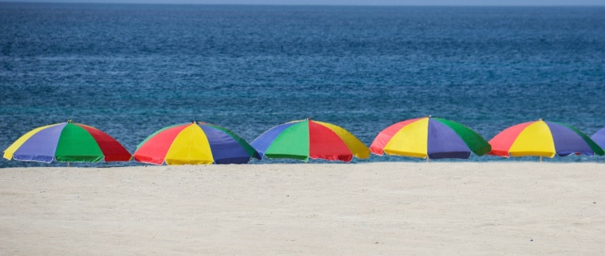
How many?
5

Slide 12
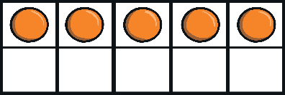
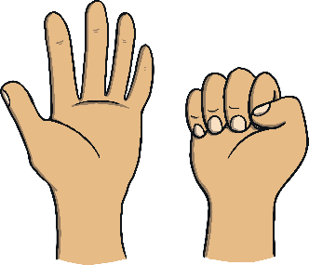
5
5

Slide 13
Commentary:
Slide 1: Let’s practice counting 1, 2, 3, 4, 5. Can you find and point to the number 1, 5, 4, 2, and 3?
Slide 2: Use your pointy finger. How many chairs, buckets, planets and flowers? Can you spot the number 1?
Slide 3: Here are different ways to show 1. Numicon 1, 1 bead, 1 cube, 1 thumb and 1 counter in our tens frame.
Slide 4: Use your pointy finger. How many apples, shoes and cars? Can you spot the number 2?
Slide 5: Here are different ways to show 2. Numicon, beads, cubes, thumb and finger and counters in the tens frame.
Slide 6: Use your pointy finger. How many balloons, rocks, telephones and pears? Can you spot the number 3?
Slide 7: Here are different ways to show 3. Numicon, beads, cubes, thumb and finger and counters in the tens frame.
Slide 8: Use your pointy finger. How many eggs, windows, trees and bird houses can you see? Can you spot the number 4?
Slide 9: Here are different ways to show 4. Numicon, beads, cubes, thumb and finger and counters in the tens frame.
Slide 10: Use your pointy finger. How many telephone boxes, puppies, umbrellas and asparagus? Can you spot the number 5?
Slide 11: Here are different ways to show 4. Numicon, beads, cubes, thumb and finger and counters in the tens frame.

