Slide 1
Learning Intention – To learn about the South West of England

Slide 2
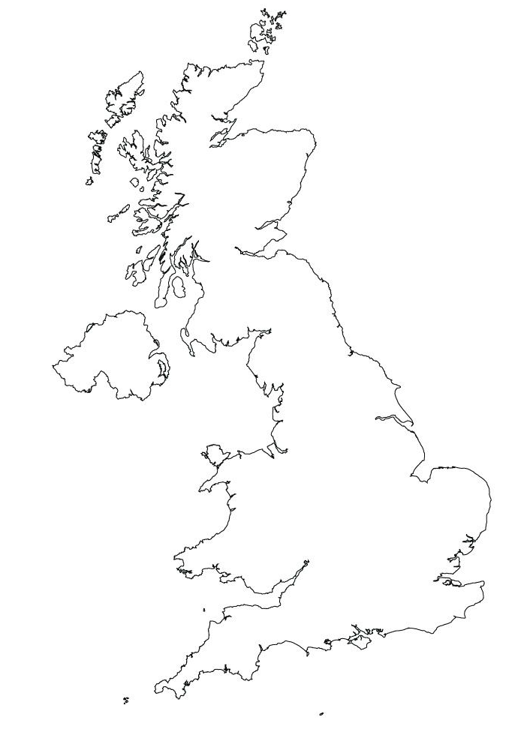
Cornwall
We are going to be learning about Cornwall over the next few lesson, an area in the South West of England.
Can you find Cornwall on a map or using the internet with websites like google Earth.

Slide 3
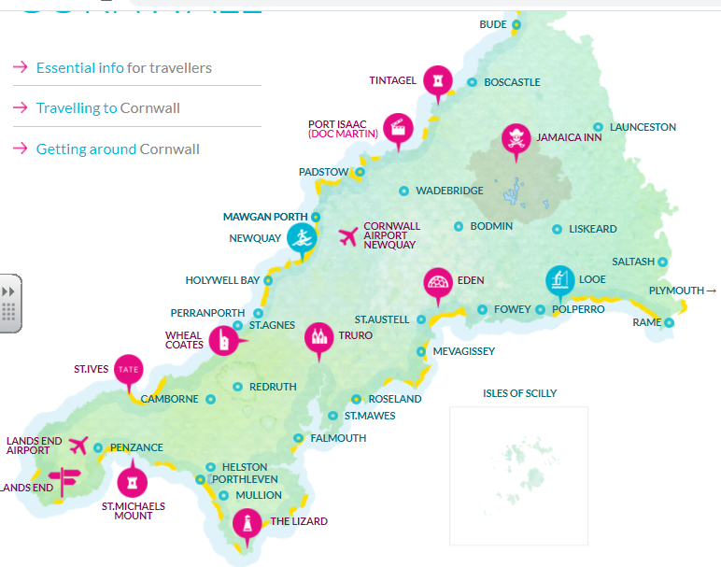
Cornwall
Cornwall is a beautiful part of England, with many different things to see and do. Have a look at this map, what do you think the symbols mean?

Slide 4
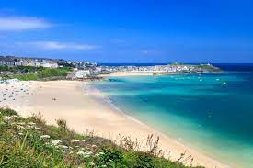
Why do people go there?
One of the main reasons that people go to visit Cornwall is for its warm, sunny beaches with great surfing waves.
Their beaches are some of the warmest and sunniest in the whole of the United Kingdom, this is because of something called the Gulf Stream.

Slide 5
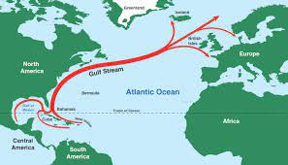
What is the Gulf Stream?
The Gulf Stream is a strong, underwater current that brings warm water from Mexico, across the Atlantic Ocean. This make the climate in places like Cornwall much warmer and attractive for people to visit.

Slide 6
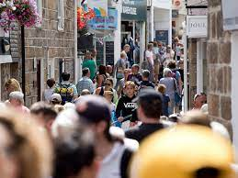
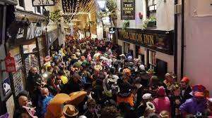
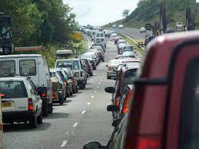
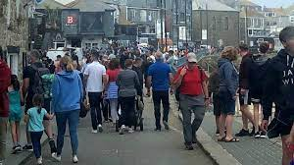
The problem with this warm climate.
Cornwall is a very attractive place to visit but this brings with it a problem, too many people. Many of the towns in Cornwall are quite small so they can’t cope with lots of people.

Slide 7
Your task today.
I want you to complete a tourism study of Cornwall. I want to think about all the benefits for people coming to Cornwall and all the negative impact it has.
You could record you ideas in this table like the one below.
Benefits of tourism | Negative impact of tourism

