Slide 1

Alternative History
Learning intention
How iron age people lived

Slide 2
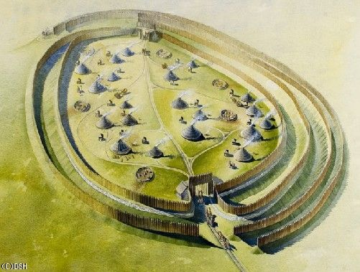
Living in an Iron Age Hillfort.

Slide 3
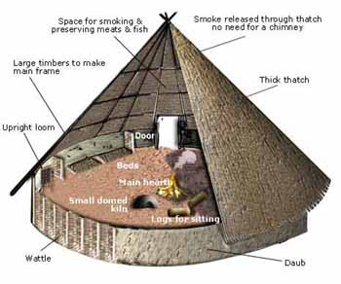
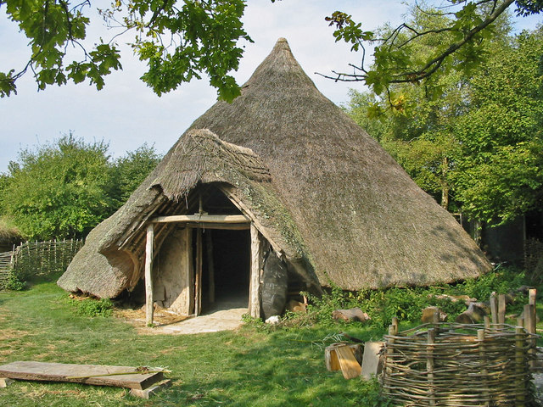
Iron age roundhouses
Round house facts
4 -9 metres across
Made from wood and grass or straw
Central pole to keep the roof up
Fire in the middle of the floor for heat, light and cooking
Beds around the edge

Slide 4
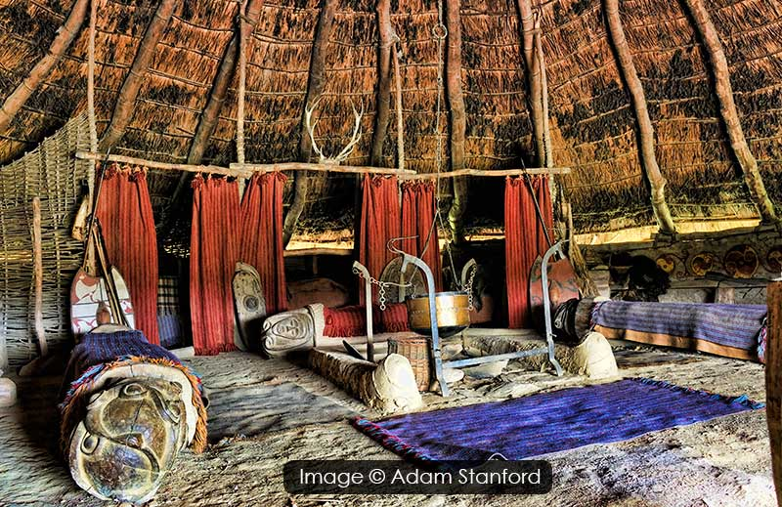
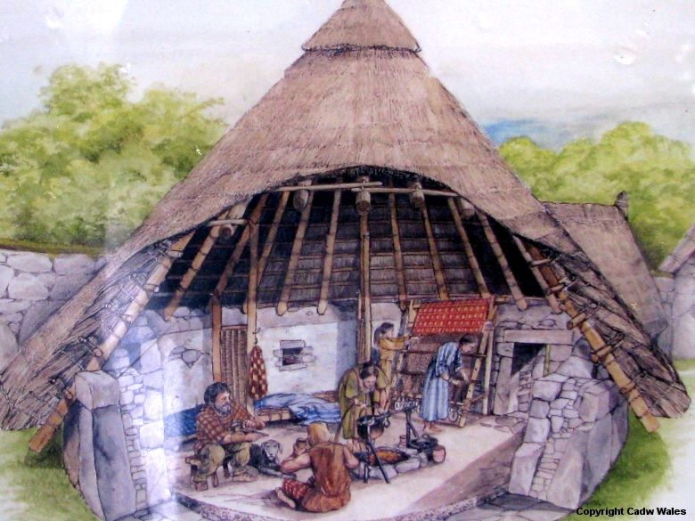
Simple wooden furniture – table, chest
Loom for weaving clothes
Animal skins used for blankets
Door decorated with carving and plants
Iron tools and weapons

Slide 5
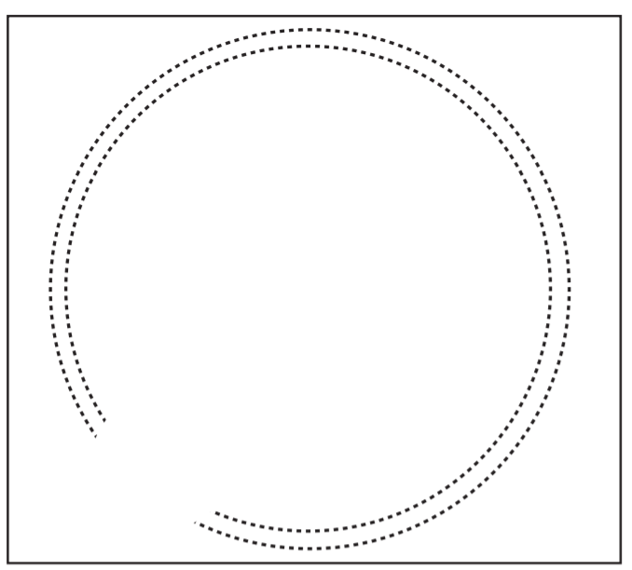
Task
Draw a plan of a roundhouse
include
A central pole Fire beds
Animal skins wooden table Wooden chest
Loom
What else could you include?
Think about:
Food cooking equipment
sleeping- blankets/wool/skins
defence – weapons
Draw a circle (a saucer or small plate might help)
Include a door way and label neatly.

