Slide 1
Learning intention - Discuss and explore how place names determine the spread of Viking settlements.

Slide 2
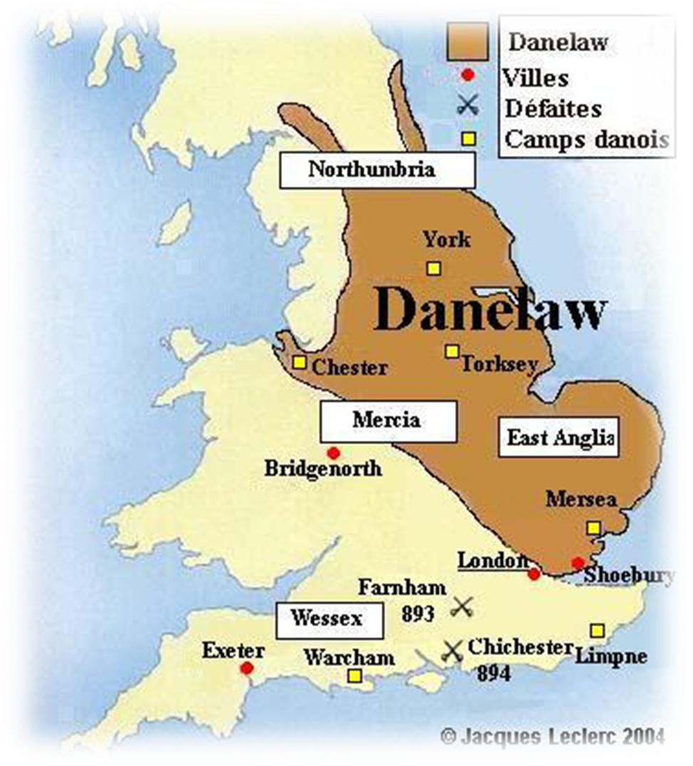
Viking Britain
During Viking Britain, many of those that travelled from Scandinavia settled in different parts of Britain and many of the towns, cities and villages names are still named after the Vikings place names.

Slide 3
Viking influence on place names
Word | Meaning
AIN | one/solitary
BECK | stream
BY | farm
DALE | valley
FELL | hill
GARTH | enclosure (usually a grass paddock near to a farmhouse)
GILL/GHYLL | ravine, narrow steep-sided valley
HOLME | island or meadow field in marshland
KIRK | church
KELD | well/spring
SCAR | outcrop of bare rock
SKEL | spill/flood
STY | pathway
THORP(E) | outlying farm
THREL | slave
TOFT | cottage/house-sit
The ending of the place names
all have a meaning.

Slide 4
Use the list of places from the last slide and a map of Great Britain to identify and make a list of the places in Great Britain that have kept their Viking place name.

