Slide 1

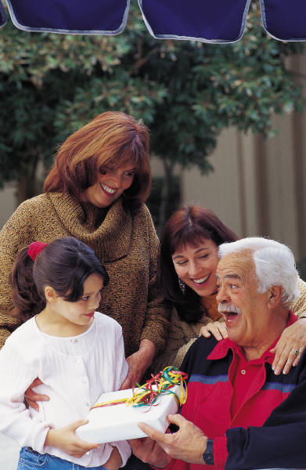
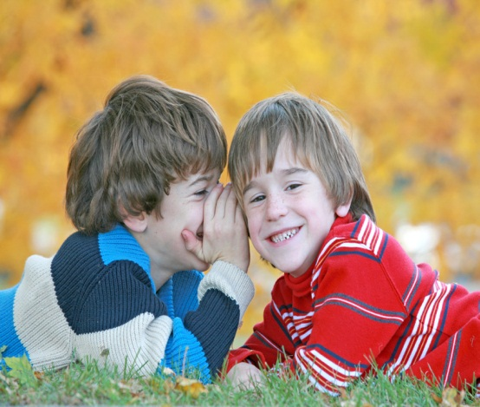
Positive, healthy relationships

Slide 2
What is a relationship?
A relationship is the connection that you share with another person.
Why is it important to have good relationships?

Slide 3
Mind Map all of the relationships you have with people
Family relationships
Relationships that make me happy
School relationships
Relationships I find hard
Use the subheadings to help you think in more detail

Slide 4
Friendship
Think about your friends, what makes them a good friend?
What makes you a good friend?
What are good qualities in friendships?
What are some of the problems that can happen in friendships?

Slide 5
Healthy relationship
Have a look at the words below, which of these words do you think describe a healthy relationship?
Loving sharing kicking playing
shouting honesty loving
Whispering fun caring helping

Slide 6
True or False?
A healthy relationship is someone who...
Listens to you when you are upset.
Says your problems aren’t important.
Buys you lots of presents.
Says sorry if they make a mistake.
Doesn’t want you to play with their friends.
Is kind and polite to you.
Helps you when you are hurt or upset.
Says unkind things about you.
Wants you to be happy and doesn’t make you feel upset.

