Slide 1
Poetry
To listen to or read a poem, discuss it and express views about it.
Vocabulary:
poem
line
verse
rhyme
rhythm
pattern
repeated

Slide 2
Line:
This can be long or short and does not always have a full stop at the end like a sentence.
Verse :
A section of the poem
Rhythm:
Regular repetition of sounds.
We clapped our hands to the rhythm of the drums.
Rhyme:
Two words sound the same when spoken out loud. They don’t need to be spelt the same. EG- me, sea
Repetition:
When a word or phrase is used more than once.
Pattern:
Sometimes the same lines are repeated in the poem so it creates a pattern

Slide 6
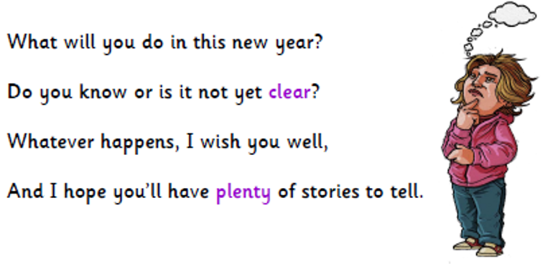

Slide 7
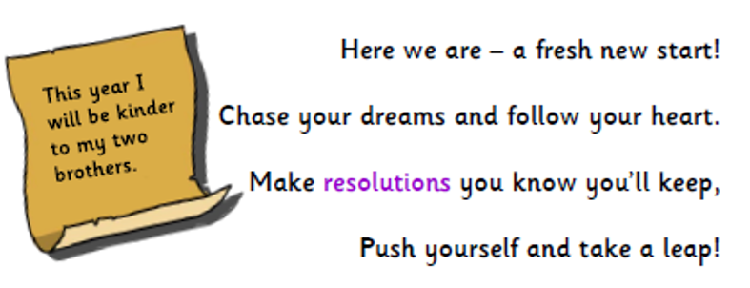

Slide 8
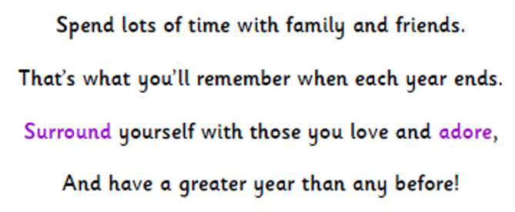

Slide 9
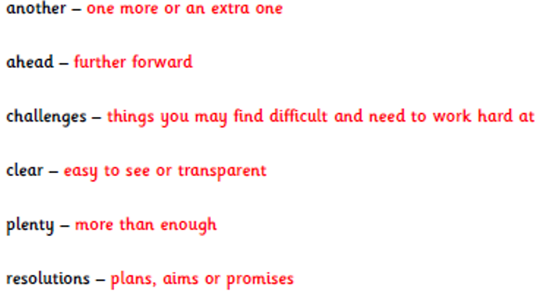

Slide 11
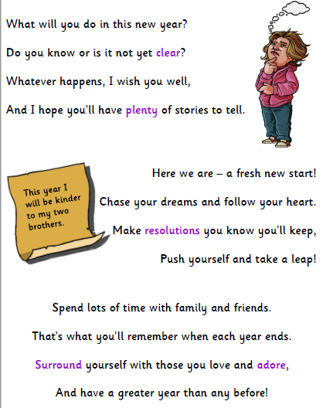

Slide 12
Task:
Read the poem to someone in your bubble or listen to it again.
Talk about the poem using some of the vocabulary words we looked at on slide 2.
Explain what you like/dislike about the poem.

