Slide 1
Fantastic Mr Fox
Chapter 5 The Terrible Tractors
What has happened so far?
Where are the foxes now?
Where are the farmers? What have they been trying to do?

Slide 2
We are now going to read chapter 5 of Fantastic Mr Fox
Task 1
Find sheet Mr Fox chapter 5 questions.
There are some questions on the sheet that you can find the answers for as you read and listen. The story will stop at the end of each slide to give you a change to check for the answer.
The questions are also on the next slide.
Think about your answers and then write them in clear sentences.
Task 2
Draw an illustration that you think would go well with any part of the story that you have read so far. This is explained further after the text.

Slide 3
Questions for chapter 5
1. On page one, how does Roald Dahl describe the size of the hole that the farmers had dug?
2. Why is this a good description?
3. On page 2, why did Bunce have to shout at Bean twice?
4. On page three, Road Dahl describes the tractors as ‘murderous, brutal looking ,monsters.’ Why has he used this language and what effect does it have on the reader?
5. On page four, in what different ways does Roald Dahl show the power of the tractors? Think about the way he describes their movement and their actions.
6. On page five, look at this section, ‘Look!’ said one of the Small Foxes. ‘Our tunnel’s got shorter! I can see daylight!’
What is happening in the story for the small fox to say this?
7. How do you think the fox family feel when they hear the tractors?
8. At the end of the chapter, why do you think that ‘Dig, dig, dig!’ has been written in italics?

Slide 4
Page 1
As the sun rose the next morning, Boggis and Bunce and Bean were still digging. They had dug a hole so deep you could have put a house into it. But they had not yet come to the end of the foxes’ tunnel. They were all very tired and cross.
‘Dang and blast!’ said Boggis. ‘Whose rotten idea was this?’
‘Bean’s idea,’ said Bunce.
Boggis and Bunce both stared at Bean. Bean took another swig of cider, then put the flask back into his pocket without offering it to the others. ‘Listen,’ he said angrily, ‘I want that fox! I’m going to get that fox! I’m not giving in till I’ve strung him up over my front porch, dead as a dumpling!’

Slide 5
Page 2
‘We can’t get him by digging, that’s for sure,’ said the fat Boggis. ‘I’ve had enough of digging.’
Bunce, the little pot-bellied dwarf, looked up at Bean and said, ‘Have you got any more stupid ideas, then?’
‘What?’ said Bean. ‘I can’t hear you.’ Bean never took a bath. He never even washed. As a result, his earholes were clogged with all kinds of muck and wax and bits of chewing-gum and dead flies and stuff like that. This made him deaf. ‘Speak louder,’ he said to Bunce, and Bunce shouted back, ‘Got any more stupid ideas?’

Slide 6
Page 3
Bean rubbed the back of his neck with a dirty finger. He had a boil coming there and it itched. ‘What we need on this job,’ he said, ‘is machines . . .mechanical shovels. We’ll have him out in five minutes with mechanical shovels.’
This was a pretty good idea and the other two had to admit it.
‘All right then,’ Bean said, taking charge. ‘Boggis, you stay here and see the fox doesn’t escape. Bunce and I will go and fetch our machinery. If he tries to get out, shoot him quick.’
The long, thin Bean walked away. The tiny Bunce trotted after him. The fat Boggis stayed where he was with his gun pointing at the fox-hole.
Soon, two enormous caterpillar tractors with mechanical shovels on their front ends came clanking into the wood. Bean was driving one. Bunce the other. The machines were both black. They were murderous, brutal-looking monsters.

Slide 7
Page 4
‘Here we go, then!’ shouted Bean.
‘Death to the fox!’ shouted Bunce.
The machines went to work, biting huge mouthfuls of soil out of the hill. The big tree under which Mr Fox had dug his hole in the first place was toppled like a matchstick. On all sides, rocks were sent flying and trees were falling and the noise was deafening.
Down in the tunnel the foxes crouched, listening to the terrible clanging and banging overhead. ‘What’s happening, Dad?’ cried the Small Foxes. ‘What are they doing?’

Slide 8
Page 5
Mr Fox didn’t know what was happening or what they were doing.
‘It’s an earthquake!’ cried Mrs Fox.
‘Look!’ said one of the Small Foxes. ‘Our tunnel’s got shorter! I can see daylight!’
They all looked round, and yes, the mouth of the tunnel was only a few feet away from them now, and in the circle of daylight beyond they could see the two huge black tractors almost on top of them.
‘Tractors!’ shouted Mr Fox. ‘And mechanical shovels! Dig for your lives! Dig, dig, dig! ’

Slide 9
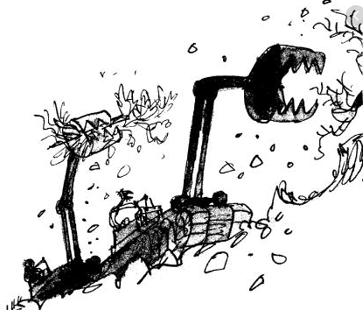
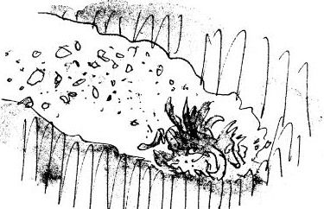
Task 2
Draw an illustration that you think would go well with any part of the story that you have read so far. Add a caption to the drawing to explain what it shows. You could choose a sentence form the text as a caption.
For example;
‘Soon, two enormous caterpillar tractors with mechanical shovels on their front ends came clanking into the wood.’
‘The machines went to work, biting huge mouthfuls of soil out of the hill.’
‘Down in the tunnel the foxes crouched, listening to the terrible clanging and banging overhead.’

Slide 10
Chapter 6
The Race

Slide 11
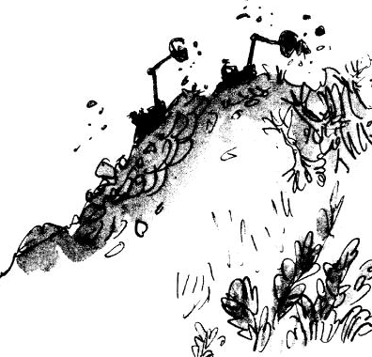
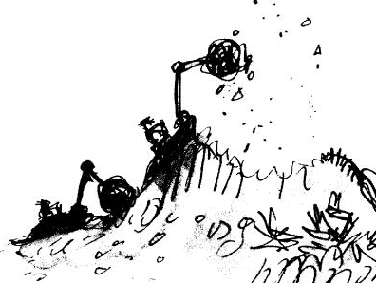
Page 1
Now there began a desperate race, the machines against the foxes. In the beginning, the hill looked like this:
After about an hour, as the machines bit away more and more soil from the hilltop, it looked like this:

Slide 12
Sometimes the foxes would gain a little ground and the clanking noises would grow fainter and Mr Fox would say, ‘We’re going to make it! I’m sure we are!’ But then a few moments later, the machines would come back at them and the crunch of the mighty shovels would get louder and louder. Once the foxes actually saw the sharp metal edge of one of the shovels as it scraped up the earth just behind them.
‘Keep going, my darlings!’ panted Mr Fox. ‘Don’t give up!’
‘Keep going!’ the fat Boggis shouted to Bunce and Bean. ‘We’ll get him any moment now!’

Slide 13
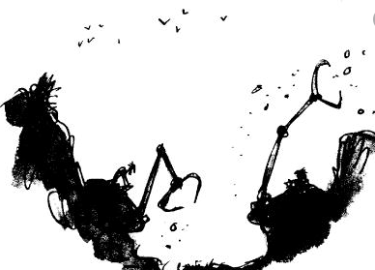
‘Have you caught sight of him yet?’ Bean called back.
‘Not yet,’ shouted Boggis. ‘But I think you’re close!’
‘I’ll pick him up with my bucket!’ shouted Bunce. ‘I’ll chop him to pieces!’
But by lunchtime the machines were still at it. And so were the poor foxes. The hill now looked like this…
The farmers didn’t stop for lunch; they were too keen to finish the job.
‘Hey there, Mr Fox!’ yelled Bunce, leaning out of his tractor. ‘We’re coming to get you now!’
‘You’ve had your last chicken!’ yelled Boggis. ‘You’ll never come prowling around my farm again!’

Slide 14
A sort of madness had taken hold of the three men. The tall skinny Bean and dwarfish pot-bellied Bunce were driving their machines like maniacs, racing the motors and making the shovels dig at a terrific speed. The fat Boggis was hopping about like a dervish and shouting, ‘Faster! Faster!’
By five o’clock in the afternoon this is what had happened to the hill…
The hole the machines had dug was like the crater of a volcano. It was such an extraordinary sight that crowds of people came rushing out from the surrounding villages to have a look. They stood on the edge of the crater and stared down at Boggis and Bunce and Bean.
‘Hey there, Boggis! What’s going on?’
‘We’re after a fox!’
‘You must be mad!’
The people jeered and laughed. But this only made the three farmers more furious and more obstinate and more determined than ever not to give up until they had caught the fox.

