Slide 1
Learning intention – summarising content drawn from more than one paragraph

Slide 2
Read the rest of the text ‘Exploring the deep’. Summarise what you learn in each section. For each section you should only use thirty words or less.

Slide 3
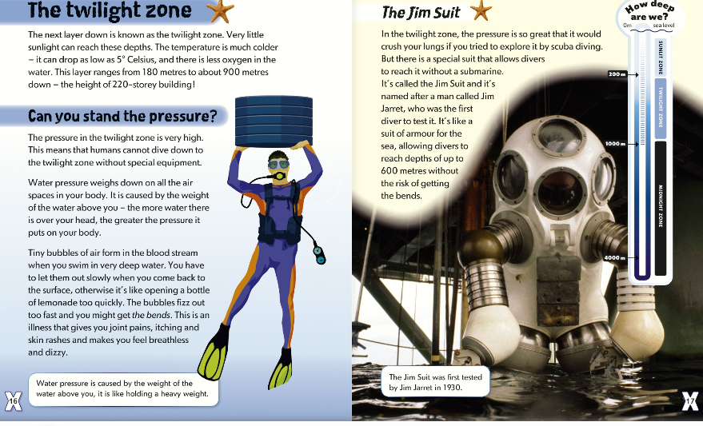

Slide 4
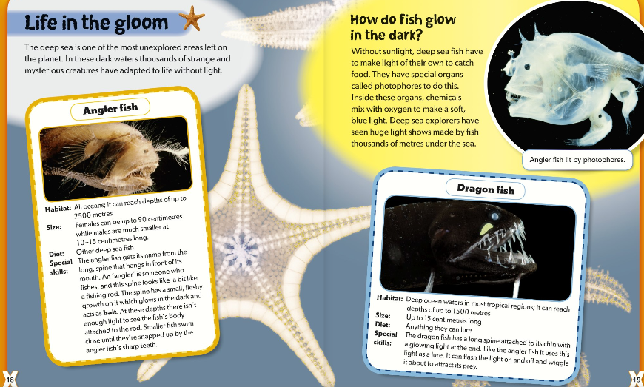

Slide 5
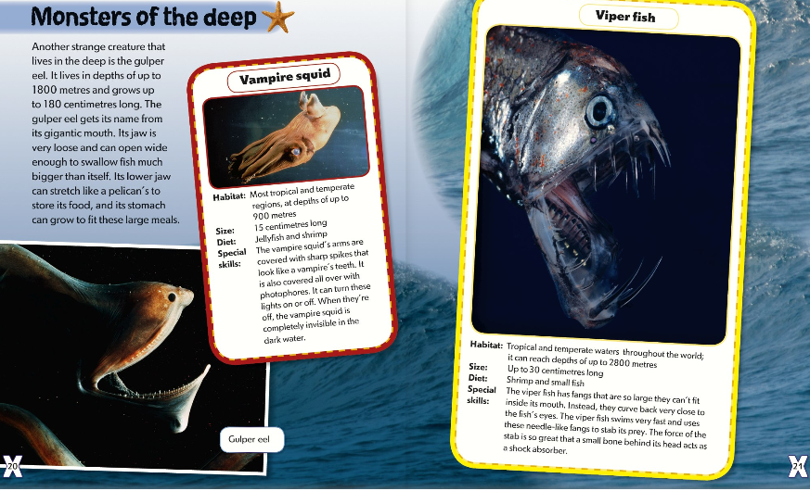

Slide 6
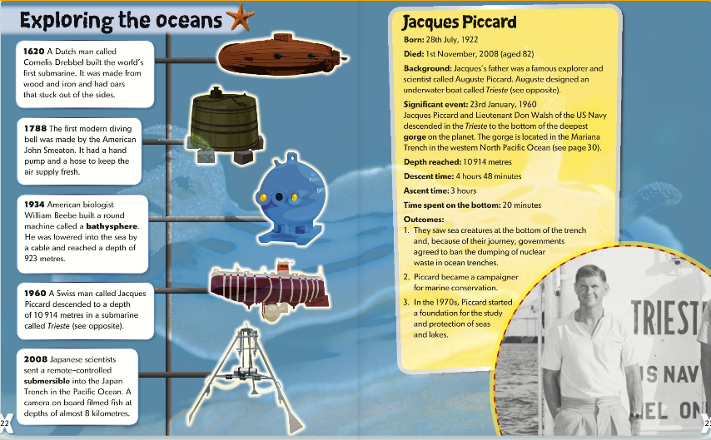

Slide 7
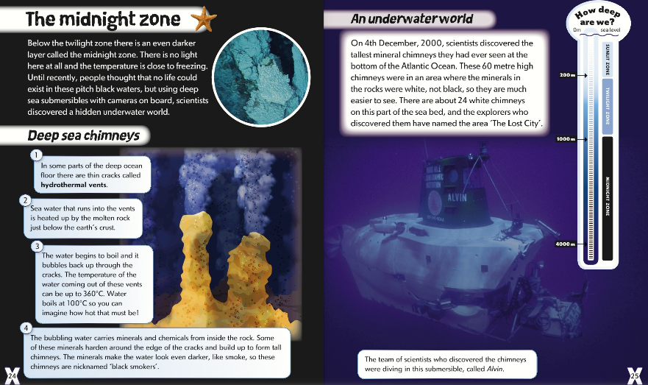

Slide 8
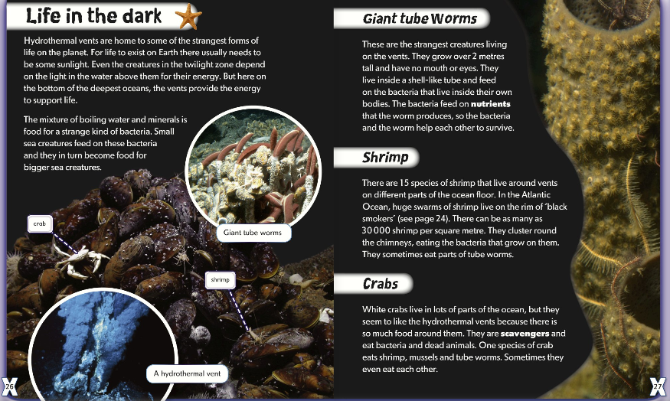

Slide 9
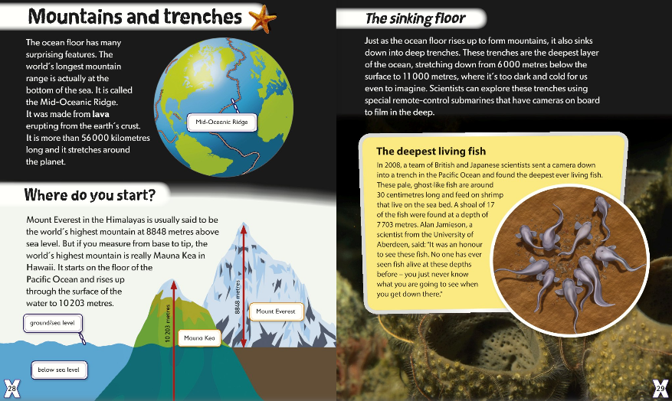

Slide 10
