Slide 1

Oh Otto!
Part 2

Slide 2
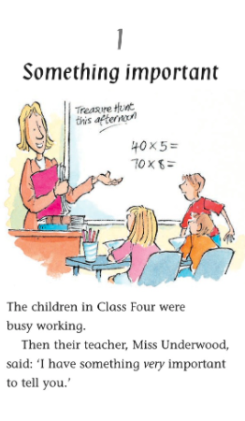
Recall
Can you tell someone in your house about what happened in chapter 1 of the story.

Slide 3
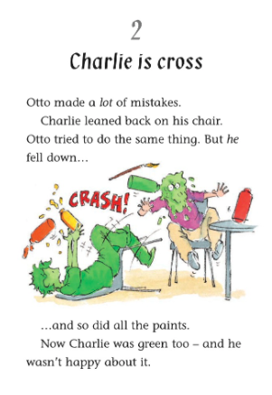
Why was Otto making so many mistakes?
How do you think Otto feel about making so many mistakes? Why do you think that?

Slide 4
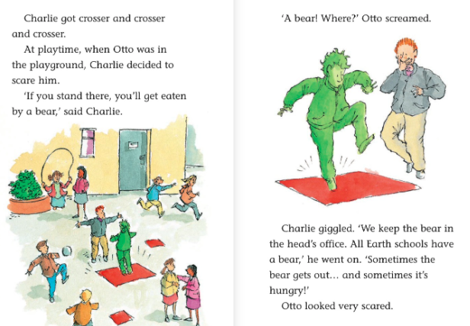
3) Why does Charlie decide to scare Otto?
4) What word at the start of the 2nd page tells you Otto was scared?
5) If you saw Charlie being acting the way he is on the playground, what would you do?

Slide 5
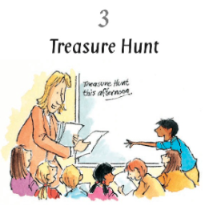
6) Chapter 3 is called ‘Treasure Hunt’. What do you predict will happen in this chapter?

