Slide 1
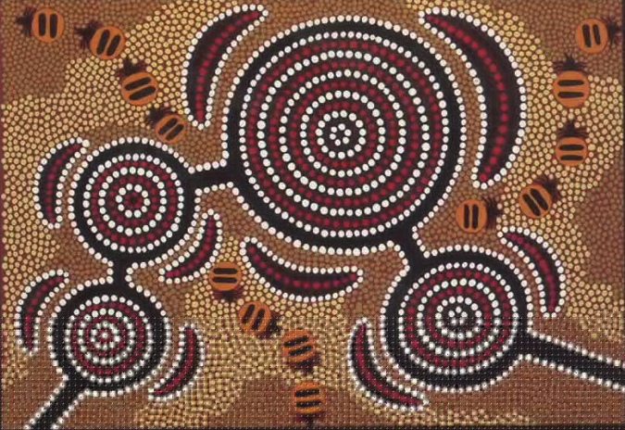
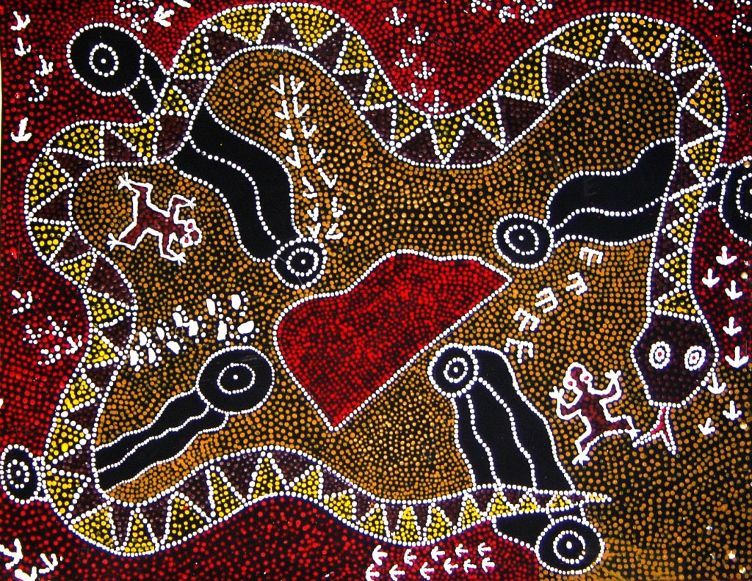

Aboriginal Art

Slide 2
Key vocabulary
Design a plan or drawing of your ideas
Pattern a repeated decorative design.
Symbols a mark, sign or word that represents an idea or object
Technique the way you create your artwork e.g. drawing, painting,

Slide 3
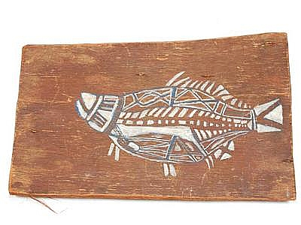
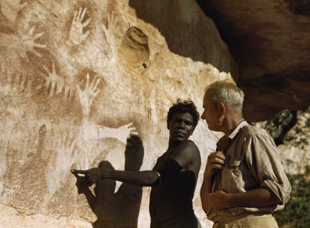
Recapping from last week
Three types of Aboriginal Art
Bark painting- X-ray fish
Negative printing - Simple figures
Geometrical

Slide 4
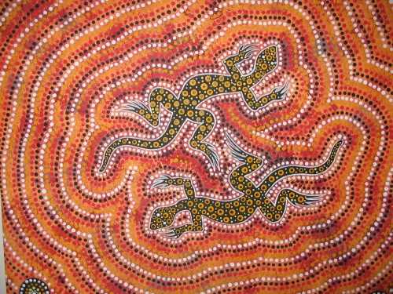
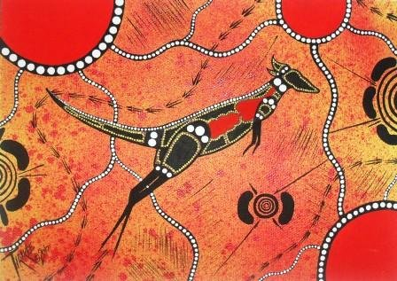
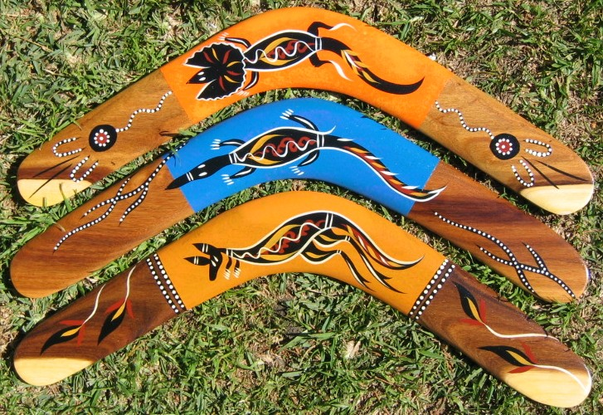
Animals in Aboriginal Art
Objects in Aboriginal Art

Slide 5
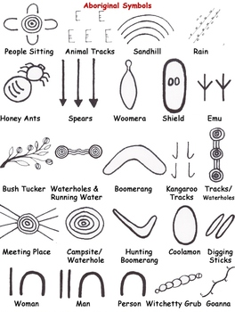
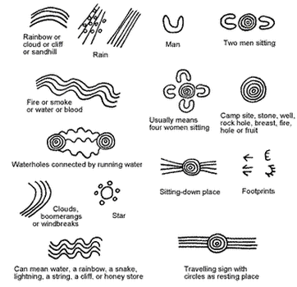

Slide 6
Now it’s your turn
Last week you pretended you were living thousands of years ago and used symbols to created your own piece of art work that you will pass down to your ancestors.
This week we would like you to think about and share your thoughts with someone at home.
What do you like about your design? Why?
Would you change anything about your design?
What have you learnt about patterns?
Using your reflections from today draw another design inspired by the symbols or patterns that we have explored over the past few weeks.

