Slide 1
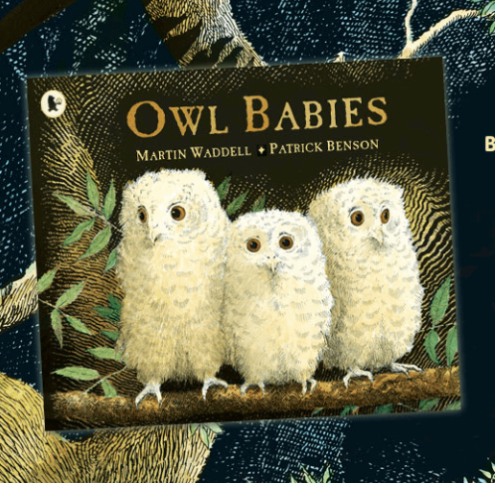
Look at the picture. This is our new story.

Slide 2
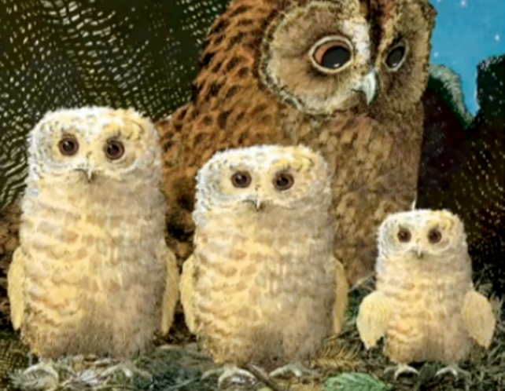
This story has three baby owls.
There are called Sarah, Bill and Percy.
They live with their
Owl Mother.
Their home is the hole in the trunk of a tree.

Slide 3
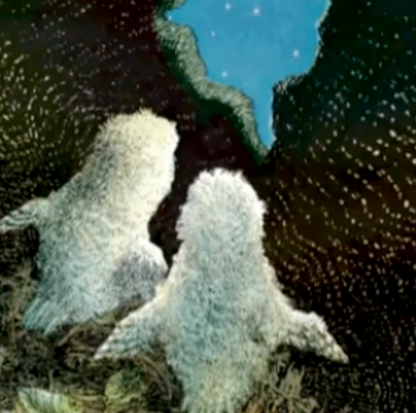
Do you think it is day or night time?
How do the babies look different to Owl Mother?
What do you think might happen in this story?

