Slide 1
Set 2 Sounds
oo
Notes:
Lets practise our set 2 sounds, today;’s sound is oo

Slide 2
Notes:
What do you think this man is going to clean up? That’s right, the poo at the zoo

Slide 3
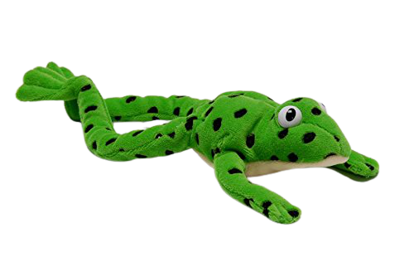
Notes:
Lets fred talk! p-oo, poo, m-oo-n, moon, s-t-oo-l, stool

Slide 4
Notes:
This is our new sound oo. It has 2 letters but 1 sound, it’s a special friend

Slide 5
Notes:
Lets practice oo. My turn first…..

Slide 6
Notes:
Now can you practice oo when the picture moves on the screen… well done

Slide 7
zoo
_
.
pool
_
.
.
spoon
_
.
.
.
Notes:
Lets read some green words! First lets use fred talk then read the word

Slide 8
Notes:
Let’s practice writing our sound - oo

Slide 9
Notes:
Let’s practice writing words with the oo sound in them mood fool stool

