Slide 1
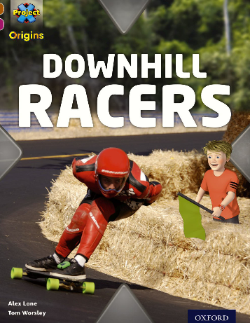
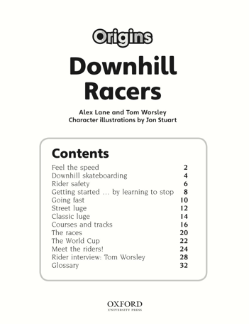
1. On which page will you learn about The World Cup?
2. What will you find on page 32?

Slide 2
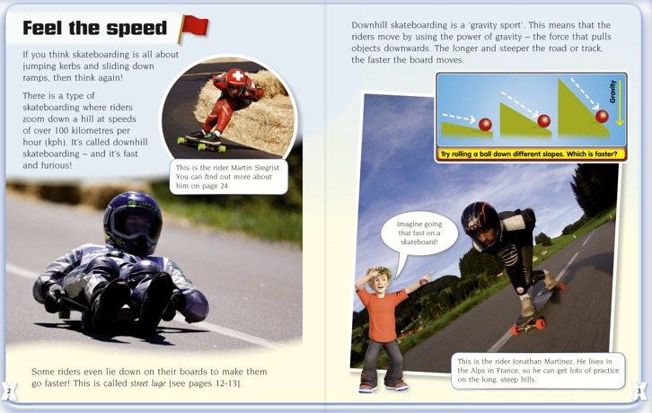
3.How fast can skateboarders race?
4.Why is downhill skateboarding called a gravity sport?

Slide 3
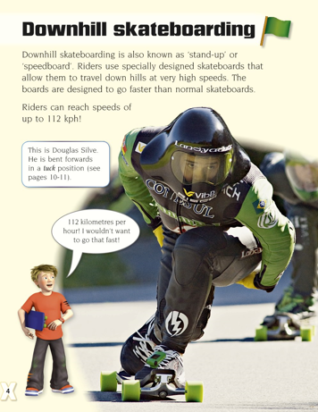

Slide 4
5. How many trucks do downhill boards have?

Slide 5
6. When did Stephen Daddow crash into the barrier?
7. Why do riders wear a leather suit?

