Slide 1
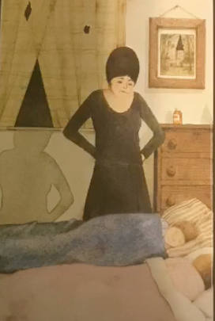
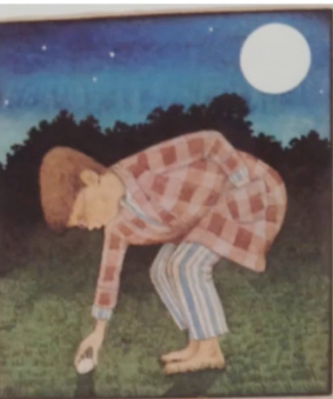
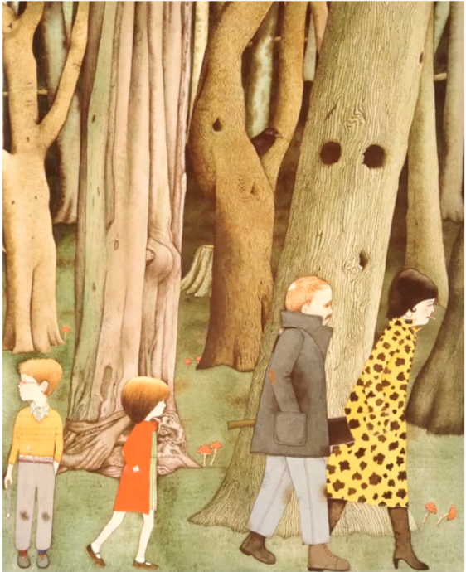
Learning intention: to write a witch story
Today we are writing the beginning of the story.
Remember to use your setting description from yesterday to help you to write your story.
Look at the next slide to see how I used my story map to help me to write the beginning.

Slide 2
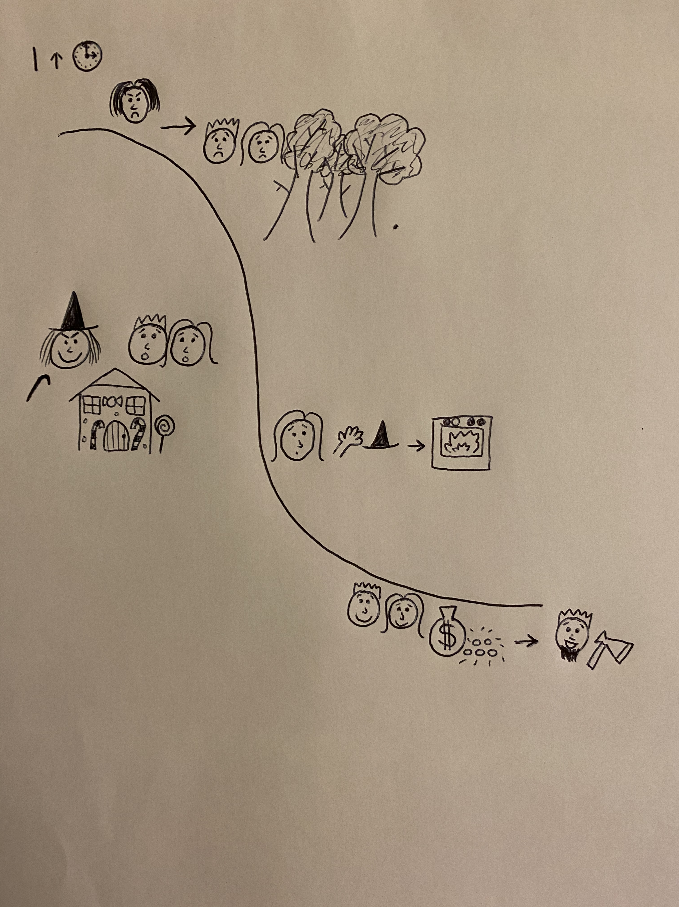
peaceful
My story beginning
freezing
suspicious
towering mountains

Slide 3
Once upon a time there lived two poor children called Hansel and Gretel. Their evil stepmother left the children on the freezing, suspicious, scary mountain. Hansel left a path of pebbles and the children got home safely. The stepmother was not happy to see them.
peaceful
freezing
suspicious
towering mountains

Slide 4
Can you write a story beginning using your story map and setting vocabulary?
Remember:
Capital letters
Full stops
Conjunctions to extend your sentences (and, or, but)

