Slide 1
Hello boys and girls. Hope you are all well today.
We are going to work on the number l

Slide 2
Number One
Lets get started are you ready?

Slide 3
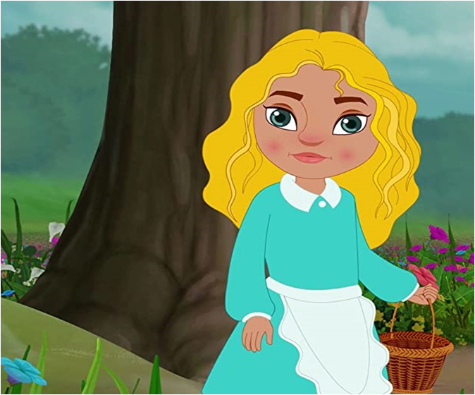
Can you look at this picture? Ask an adult to help you.

Slide 4
Can you find l Pink
flower? ​
​
Now can you
look for l Brown basket?​
Can you see the l girl in the picture?

Slide 5
You are working really well today. How many did you find ?

Slide 6
What number are we working on today?
How many fingers am I holding up?

Slide 7
Yes that’s right!
you are holding finger up just like the picture.

Slide 8
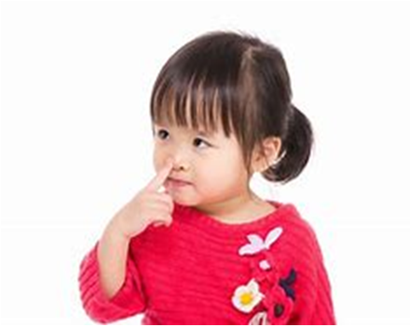
Now can you point to your nose?

Slide 9
Yes that’s right!
Well done!
You have found your nose .

Slide 10
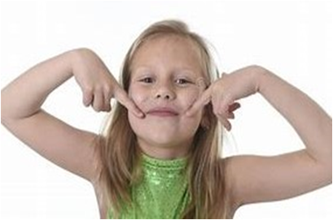
Can you show an adult in your house your mouth?

Slide 11
Yes! Keep going try one more. You are doing really well today. That’s right you have found your mouth.

Slide 12
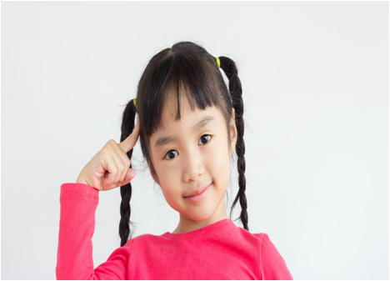
Can you point to your head ?

Slide 13
Yes that’s right! ​
Well done!​
You have pointed to your l head.

Slide 14
Thank you for joining today hope you have had fun working on the number l .

