Slide 1

Learning intention
First person and past tense

Slide 2

First person words I my me mine
The First person is you!
Look…
I went to bed. I have a sweet. It is mine. I have my coat.

Slide 3


These are not first person words he she they him her their
Everybody else!
Look…
He went to bed. She has a sweet. It is theirs. He has his coat.

Slide 4

Which one is which
Arran
You
Not you
Arran is happy.
They are very quiet.
Give me my hat.
It is my football.
He is walking.
I am ready.

Slide 5
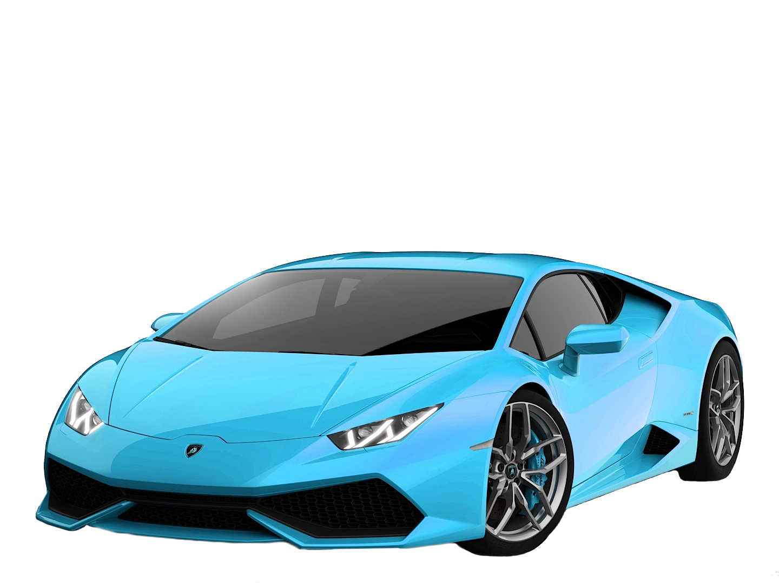
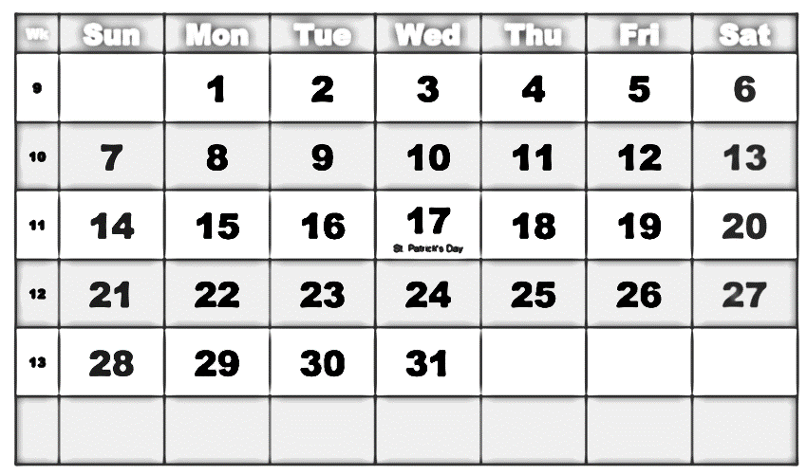
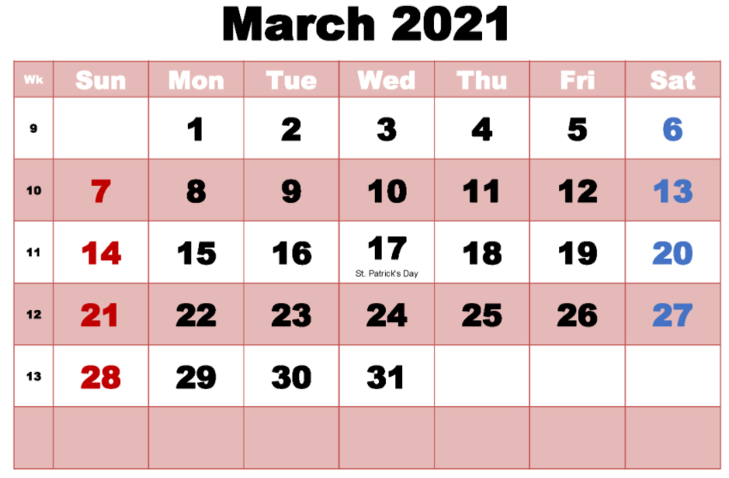
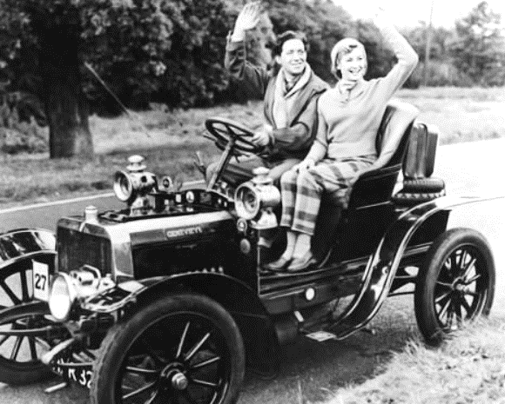
Past tense
When something has
already happened If it is happening now it is
it is in the past. the present.
January 1921

Slide 6
Past and present tense verbs (action words)
Past tense verbs
Present tense verbs
Walked
Did
Screamed
Ate
Played
slept
Walk
Do
Scream
Eat
Play
sleep

Slide 7
Task 2 Pairs. Which goes with which?
Present tense
Past tense
Look
watch
wait
see
have
catch
say
eat
Watched
Said
Looked
Ate
Saw
Waited
Had
caught

