Slide 1
23.1.21
Hansel and Gretel
Part Two
Listen to the final part of the story.
I have underlined some words for you to think about - what do they mean? Check if you are right at the end.

Slide 2
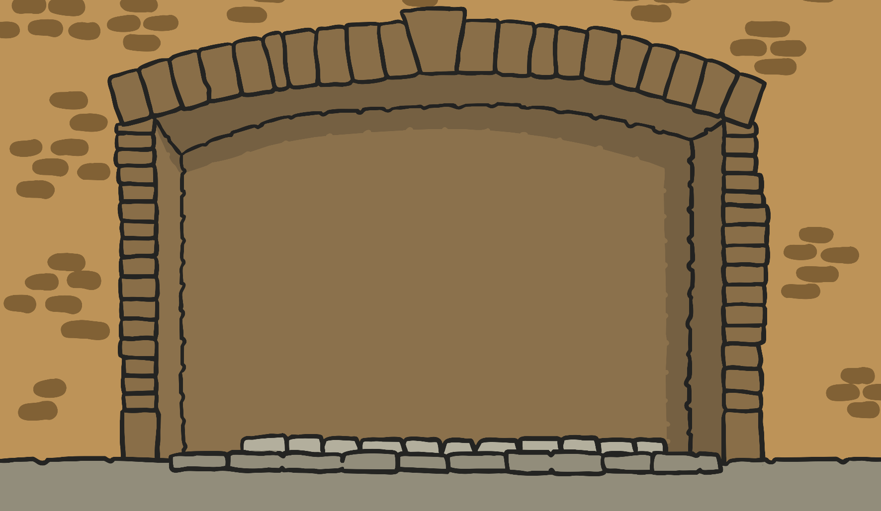
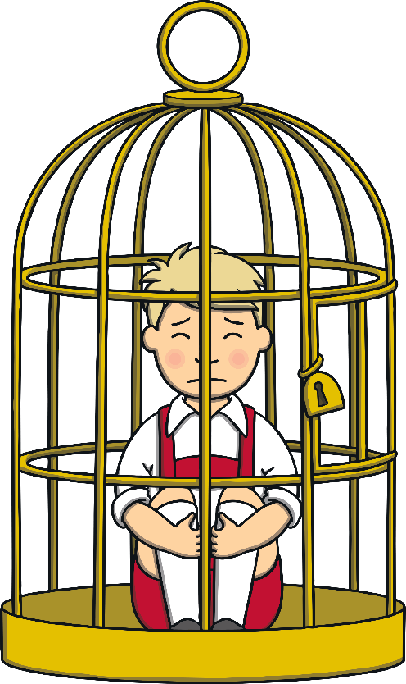
But once the children were inside, they found that the old woman was very cruel. She locked Hansel in a cage. She wanted to fatten him up and eat him!

Slide 3
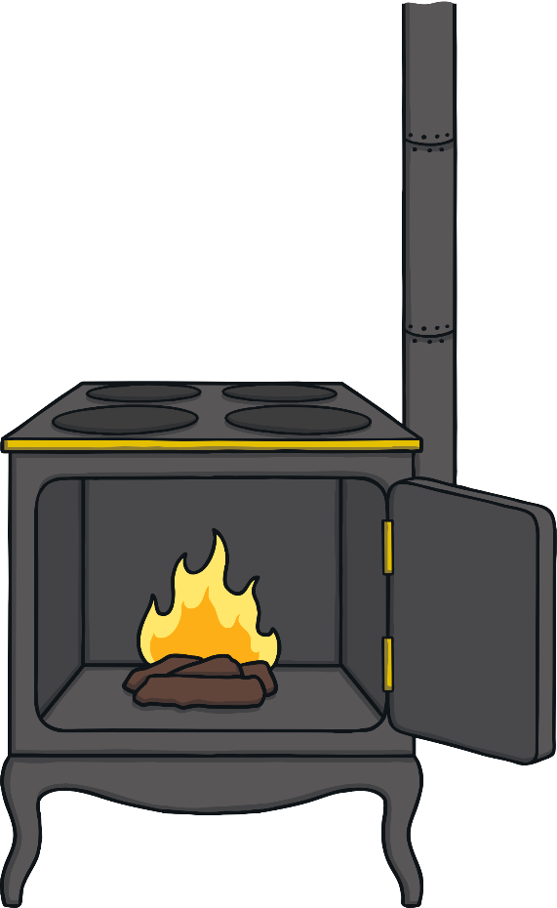
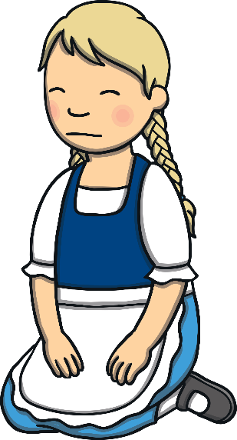
One day, the old woman showed Gretel the oven where she was going to cook Hansel.

Slide 4
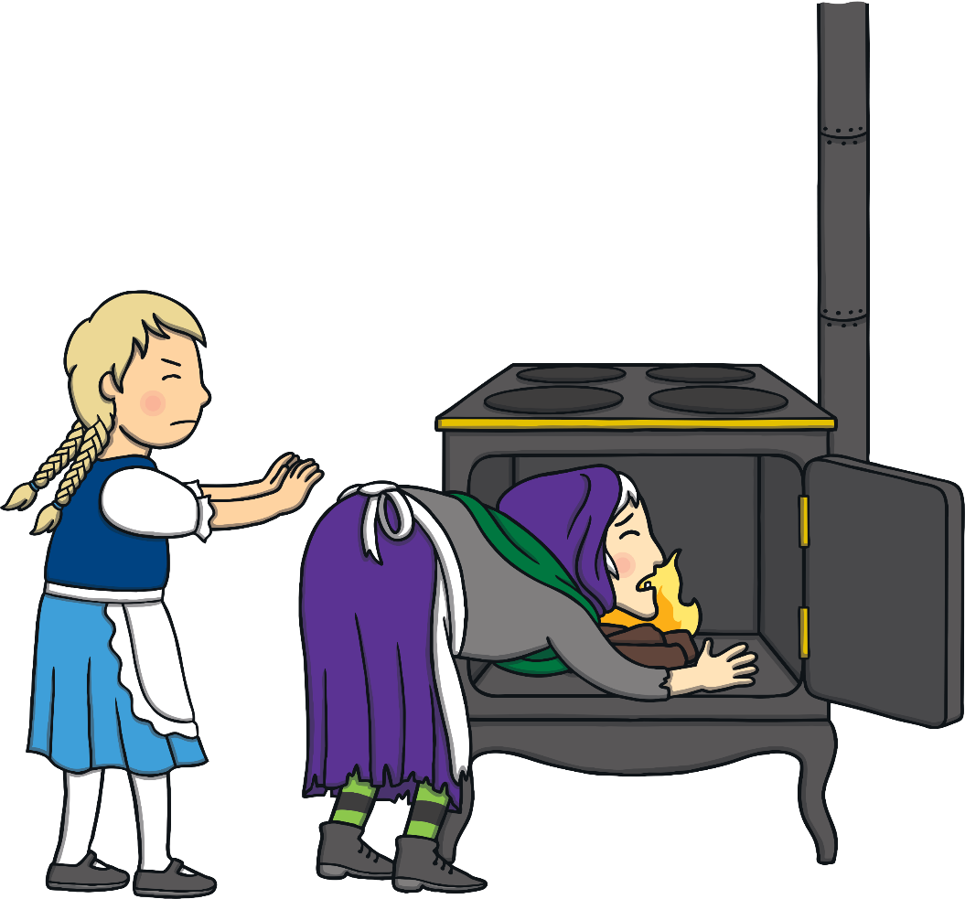
Gretel decided to trick the old woman. She told her that Hansel was too big to fit into the oven. The old woman leaned forward to take a closer look. Gretel pushed her straight into the oven!

Slide 5
Next, Gretel found the key to the cage and unlocked it so that Hansel could get out. They were overjoyed!

Slide 6
Before leaving, Hansel and Gretel had a look around the gingerbread house. They found a chest full of gold coins! They decided to bring the chest home with them.

Slide 7
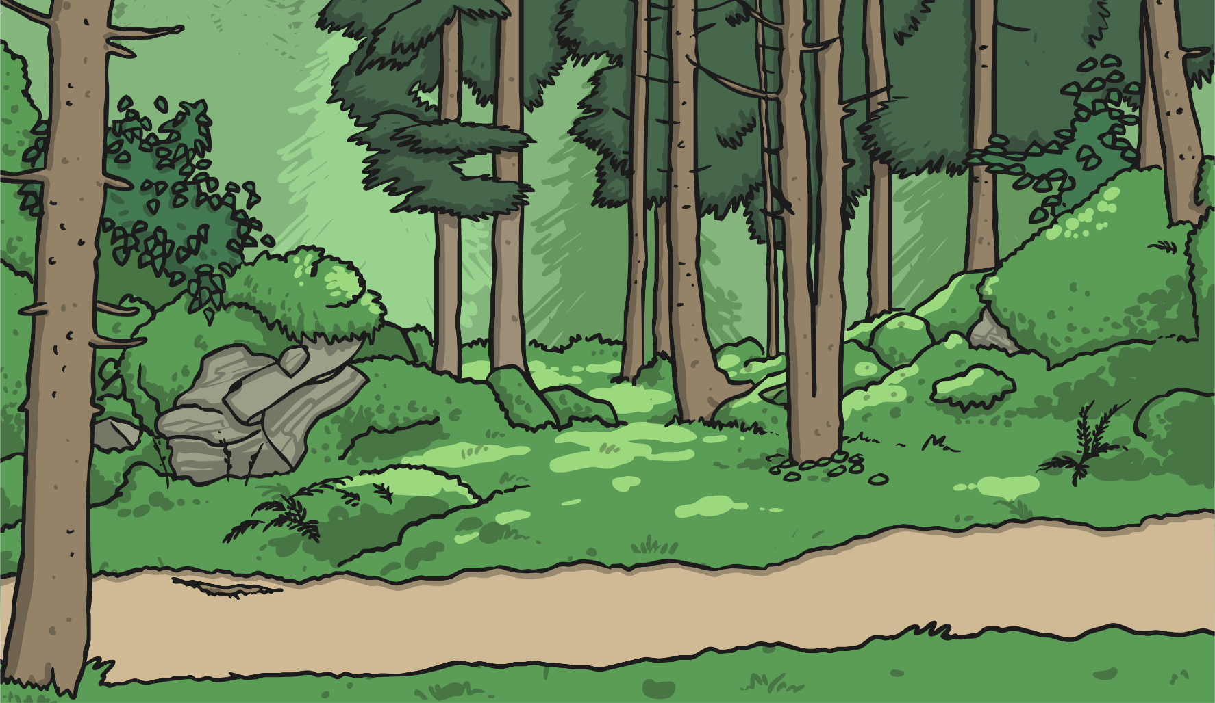
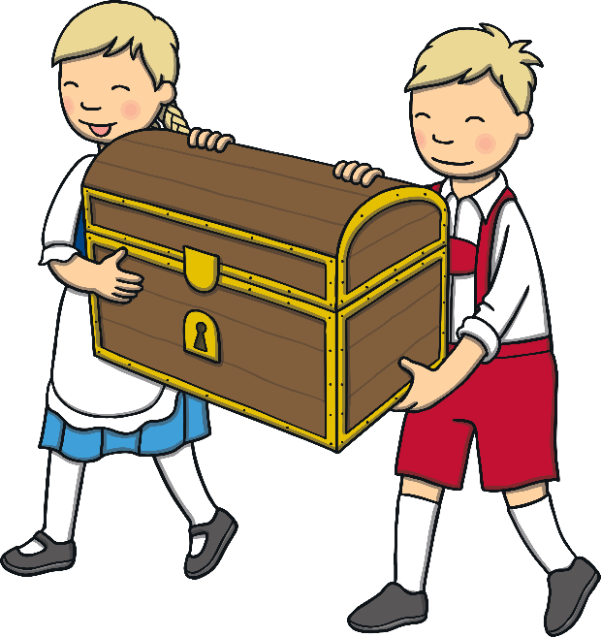
After a long walk through the forest, Hansel and Gretel eventually found a path they recognised. They ran excitedly along the path and finally saw their home in the distance.

Slide 8
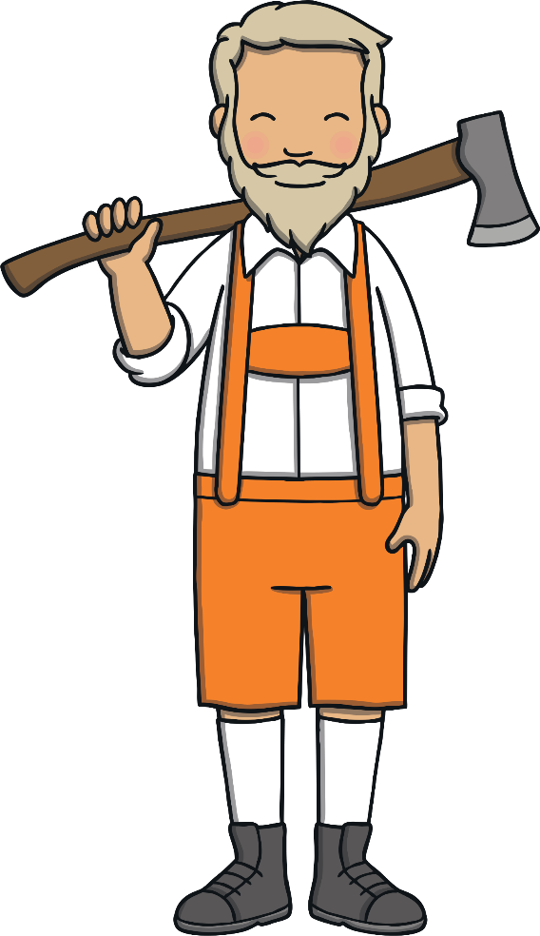
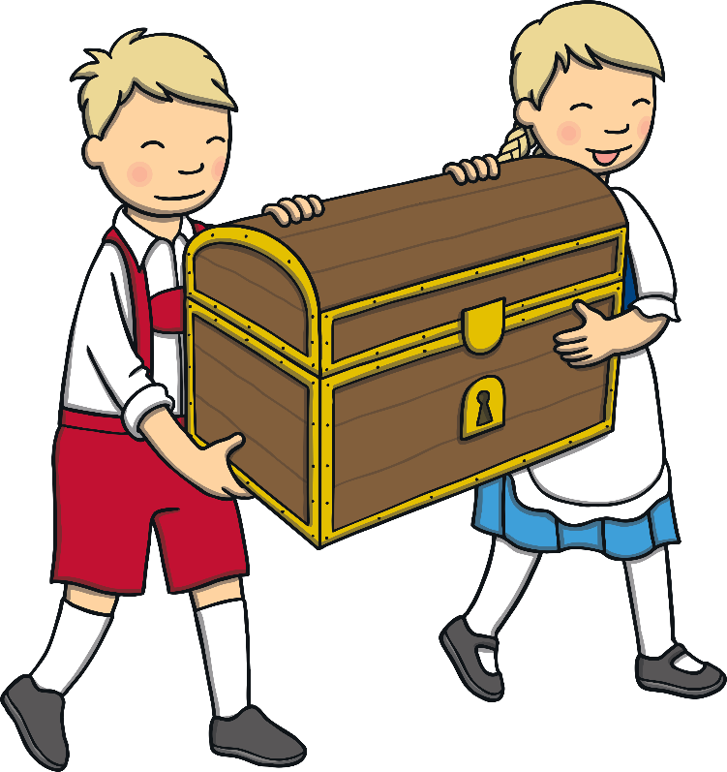
There, outside the cottage, was their father. Their stepmother had died. Now they had enough riches to last them a lifetime, and they would never be hungry again.

Slide 9
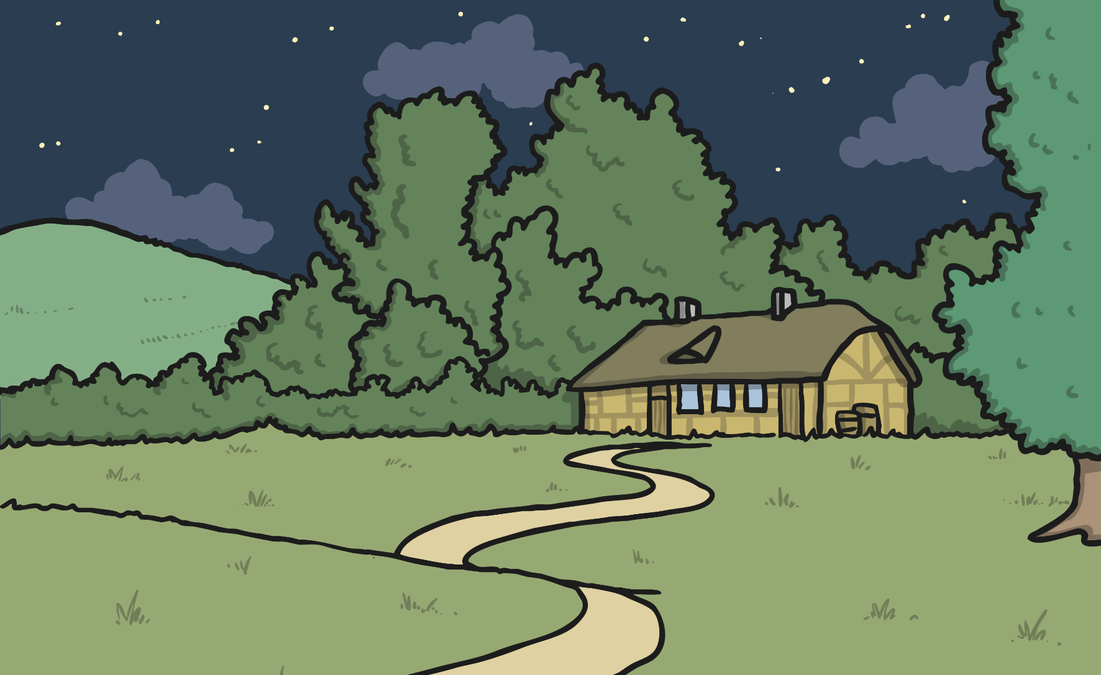
The three of them lived happily ever after.

Slide 10
Word check:
Cruel - nasty, mean, unkind or horrible.
Eventually - finally, after a long time, in the end.
Happily ever after - live happily for the rest of their lives.

Slide 11
Points to think / talk about:
Have you heard this story before?
Did you like the ending? Why?
What was your favourite part of the story? Why?

