Slide 1
Year 1 Odd and even numbers

Slide 2
All numbers are either odd or even.

Slide 3
Even numbers
Even numbers are numbers that can be shared equally between 2. They can also be halved.
When looking at a number line, the first even number is number 2. We then miss a number and the next even number is 4 and so on. I have highlighted the even numbers to show you. What do you notice about the even numbers?
1 | 2 | 3 | 4 | 5 | 6 | 7 | 8 | 9 | 10
11 | 12 | 13 | 14 | 15 | 16 | 17 | 18 | 19 | 20
21 | 22 | 23 | 24 | 25 | 26 | 27 | 28 | 29 | 30

Slide 4
Even numbers
Even numbers can be small or they can be very big.
If a number ends in a 0, 2, 4, 6 or 8, it is an even number.
14
36
100
52
78

Slide 5
Even numbers
Can you point to the numbers that are even?
20
29
12
37
30
55
44

Slide 6
That’s right!
20
29
12
37
30
55
44

Slide 7
Odd numbers
Odd numbers are numbers that can’t be halved and they can’t be shared equally between two.
When looking at a number line, the first odd number is number 1. We then miss a number and the next odd number is 3 and so on. I have highlighted the odd numbers to show you. What do you notice about the odd numbers?
1 | 2 | 3 | 4 | 5 | 6 | 7 | 8 | 9 | 10
11 | 12 | 13 | 14 | 15 | 16 | 17 | 18 | 19 | 20
21 | 22 | 23 | 24 | 25 | 26 | 27 | 28 | 29 | 30

Slide 8
Odd numbers
Like even numbers, odd numbers can be small or they can be very big.
If a number ends in a 1, 3, 5, 7 or 9, it is an odd number.
17
43
99
101
55

Slide 9
Odd numbers
Can you point to the numbers that are odd?
20
29
12
37
30
55
44

Slide 10
That’s right!
20
29
12
37
30
55
44

Slide 11
Here is a 100 square to show you the pattern of odd and even numbers. The green numbers are odd and the pink numbers are even.
1 | 2 | 3 | 4 | 5 | 6 | 7 | 8 | 9 | 10
11 | 12 | 13 | 14 | 14 | 16 | 17 | 18 | 19 | 20
21 | 22 | 23 | 24 | 25 | 26 | 27 | 28 | 29 | 30
31 | 32 | 33 | 34 | 35 | 36 | 37 | 38 | 39 | 40
41 | 42 | 43 | 44 | 45 | 46 | 47 | 48 | 49 | 50
51 | 52 | 53 | 54 | 55 | 56 | 57 | 58 | 59 | 60
61 | 62 | 63 | 64 | 65 | 66 | 67 | 68 | 69 | 70
71 | 72 | 73 | 74 | 75 | 76 | 77 | 78 | 79 | 80
81 | 82 | 83 | 84 | 85 | 86 | 87 | 88 | 89 | 90
91 | 92 | 93 | 94 | 95 | 96 | 97 | 98 | 99 | 100

Slide 12
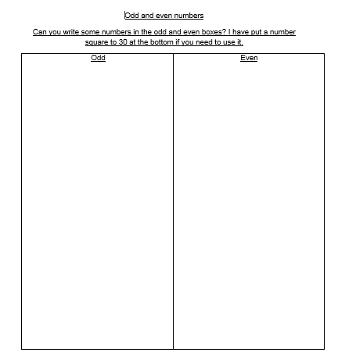
Now have a go at the worksheet. Can you write as many odd and even numbers in the columns as you can?

Slide 13
Slide 1 – Hello year 1 today we are going to be recapping odd and even numbers.
Slide 2 – All numbers are either odd or even.
Slide 3 – Lets start with even numbers. Even numbers are numbers that can be shared equally between 2. They can also be halved. When looking at a number line, the first even number is number 2. We then miss a number and the next even number is 4 and so on. I have highlighted the even numbers to show you. What do you notice about the even numbers?
Slide 4 - Even numbers can be small or they can be very big. If a number ends in a 0, 2, 4, 6 or 8, it is an even number. Look here are some even numbers.
Slide 5- Can you point to the numbers that are even?
Slide 6 – That’s right! 12, 20, 30 and 44 are all even.
Slide 7 - Now lets look at odd numbers. Odd numbers are numbers that can’t be halved and they can’t be shared equally between two. When looking at a number line, the first odd number is number 1. We then miss a number and the next odd number is 3 and so on. I have highlighted the odd numbers to show you. What do you notice about the odd numbers?
Slide 8 - Like even numbers, odd numbers can be small or they can be very big.
If a number ends in a 1, 3, 5, 7 or 9, it is an odd number.
Slide 9 - Can you point to the numbers that are odd?
Slide 10 – That’s right! 29, 37 and 55 are all odd.
Slide 11 - Here is a 100 square to show you the pattern of odd and even numbers. The green numbers are odd and the pink numbers are even.
Slide 12 - Now have a go at the worksheet. Can you write as many odd and even numbers in the columns as you can?

