Slide 1
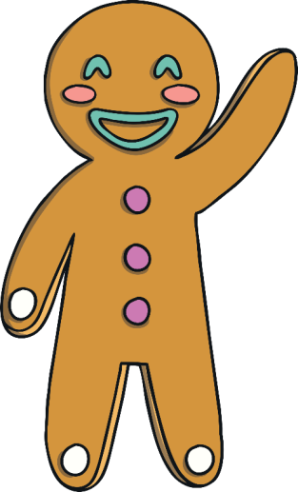
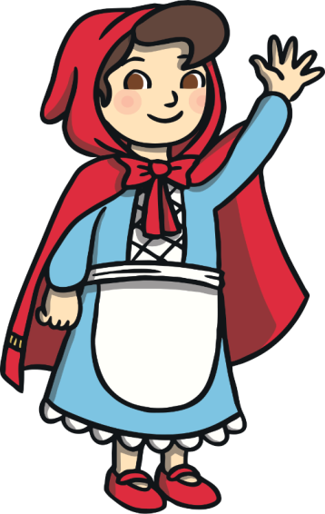
World Book Day Quiz

Slide 2
I am going to give you some clues, can you guess which traditional tale it is?

Slide 3
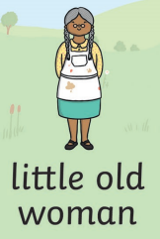
Which story is it?

Slide 4
That’s right! It’s the Gingerbread Man!

Slide 5
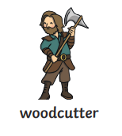
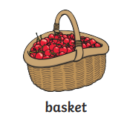
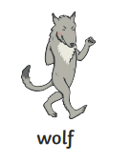
Which story is it?

Slide 6
That’s right! It’s Little Red Riding Hood!

Slide 7
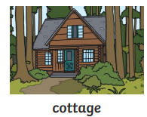
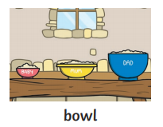
Which story is it?

Slide 8
That’s right! It’s Goldilocks and the Three Bears!

