Slide 1
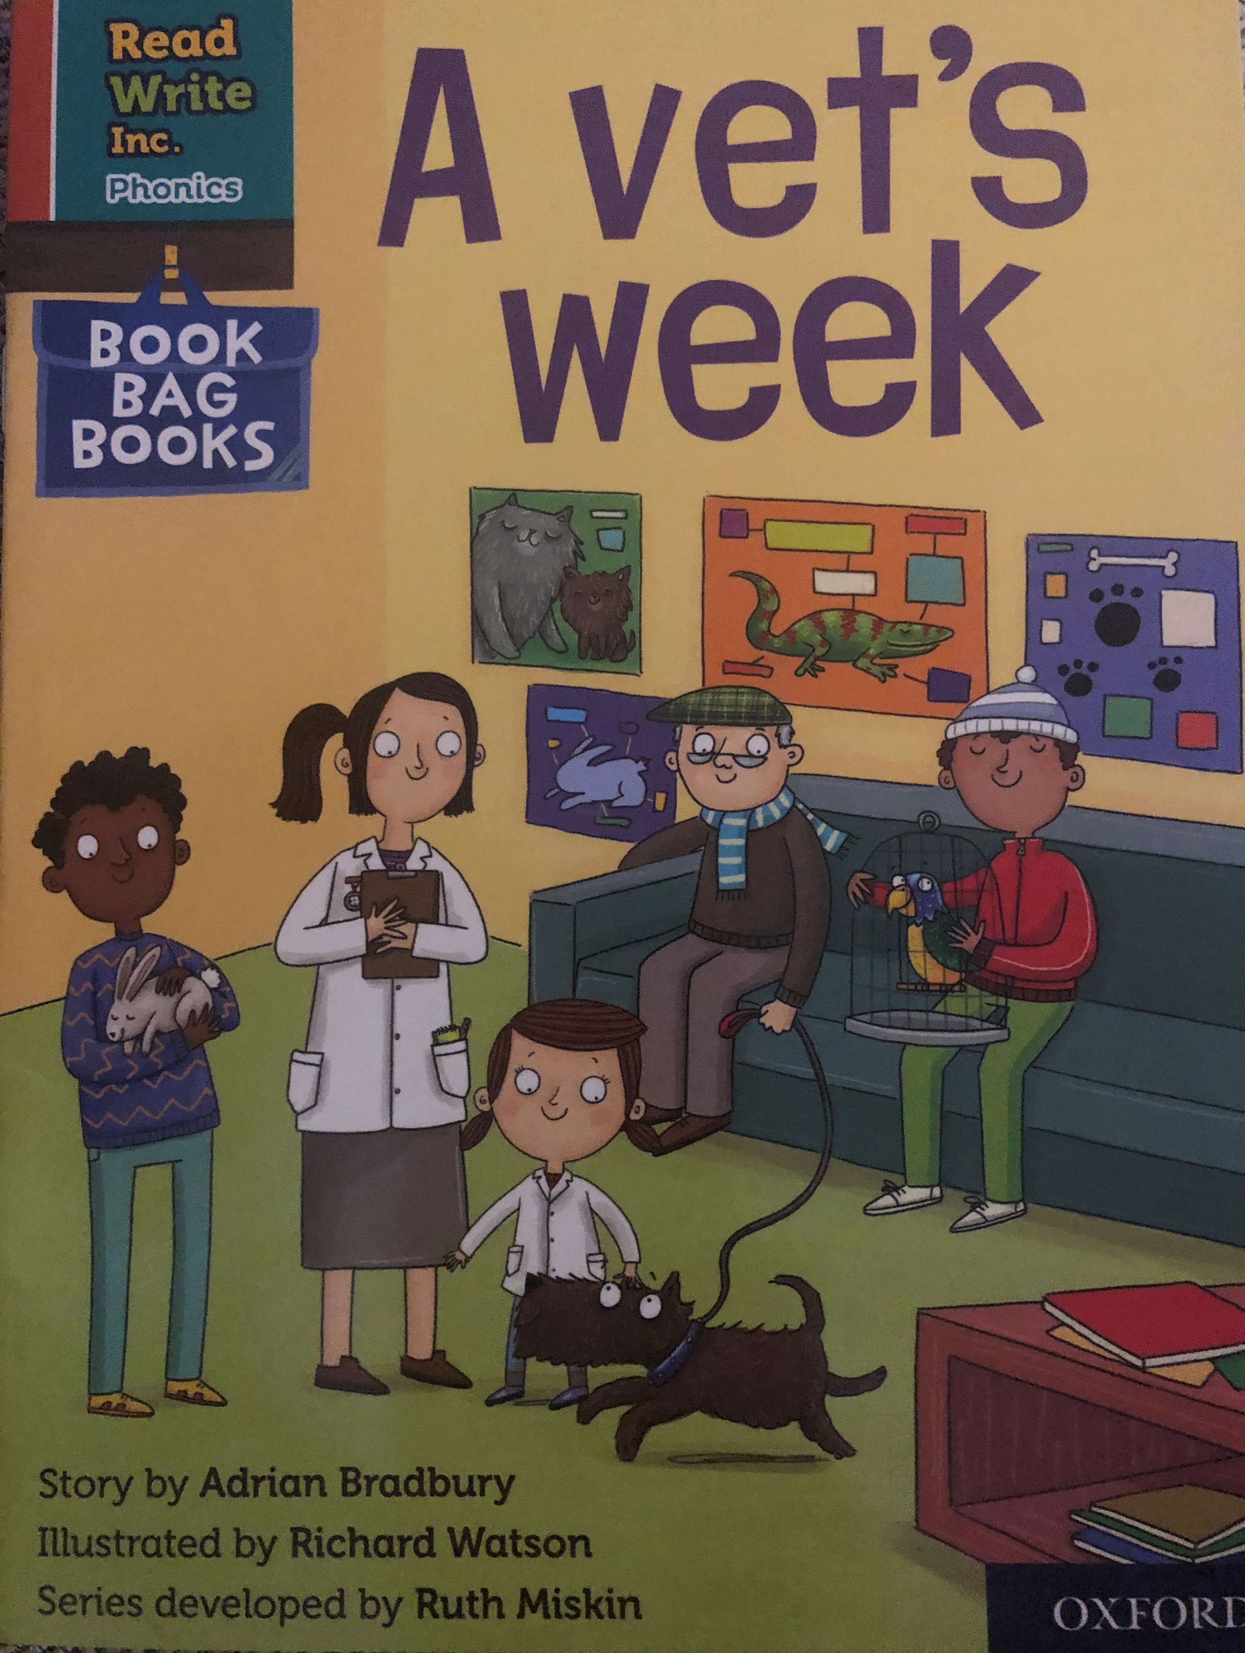

You are going to read the story ‘A Vet’s week’.
In this story you will hear words with the sound:
ee
The ee sound is in the words:
see
peel
keep

Slide 2
Can you write two words with the ee sound in?
Look at the picture. What can you see? What will happen in the story?

Slide 3
Let’s read these words together. These are words you will come across in the story.
Green Words
still
stray
needs
deep
patch
stomp
Red Words
do he
you put
want the
to your
be
me
I

Slide 4
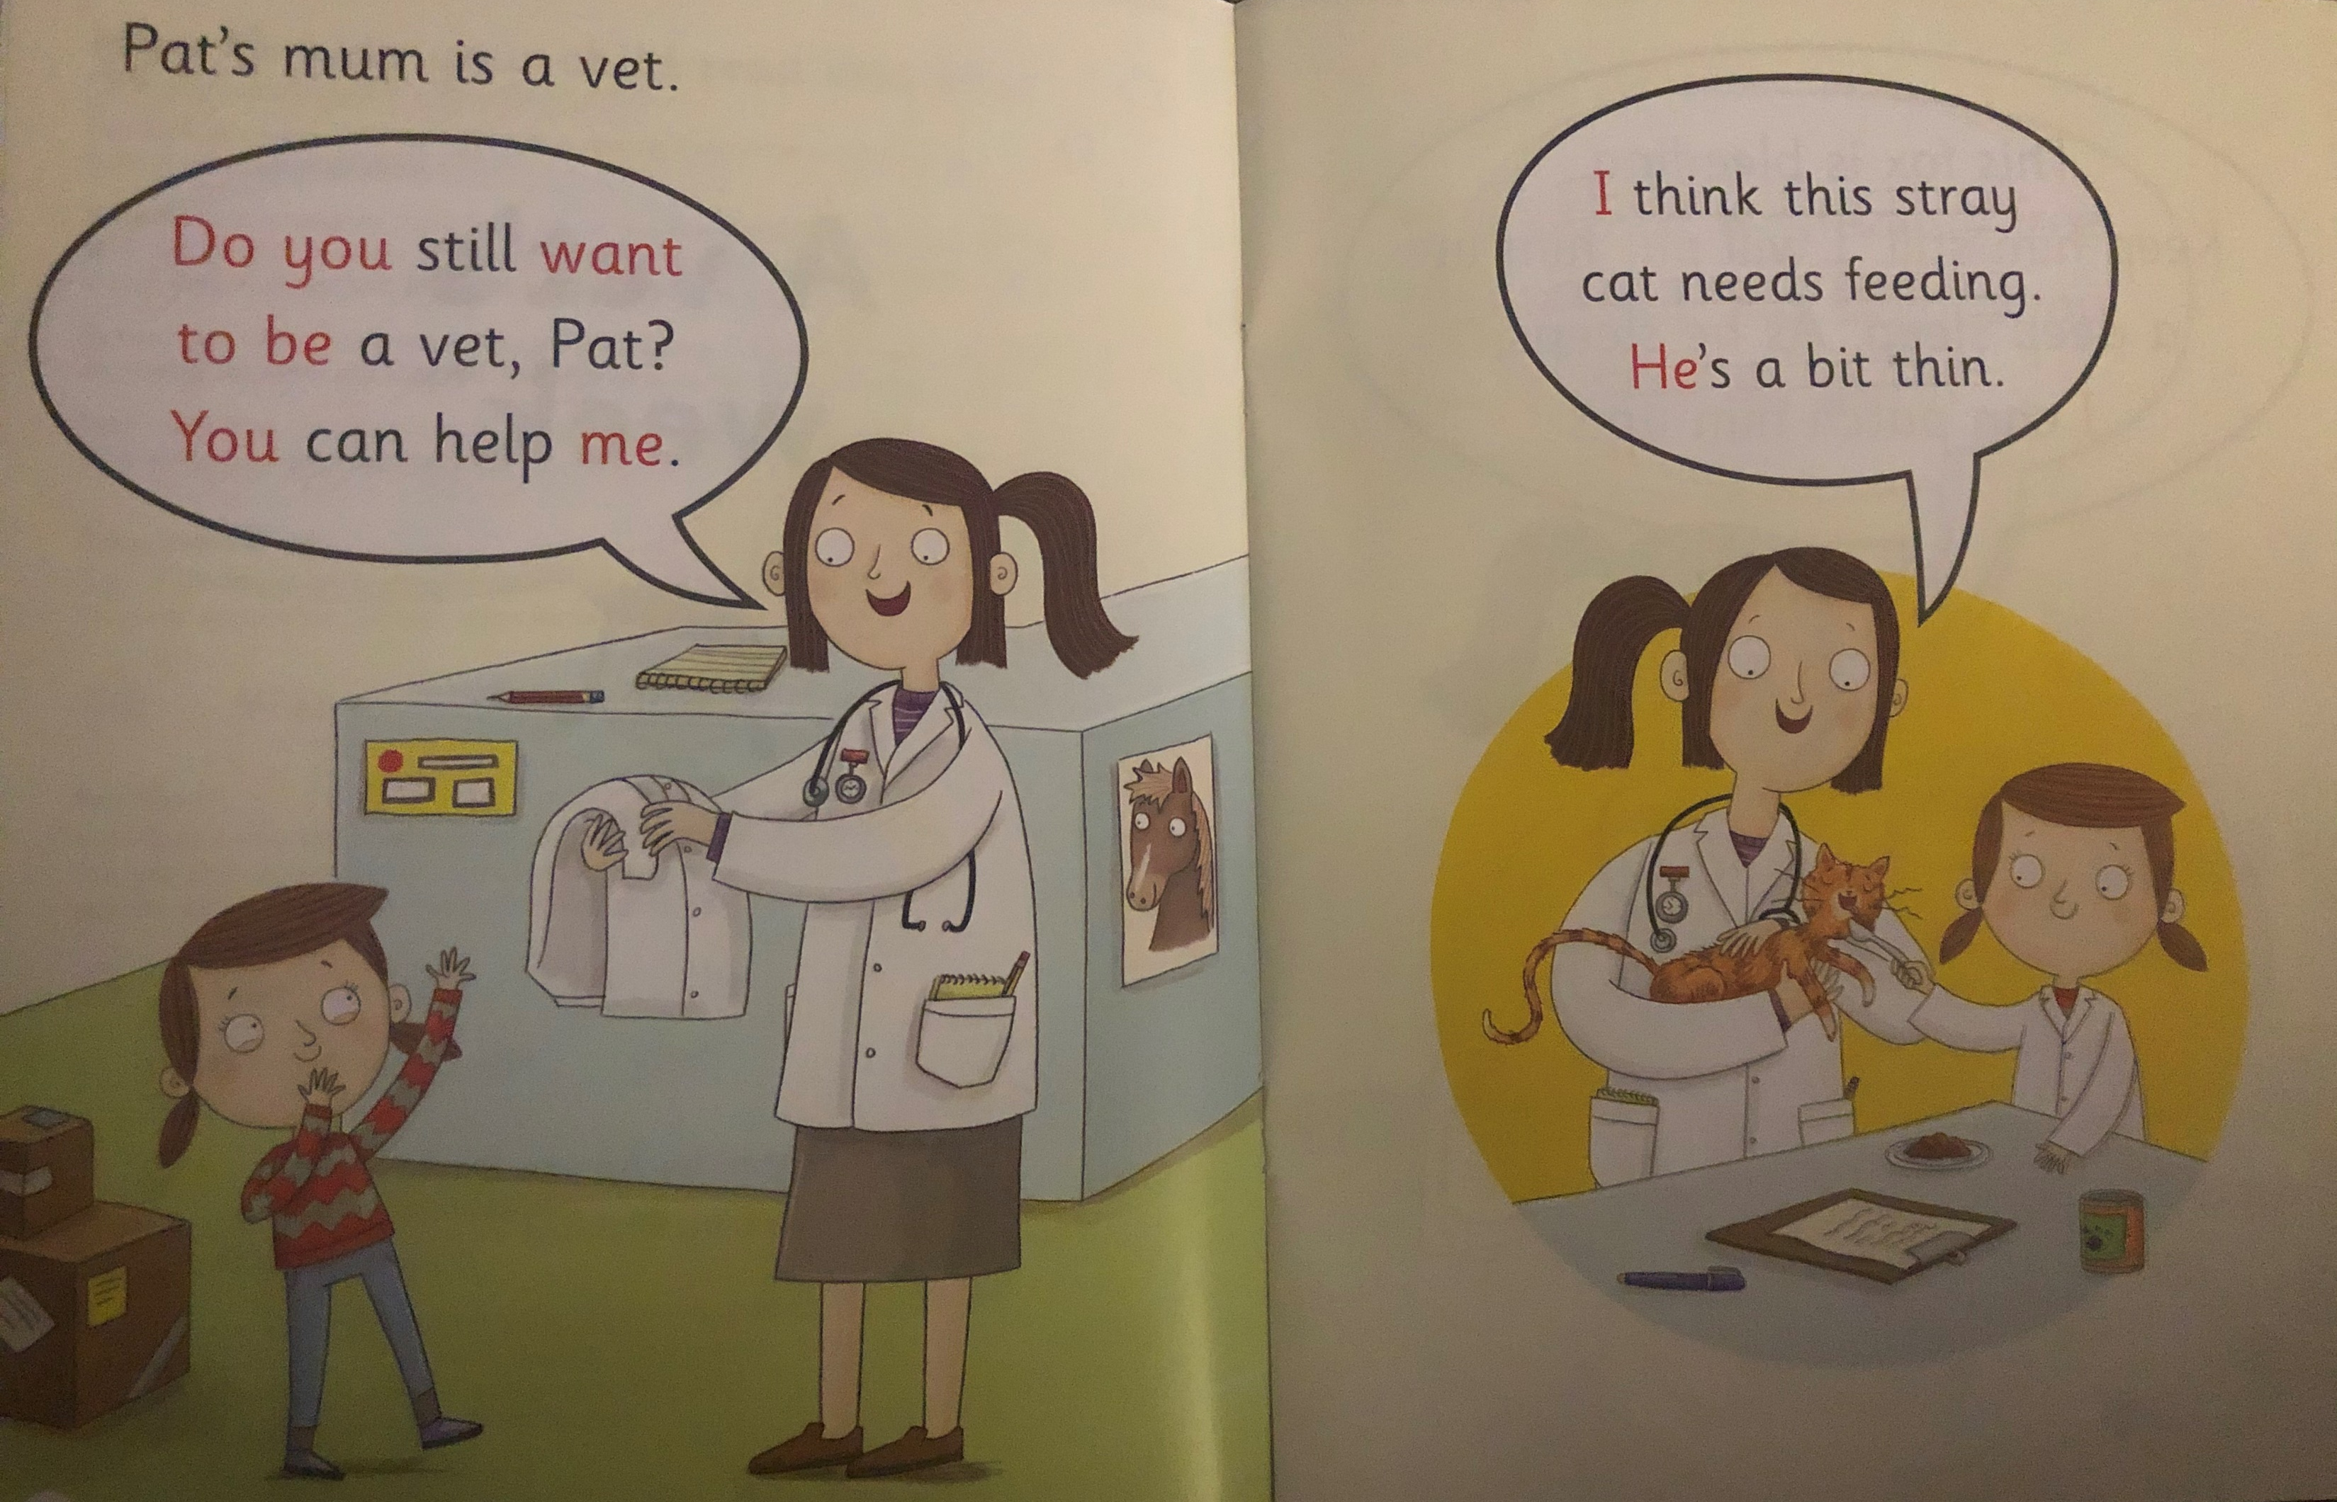
Write down all of the words you can see with the ee sound we are learning today.
What job does Pat’s mum do?
What is wrong with the stray cat?

Slide 5
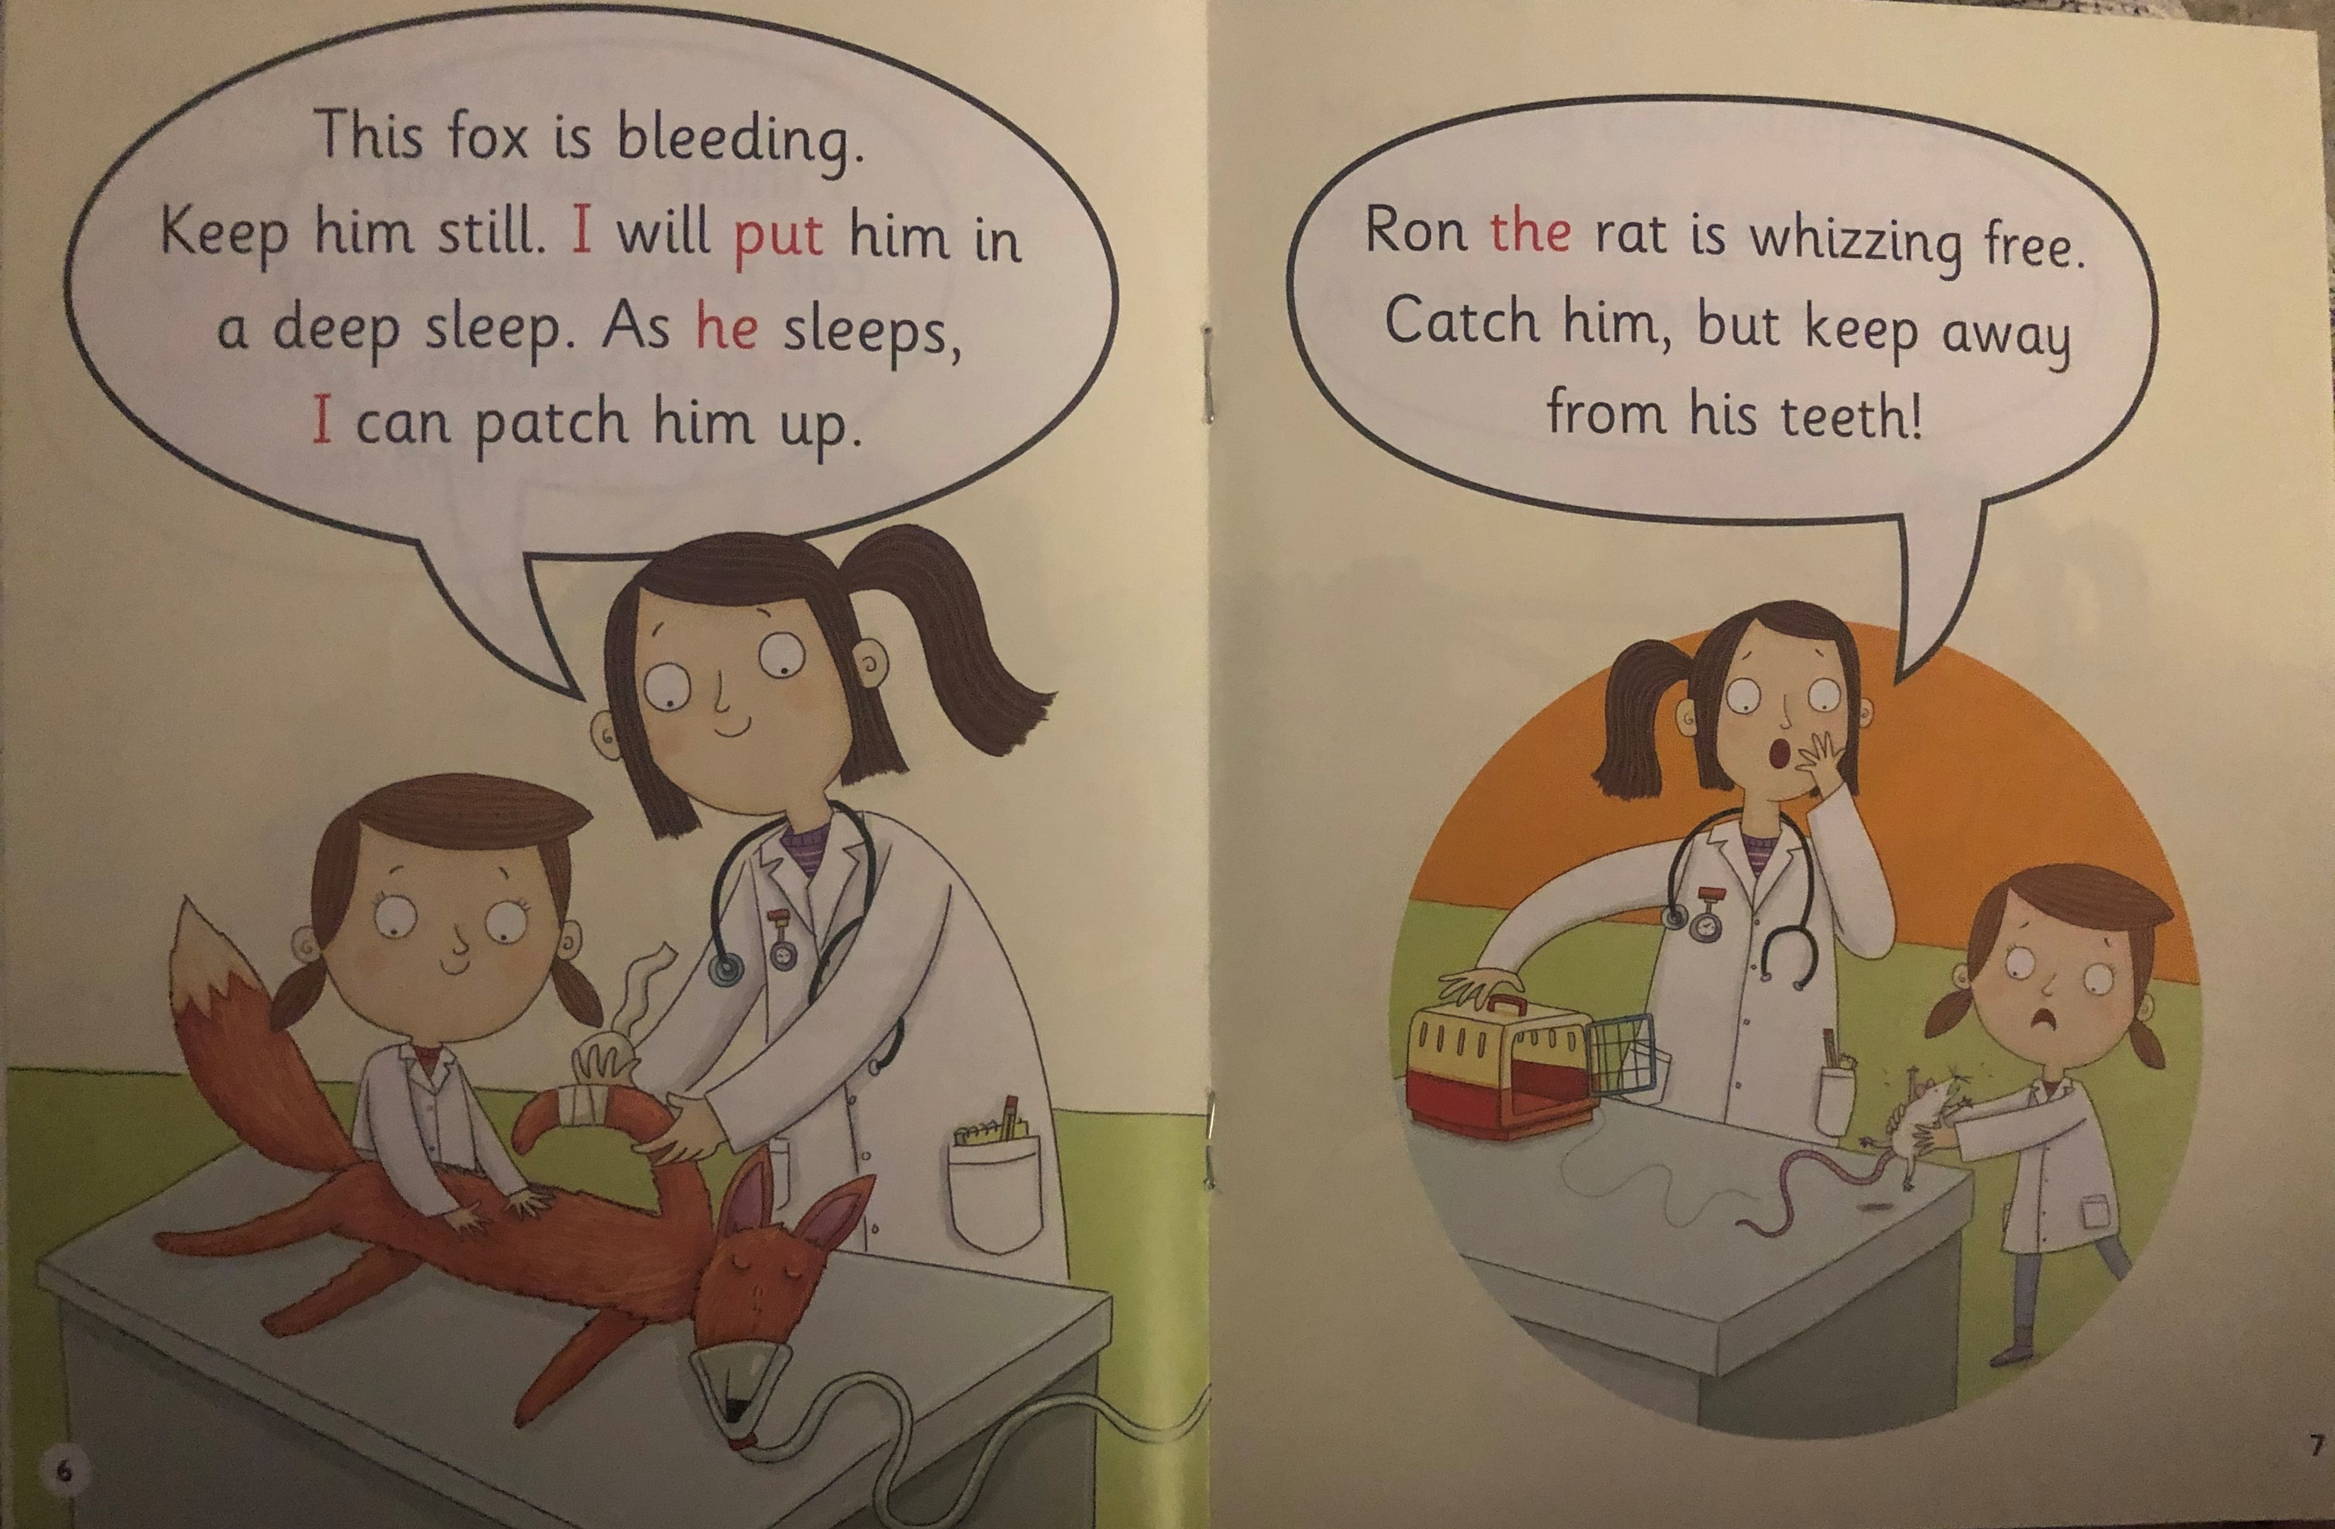
What has happened to the fox?
What type of animal is Ron?

Slide 6
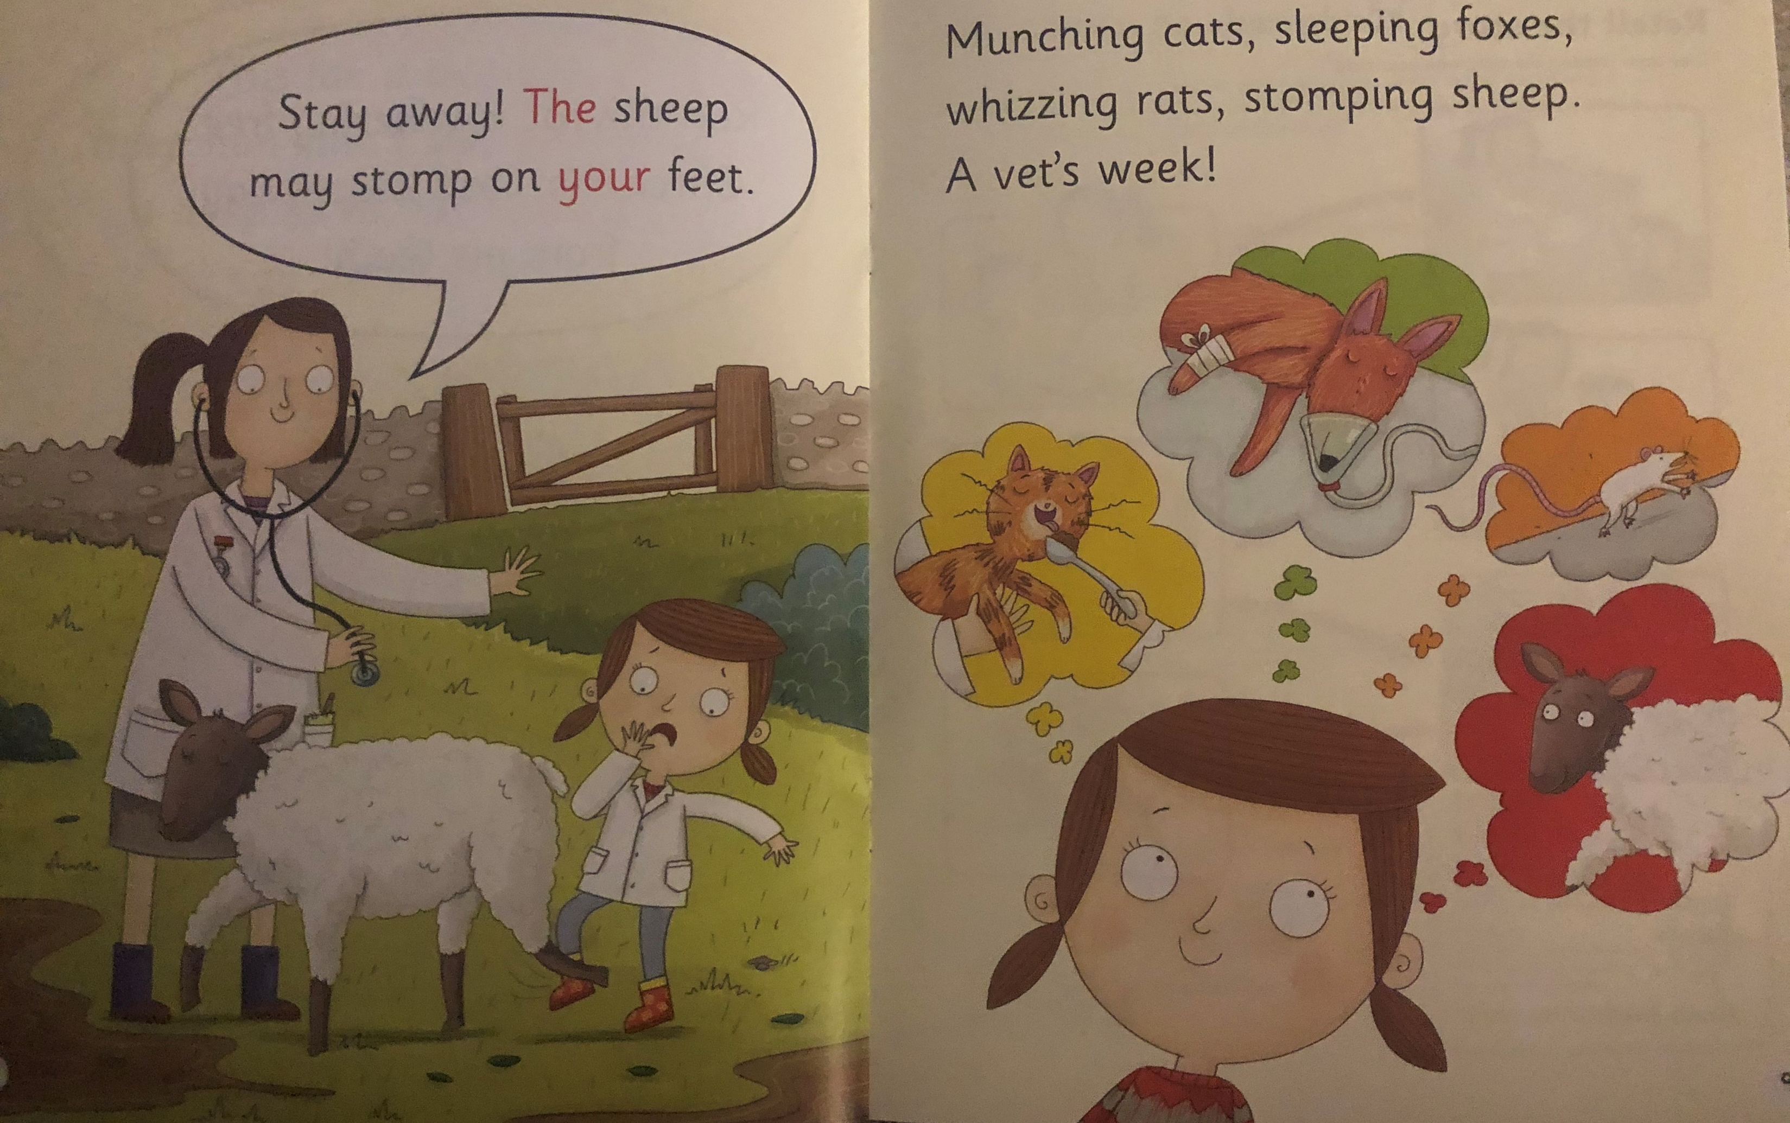
What might the sheep do if you get close to it?
What happens in a vet’s week?

Slide 7
Recap questions
What does Pat want to be?
Why does the vet put the fox into a deep sleep?
What does Pat have to keep away from when she catches the rat?
Would you like to be a vet? Why or why not?

