Slide 1
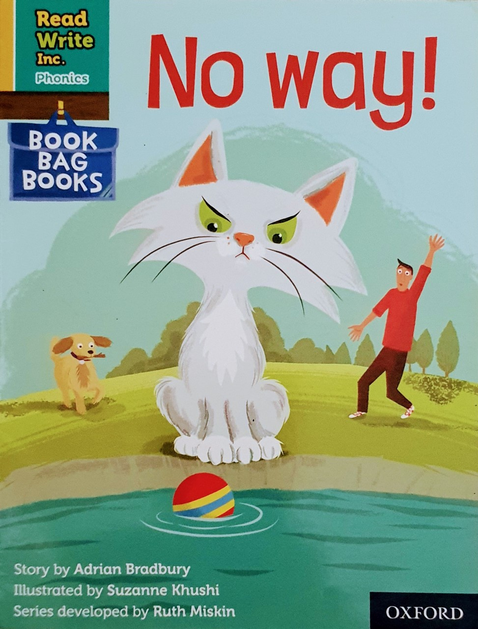

You are going to read the story ‘No Way’
In this story you will hear words with the sound:
ay
The ay sound is in the words:
stay
play
Can you write two words with the ay sound in?
Look at the picture. What can you see? What will happen in the story?

Slide 2
Let’s read these words together. These are words you will come across in the story.
Green Words
strict
fetch
chucks
brings
dripping
chilly
snuggles
Red Words
are
want

Slide 3
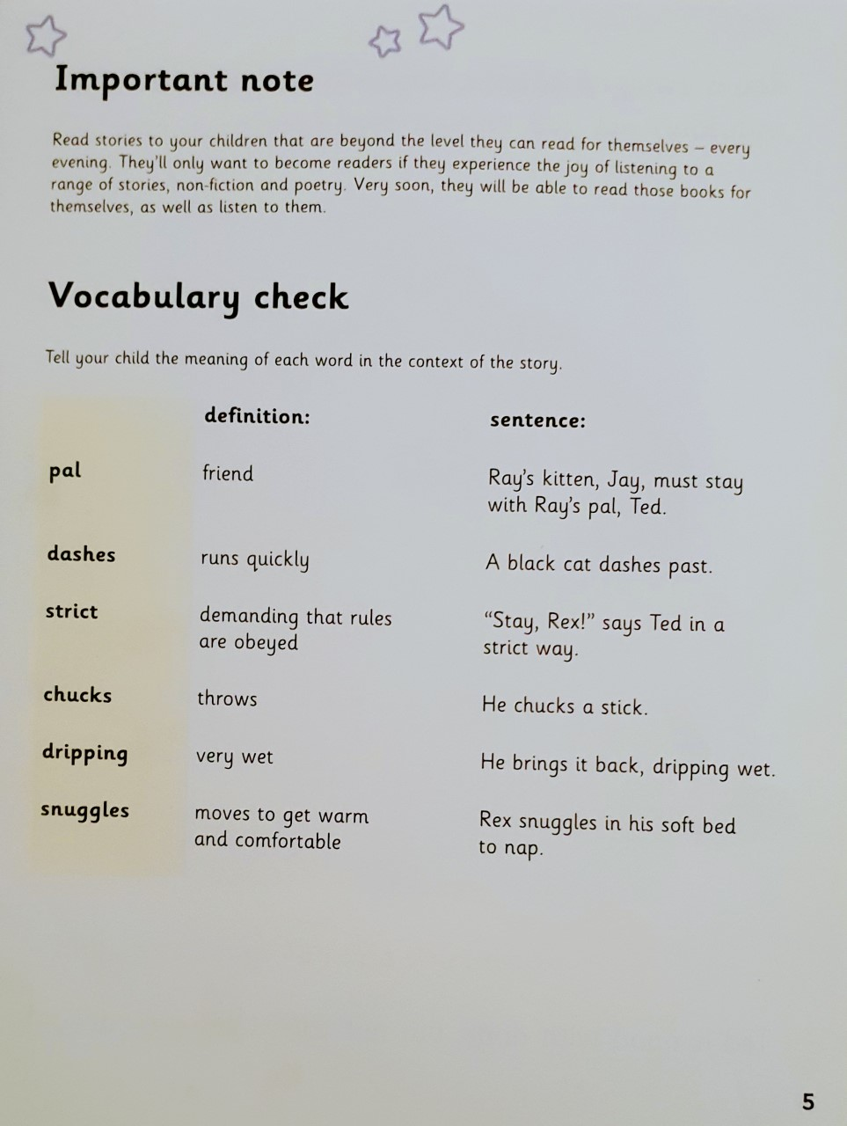

Slide 4
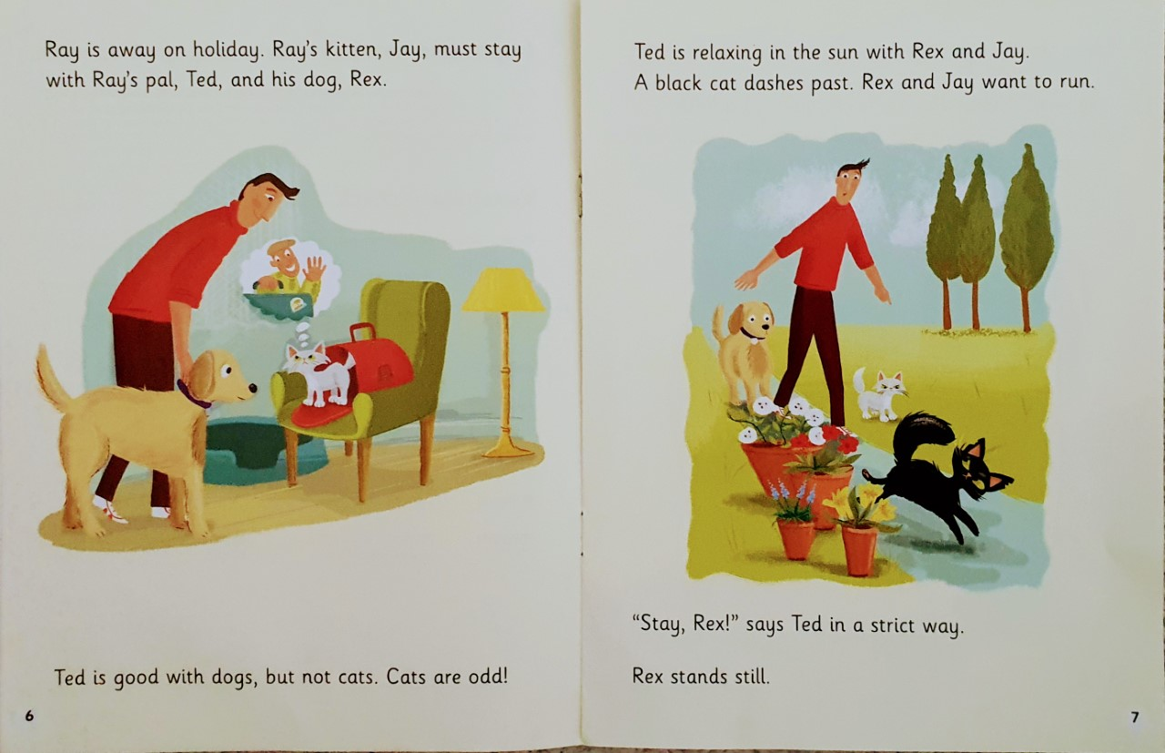
Who does Ray’s kitten have to stay with?
What does Ted think about cats?
In what way does Ted tell Rex to stay?

Slide 5
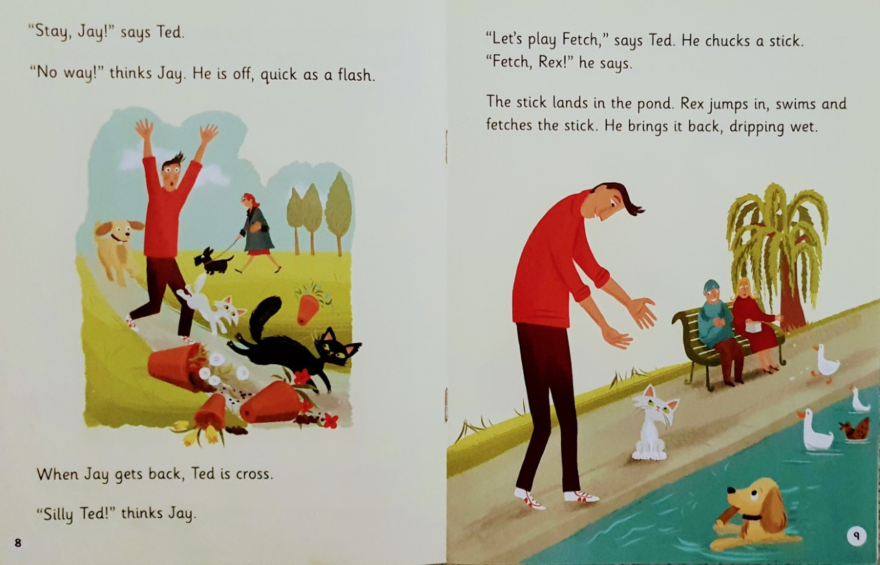
How does Ted feel when Jay gets back?
Where does the stick land?
Describe the stick when Rex brings it back.

Slide 6
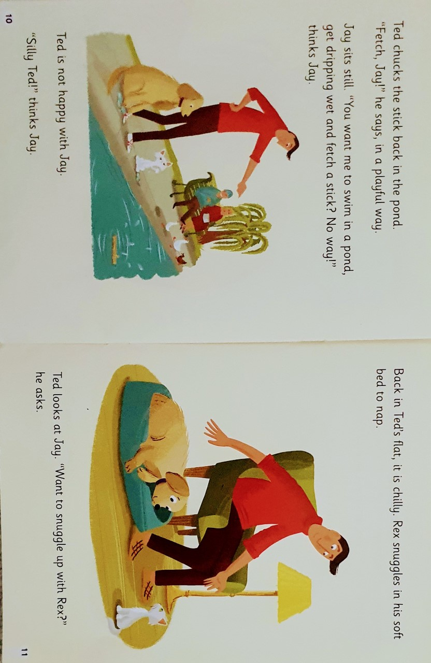
In what way does Ted ask Jay to fetch the stick?
Why does Rex snuggle in his soft bed?

Slide 7
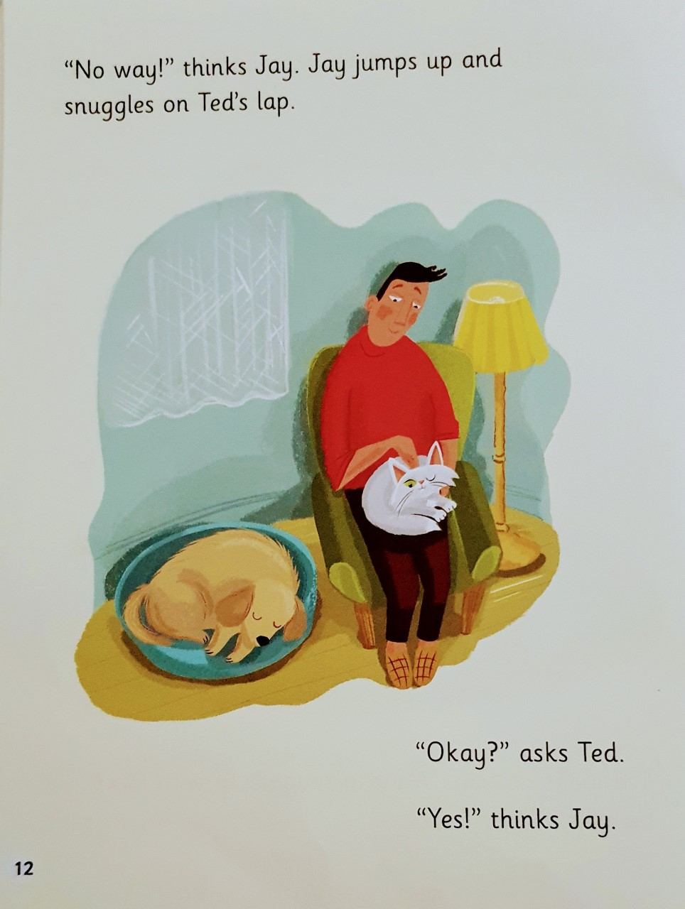
Where does Jay decide to snuggle?
Is Ted happy with what Jay does?

Slide 8
