Slide 1

Learning intention
Comparing Poems

Slide 2
Which of these poetic devices do you know?
Rhyme
Alliteration
Imagery
Rhythm
Onomatopoeia

Slide 3
Rhyme – The words at the end of a line end with the same sound.
Mary had a little lamb
Its fleece was white as snow.
Everywhere that Mary went
The lamb was sure to go.
Rhyming couplets

Slide 4
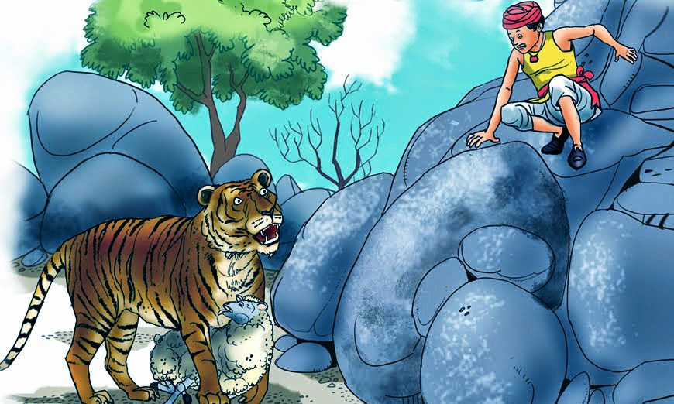
Alliteration – the consonant sound at the start of different words is the same.
The terrifying tiger turned and faced towards trembling Tom.

Slide 5
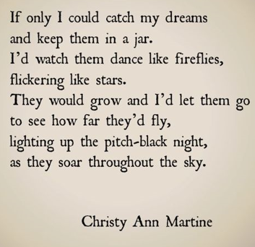
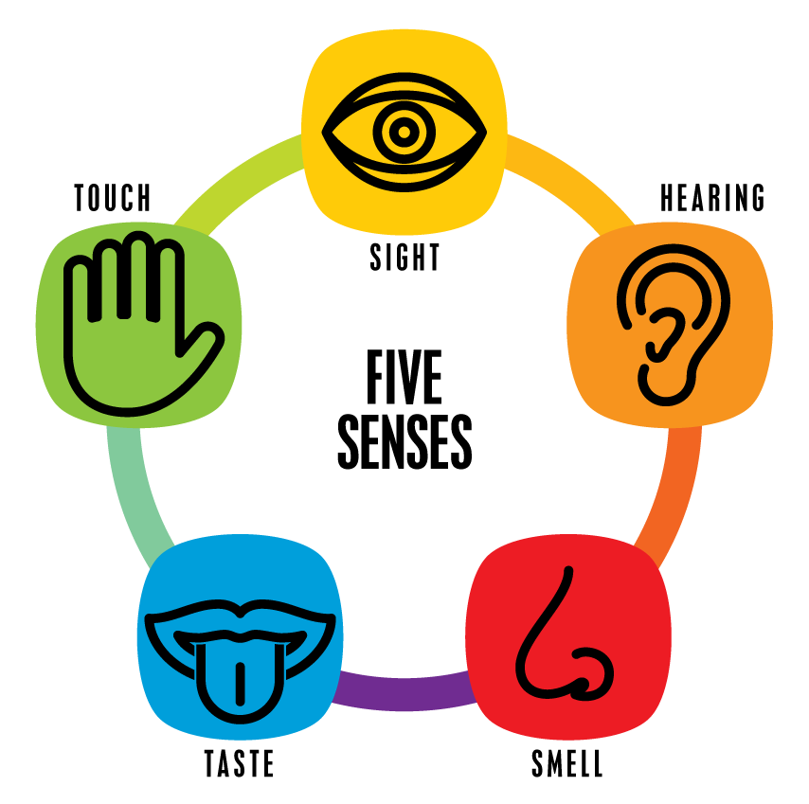
Imagery – words used to create an image in the readers mind using your senses.

Slide 6
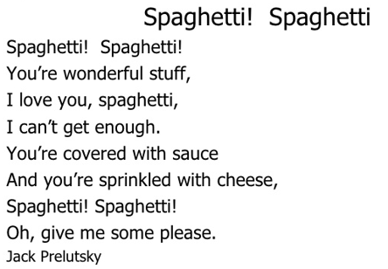
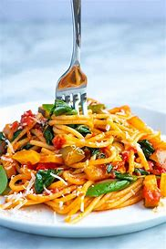
Rhythm – the ‘beat’ of a poem. Its pattern of sounds (syllables)

Slide 7
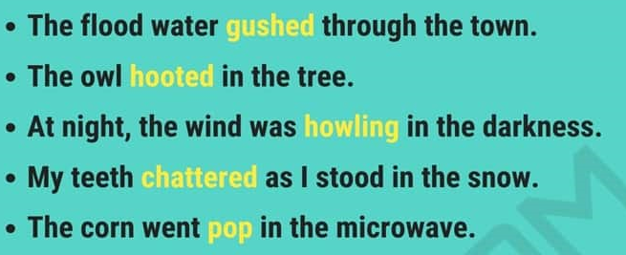
Onomatopoeia – when the word is spelt like the sound it makes.
https://www.bbc.co.uk/bitesize/topics/z4mmn39/articles/z8t3g82
Gush
Hoot
Howl
Chatter
Pop

Slide 8
Now listen to and then read out loud the three poems on the next slides.
Which of the features can you see.
Rhythm
Rhyme
Onomatopoeia
Alliteration
Imagery

Slide 9
Top tips for reading a poem aloud
Work on the tricky words. Find out what they mean and how they are said. Practise saying them.
Look for the full stops. Make sentences flow to the full stop, even when there’s a new line.
Slow down. Speak slowly when you’re reading a poem, so that others can hear the words.
Project your voice. Imagine someone on the other side of the room and speak to them.
Practise. Read and read and read your poem, so that you get better each time.

Slide 10
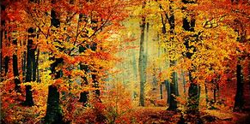
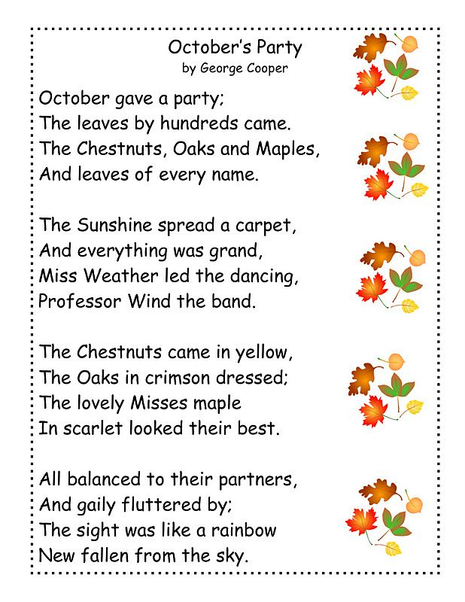
Octobers Party
George Cooper
Rhythm
Rhyme
Onomatopoeia
Alliteration
Imagery

Slide 11
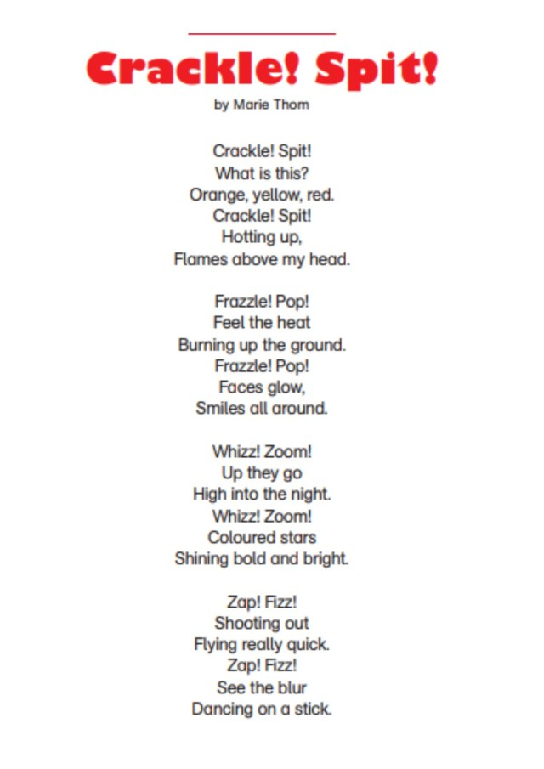
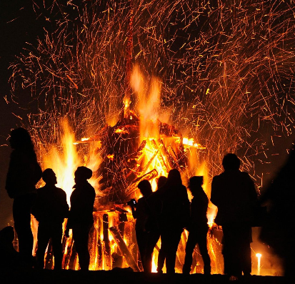
Crackle! Spit!
Marie Thom
Rhythm
Rhyme
Onomatopoeia
Alliteration
Imagery

Slide 12
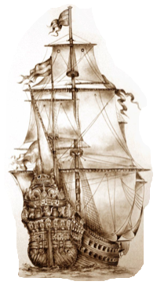
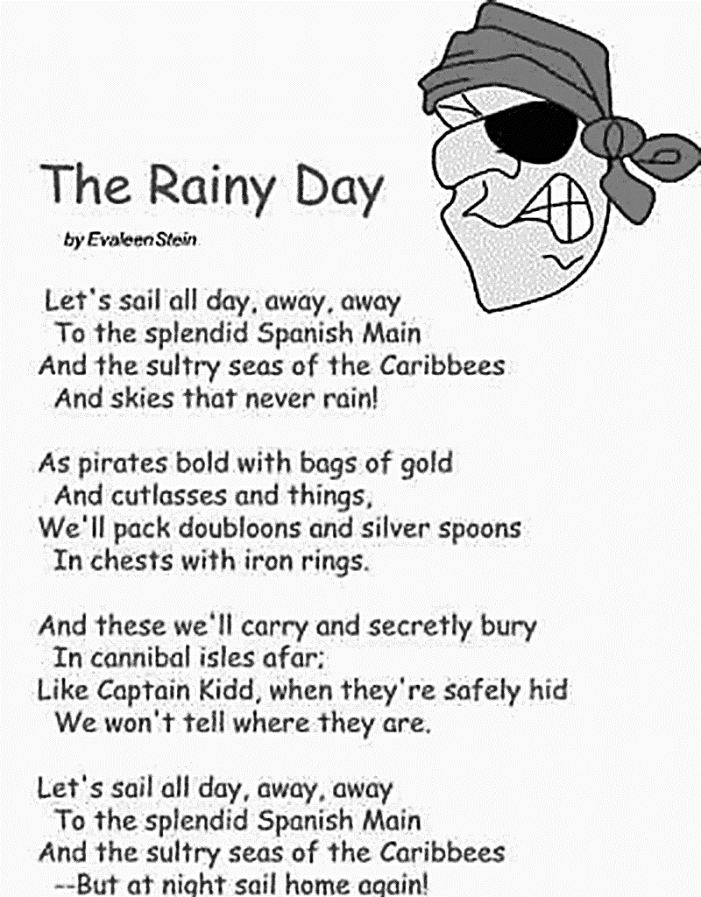
Rhythm
Rhyme
Onomatopoeia
Alliteration
Imagery

Slide 13
What features did you find.
Did you find rhyming Words?
Can you hear the rhythm when you listen and read out loud?
Have the poems created an image in your head using imagery?
Can you smell the autumn leaves and see the colours, in ‘Octobers party’?
Can you hear the sounds in ‘Crackle! Spit!’?
Can you taste the sea and feel the wind in ‘The Rainy Day’?
Have you found onomatopoeia?
Which of the poems do you prefer?
Why? Which feature makes it interesting for you?

Slide 14
Compare the poems
What is the same about the poems?
What are different about the poems?
Write a paragraph to compare the poems.
For example:
‘All the poems have rhyming words.
grand – band
ground – around
things – rings
They also have…
In addition…
The poems are different in the imagery they create. The first poem…

