Slide 1
Set 1 Sounds j

Slide 2
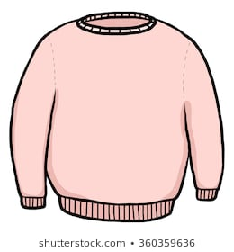
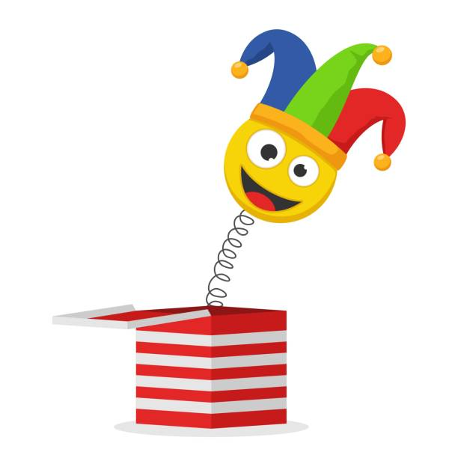

Slide 6
