Slide 1
The Destroyer
Part 2

Slide 2
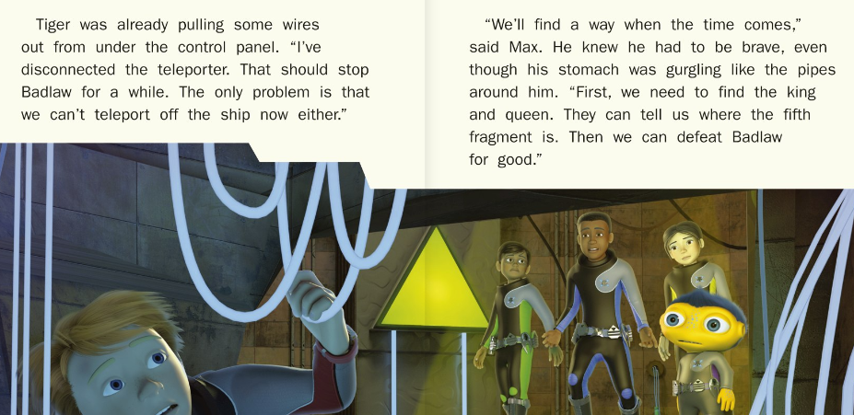

Slide 3
Why did Tiger disconnect the teleporter wires?
How do you think Max felt about Tiger disconnecting the wires?
What word would you use to describe the feeling Max had when his ‘stomach was gurgling’?

Slide 4
4) What does it mean when Ant was studying the panel?
He found a book about control panels.
He was looking carefully at the control panel.
He was pressing all the buttons on the control panel
5) Where do they need to go to access the ship’s computer?

Slide 5
6) What was making the rumbling sound?
7) How do you think the group felt when they heard that noise? Why?
8) Why did Tiger whisper and not shout?

Slide 6
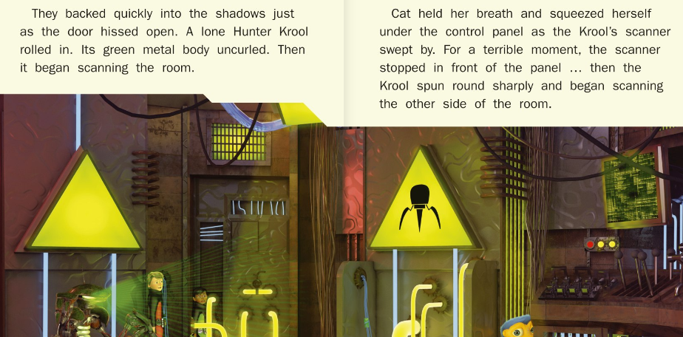

Slide 7
9) Is hiding in the shadows a good idea? Why?
10) What word tells you the hunter Krool was by himself?
11) What word tells you the Krool turned round quickly?
12) What do you predict will happen next?

