Slide 1

Peter and the Wolf
Can you remember how many characters we have met so far?
Notes:
Can you remember how many characters we have met so far in our text, ‘Peter and the Wolf’?

Slide 2
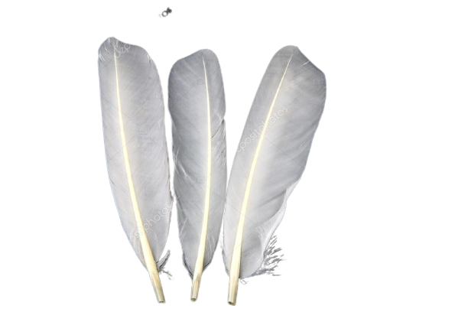
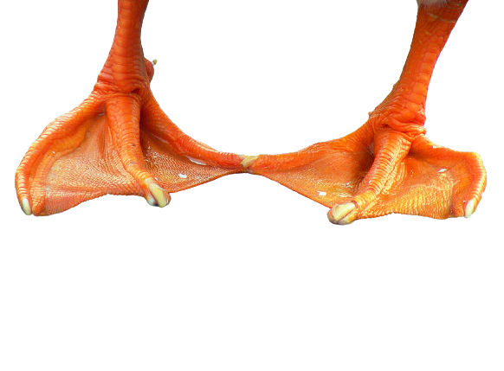
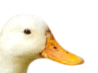
1) Who am I?
White feathers
Webbed feet
An orange beak
I can swim
Notes:
Character 1… who am I? I have white feathers, webbed feet, an orange beak and I can swim.

Slide 3
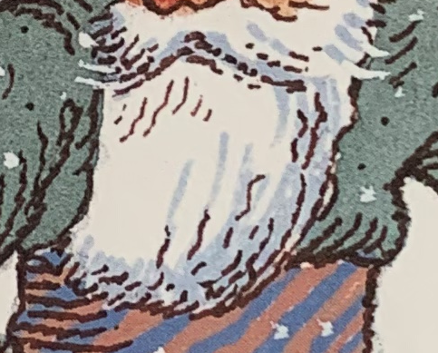
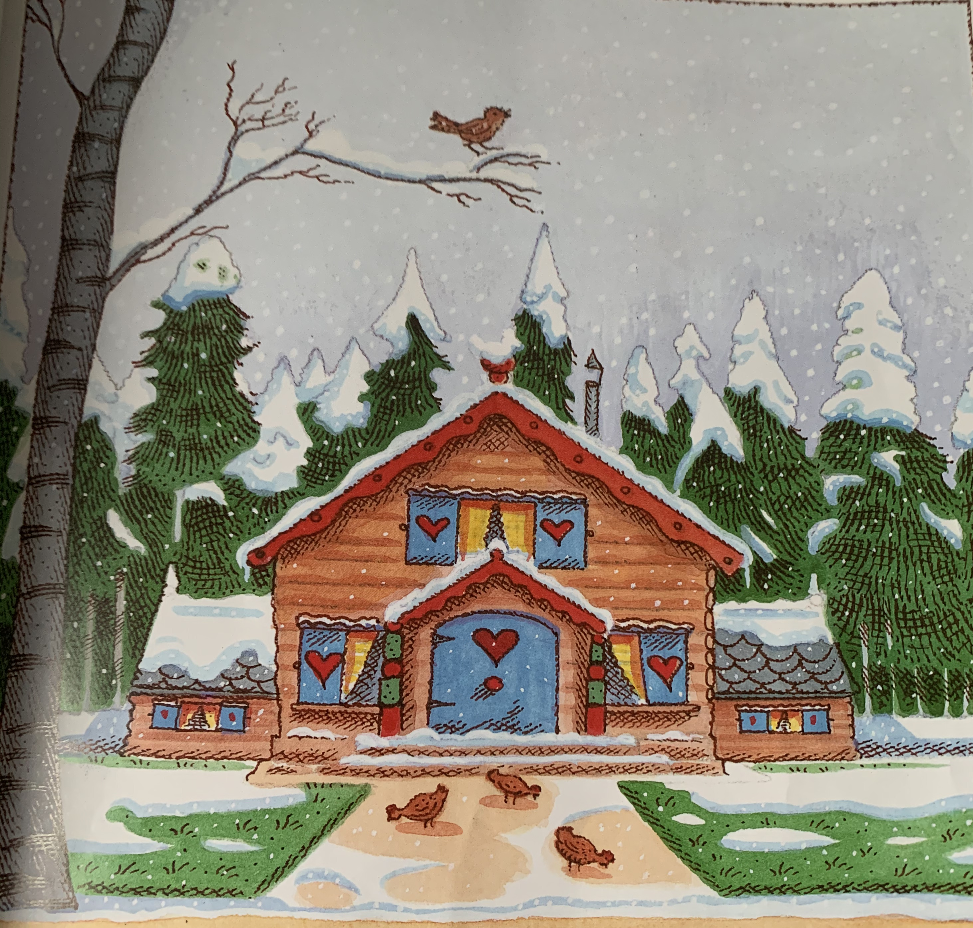
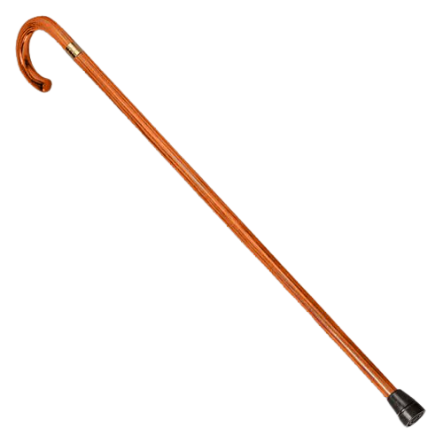
2) Who am I?
Wooden house
White beard
Walking stick
Tall
Notes:
Character 2… who am I? I live in a wooden house, I have a white beard, I use a walking stick and I am tall. Who am I?

Slide 4
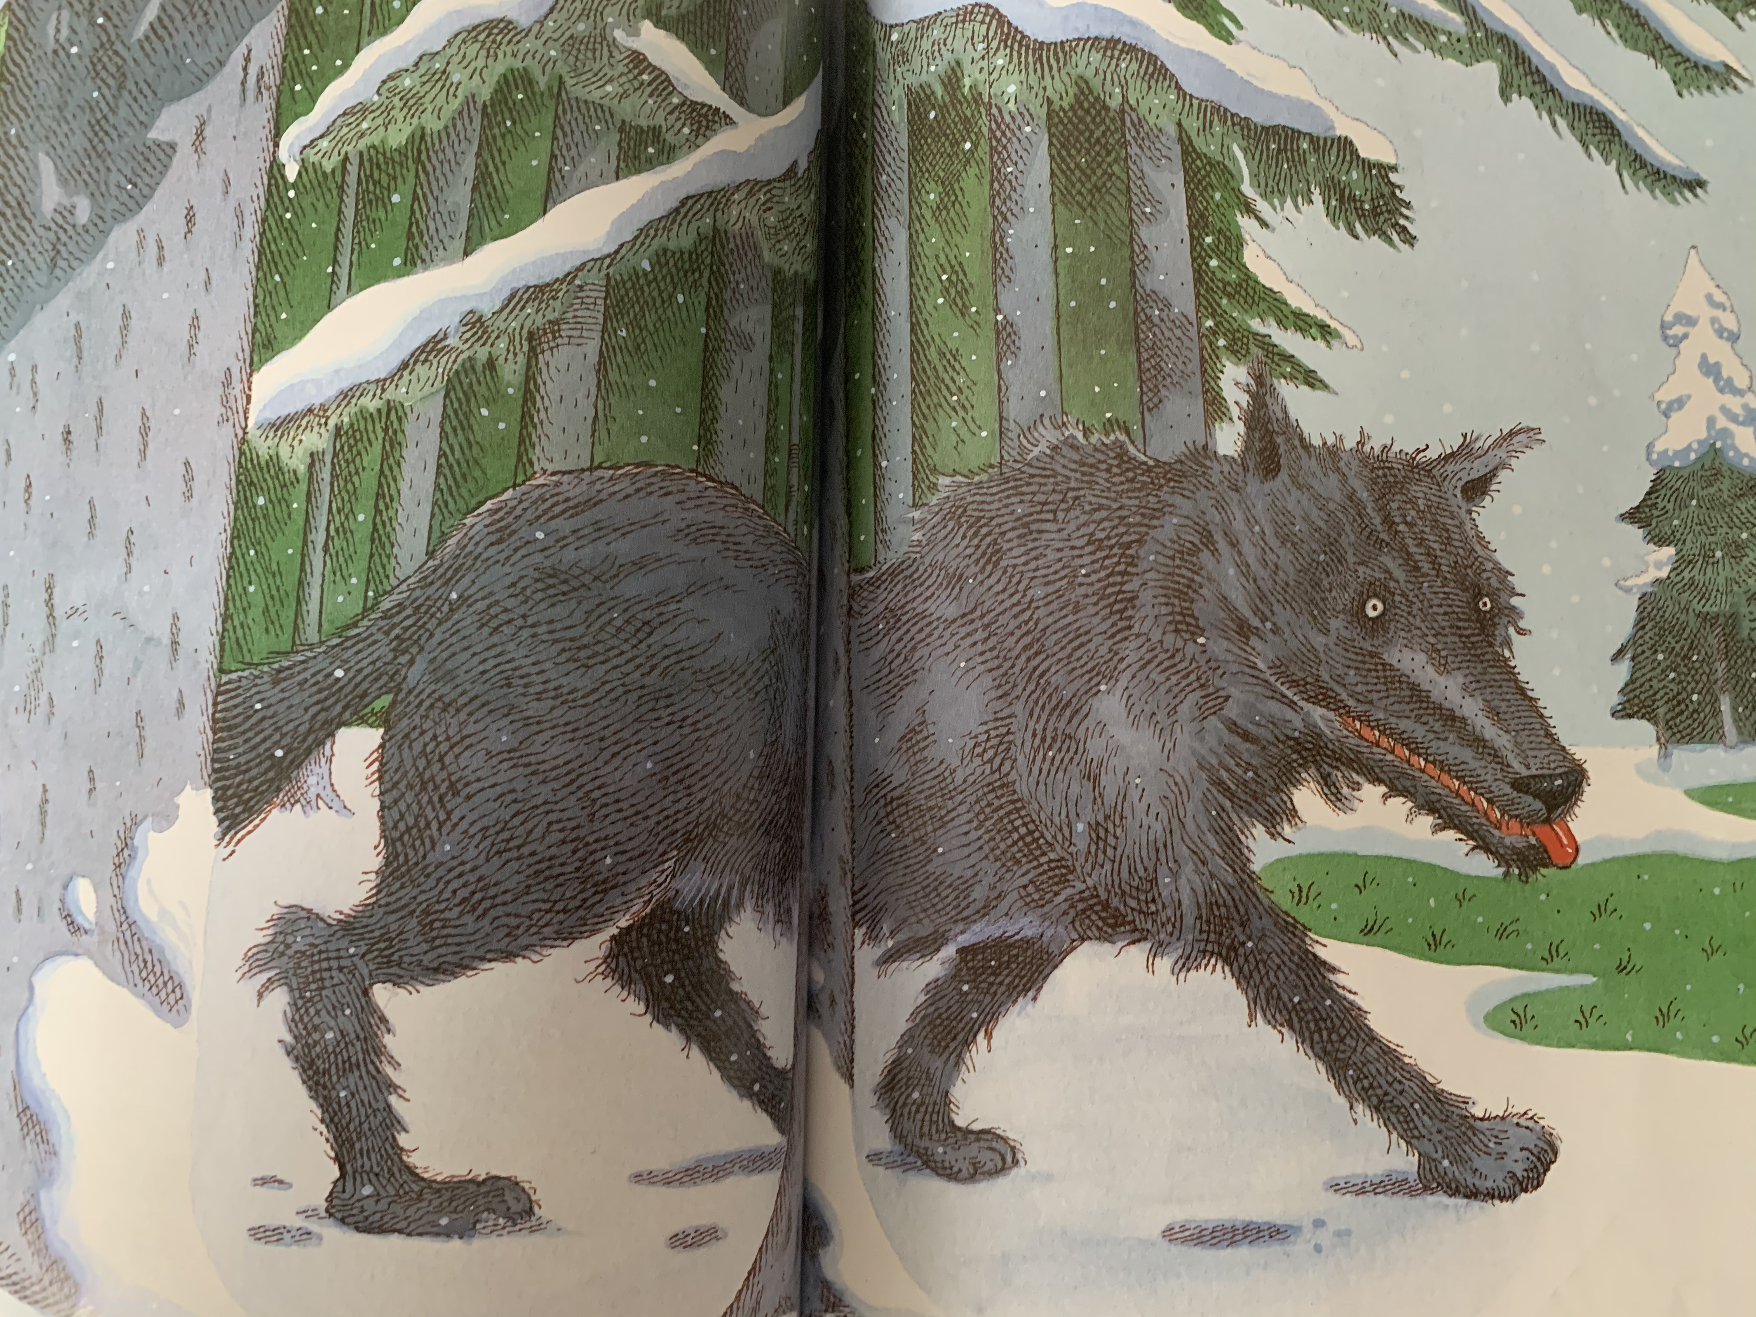
3) Who am I?
4 legs
Grey bushy tail
Sharp and pointy teeth
Round white eyes
Notes:
Character 3, who am I? I have 4 legs, a grey bushy tail, my teeth are sharp and pointy and I have round white eyes. Who am I?

Slide 5
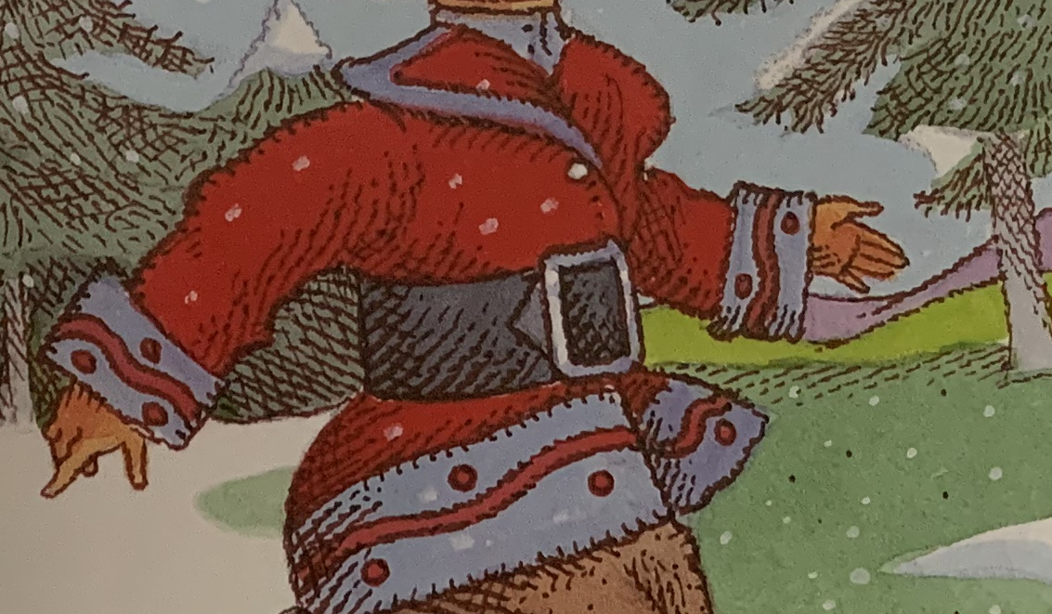
4) Who am I?
2 legs
Wooden house
Brave
Red and blue coat
Notes:
Finally, character 4… who am I? I have 2 legs, I live in a wooden house, I think that I am brave and I wear a red and blue coat. Who am I?

Slide 6
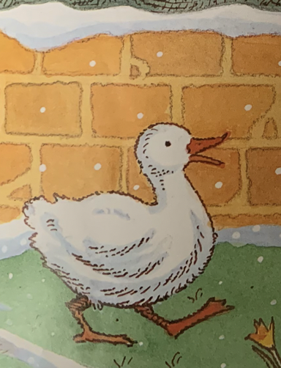
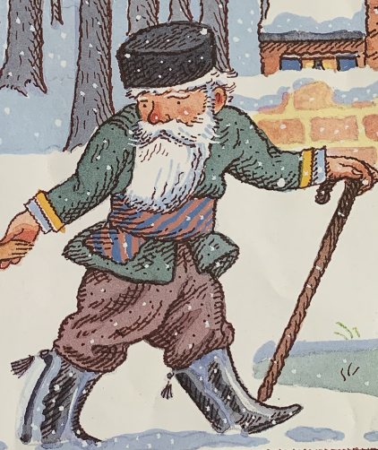
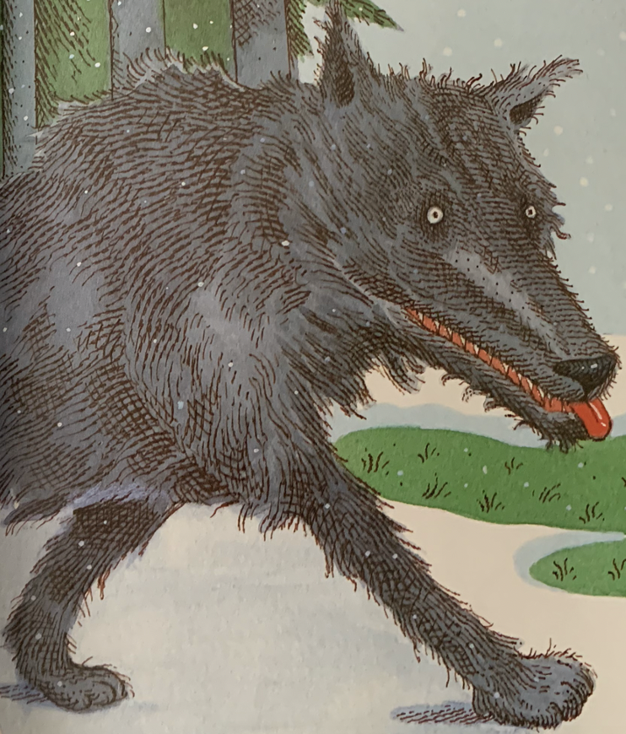
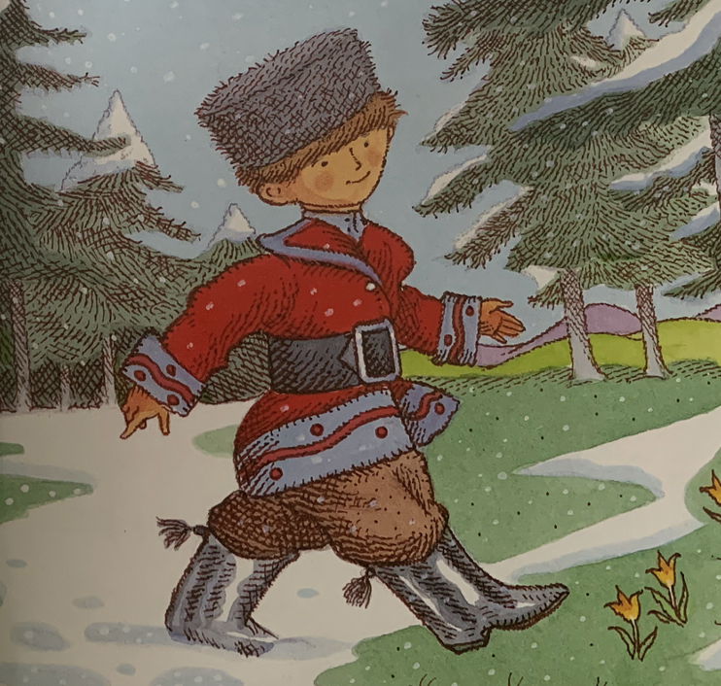
Answers:
Are we missing any?
Notes:
Here are the answers, the duck, the Grandfather, the wolf and Peter. Are we missing anyone?

Slide 7
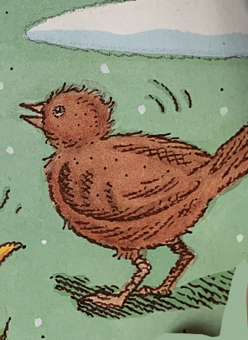
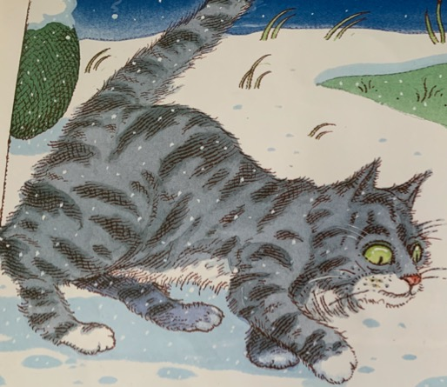
Notes:
Yes! We are missing little bird and cat! Can you describe them?

Slide 8
Now it’s your turn to draw the characters and describe them! Can you remember all 6?
Notes:
Bird has brown feathers, a small beak and wings. Cat has grey striped fur, large green eyes and a pink triangle nose. Are these characters friends? Are they kind? Tell me more about them… Now it’s your turn to draw the characters and describe them! Can you remember all 6?

Slide 9
Commentary:
Slide 1: Can you remember how many characters we have met so far in our text, ‘Peter and the Wolf’?
Slide 2: Character 1… who am I? I have white feathers, webbed feet, an orange beak and I can swim.
Slide 3: Character 2… who am I? I live in a wooden house, I have a white beard, I use a walking stick and I am tall. Who am I?
Slide 4: Character 3, who am I? I have 4 legs, a grey bushy tail, my teeth are sharp and pointy and I have round white eyes. Who am I?
Slide 5: Finally, character 4… who am I? I have 2 legs, I live in a wooden house, I think that I am brave and I wear a red and blue coat. Who am I?
Slide 6: Here are the answers, the duck, the Grandfather, the wolf and Peter. Are we missing anyone?
Slide 7: Yes! We are missing little bird and cat! Can you describe them?
Slide 8: Bird has brown feathers, a small beak and wings. Cat has grey striped fur, large green eyes and a pink triangle nose. Are these characters friends? Are they kind? Tell me more about them… Now it’s your turn to draw the characters and describe them! Can you remember all 6?

