Slide 1
Learning intention
Understanding a text style

Slide 2
Look at the text examples on each slide.
Ask these questions about each one.
-What is the subject of the text?
-Who has written it?
-Who is it written for?
-Who might read it?
-Is it informative?
-Would you like to read more?
?

Slide 3
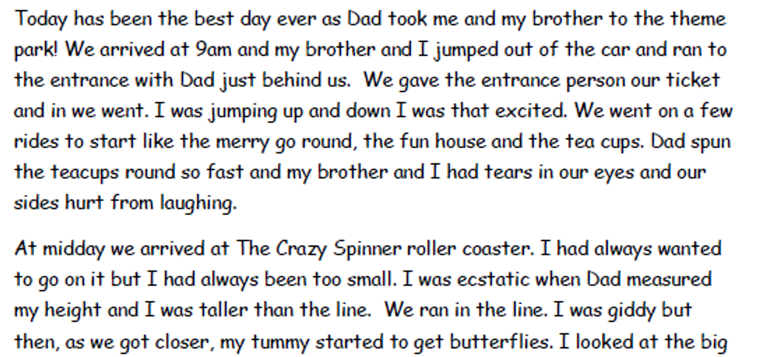


Slide 4
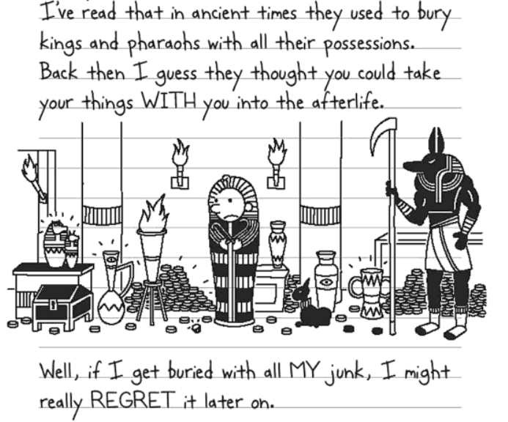
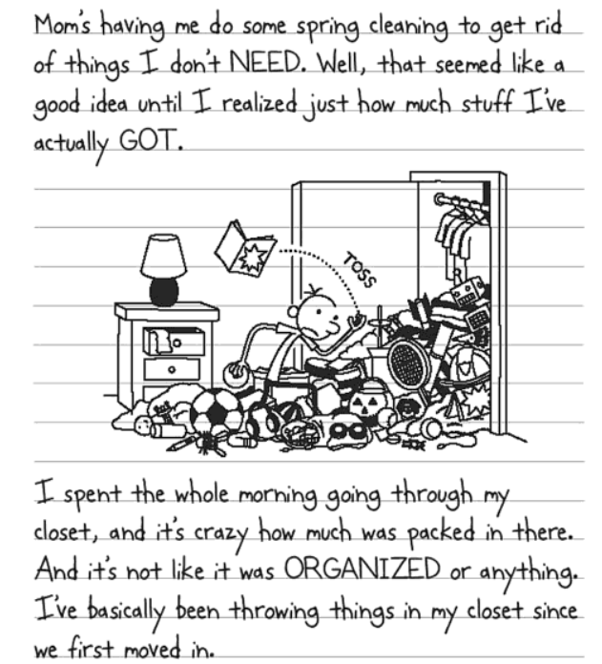

Slide 5
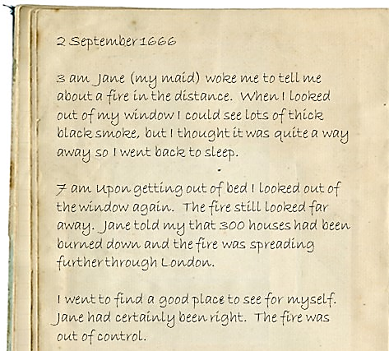

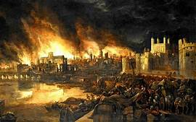

Slide 6
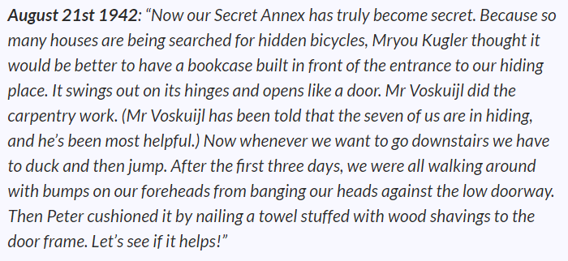


Slide 7
What do you think these all are?
Why? What clues do you have?
What do they have in common?
What is different about them?
When do you think they were written?

Slide 8




Have you ever read or written in a Diary

Slide 9
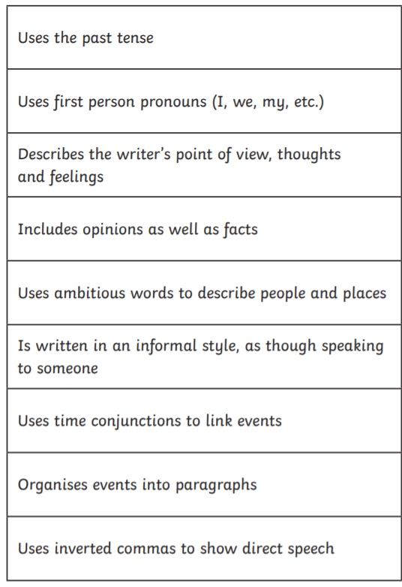
Features of a Diary

