Slide 1
Year two
Telling the time using an analogue clock.

Slide 2
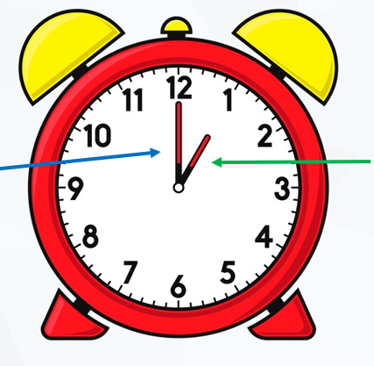
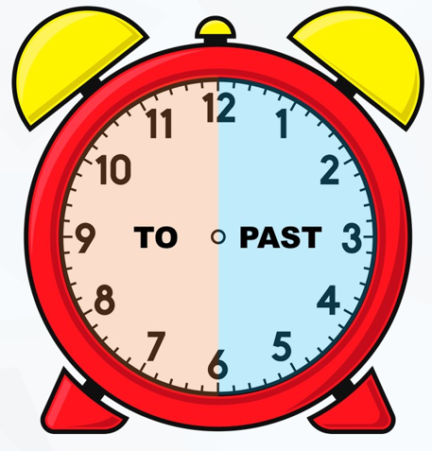
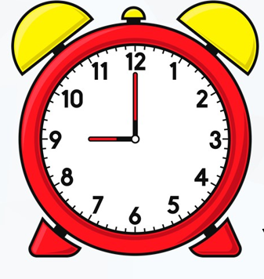
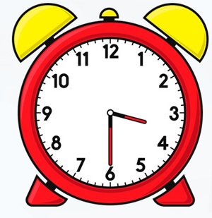
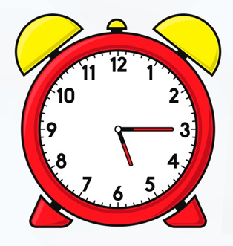
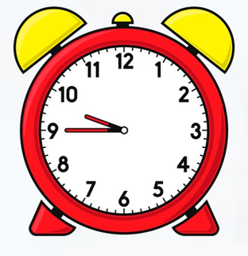
Minute hand
hour hand
A B C D

Slide 3
Today we will focus on using o’clock and half past.

Slide 4
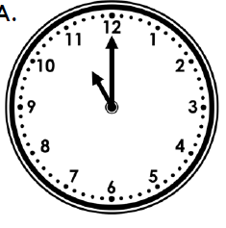
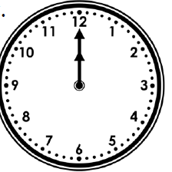
The time is 11 o’clock.
The minute hand is pointing to the 12.
The hour hand is pointing to the 11.
The time is 12 o’clock.
The minute hand is pointing to the 12.
The hour hand is pointing to the 12.

Slide 5
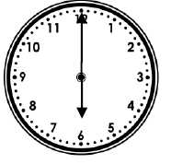
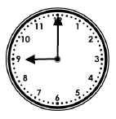
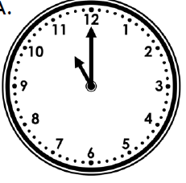
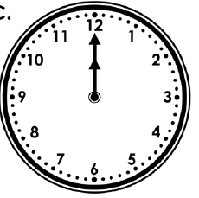
Write the times shown on the clocks
A
B
C
D

Slide 6
A
B
6 o’clock 9 o’clock
C
D
6 o’clock 9 o’clock

Slide 7
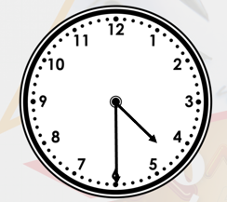
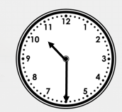
Half past times
A
B
It is half past 10.
The minute hand is pointing to the 6.
The hour hand is pointing half way between the 10 and 11.
It is half past 4.
The minute hand is pointing to the 6.
The hour hand is pointing half way between the 4 and 5.

Slide 8
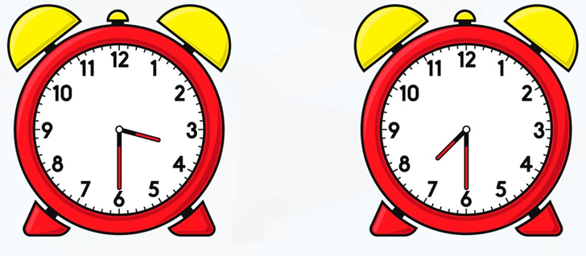
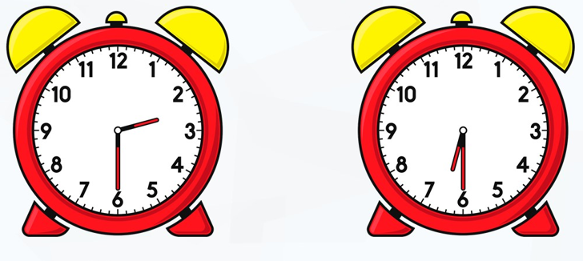
Write the time shown on the clocks below.
A
B
C
D

Slide 9
Answers.
A
B
Half past 3 half past 7
C
D
Half past 2 half past 6

