Slide 1
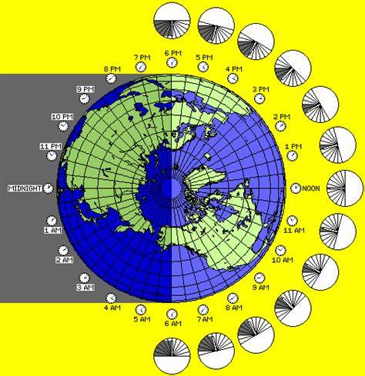

Geography - Time Zones

Slide 2
What are time zones?
Time zones are divided by imaginary lines called meridians which run from the North Pole to the South Pole.
There is an imaginary line running through the UK called the Prime Meridian. It runs through a place in London called Greenwich.
The Prime Meridian splits the world into eastern and western hemispheres.
Time in countries to the east of the Prime Meridian is always in front of that in the UK.
Time in countries to the west of the Prime Meridian is always behind that of the UK.

Slide 3
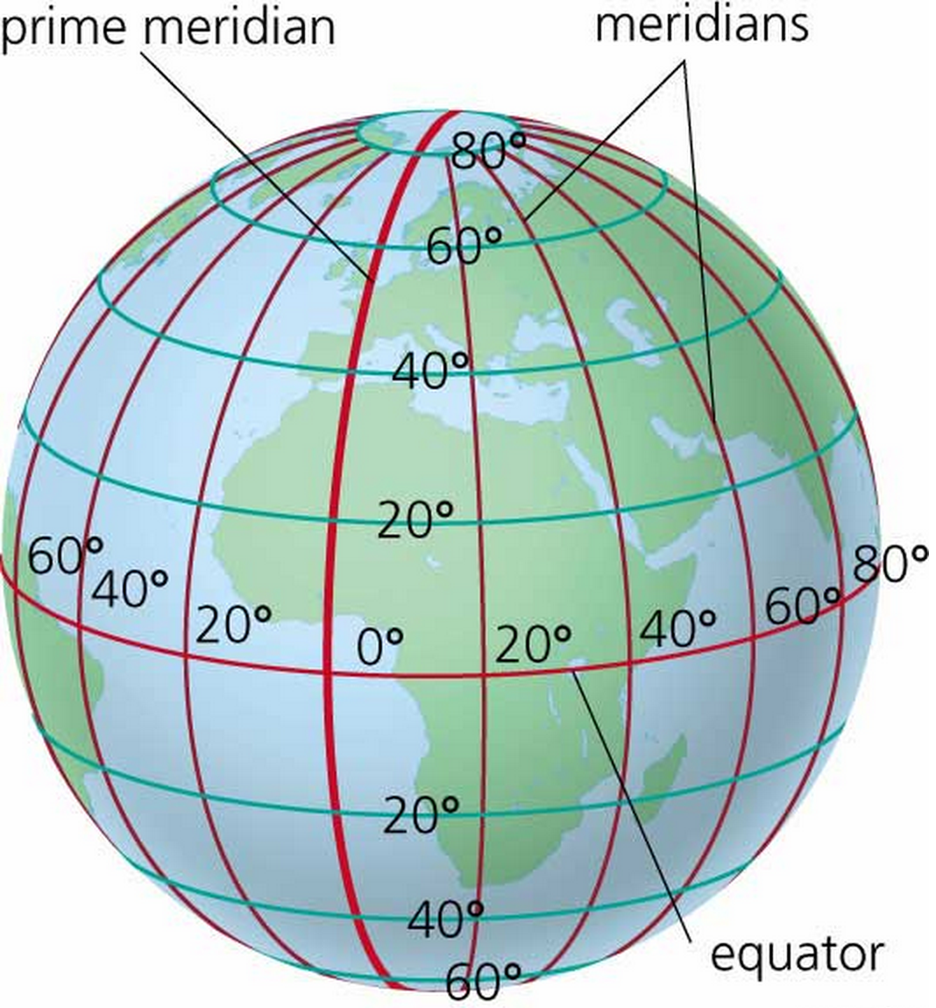
This diagram shows the Prime Meridian that runs through London. Each of the red lines show the imaginary lines that run from North to South and divide the world into time zones.

Slide 4
Times in Different Parts of the World
As the Earth rotates on its axis, the Sun only shines on the side of the Earth that it is facing. This means:
it is daytime for the parts of the Earth that have the Sun shining on them
it is night-time for places that are on the opposite side of the Earth and are in the shade
As it is night in some parts of the world while it is day in other parts, different places in the world have different times. This is why the world is divided into 24 different time zones. One for each hour in a day.
Very large countries that are spread out across many time zones, such as Russia or the USA, are divided into separate time zones. Most smaller countries keep to the same time zone even if part of them falls outside a meridian line. Some Countries, like China and India have half past the hour in their time zone.

