Slide 1
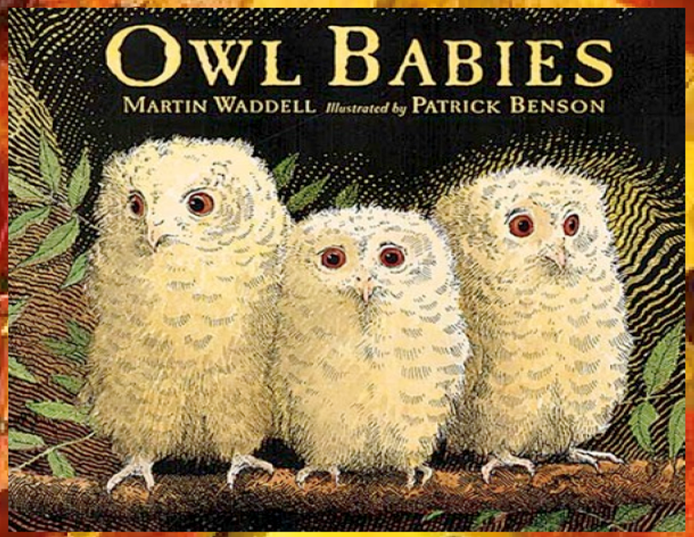
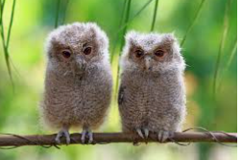
Today we will look at some real owl babies.

Slide 2
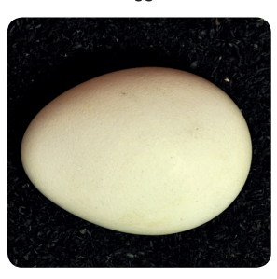
Baby owls hatch from an egg. This is an egg. Look at the shape.

Slide 3
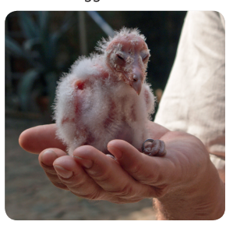
This baby owl has just hatched from an egg. It still has its eyes closed. Can you see its beak?

Slide 4
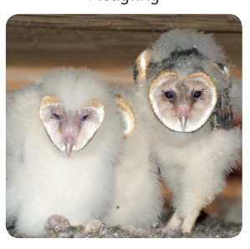
These baby owls are now growing more feathers.

Slide 5
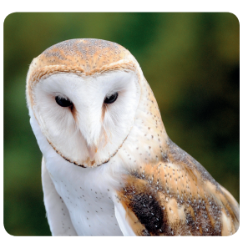
This is an owl when it has grown up. Like Owl Mother in the ‘Owl Babies’ story.

