Slide 1

Set 2 Sounds
‘igh’

Slide 2
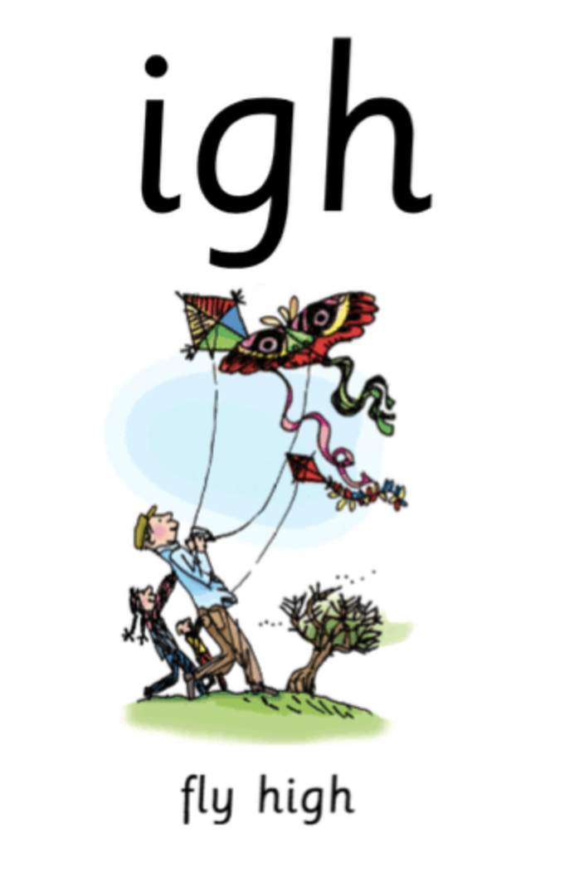

Notes:
Fly high

Slide 3
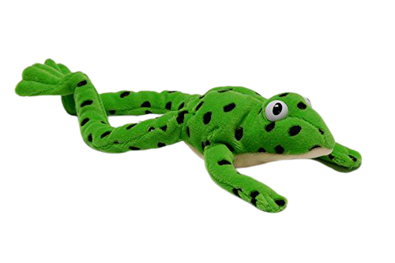
Notes:
Fred talk time! H-igh, b-r-igh-t, n-igh-t, f-r-igh-t

Slide 4
Notes:
Igh, three letters, one sound, special friends, igh

Slide 5
Notes:
My turn – igh. Your turn. My turn – Fly high. Your turn.

Slide 6
Notes:
Now let’s play our game – can you remember? When it wiggles tell me if it’s igh, or fly high. If you don’t have the wiggle don’t worry, ask someone to point and if you don’t have someone there, that’s ok too, have a practice at being super speedy and point when you say it. Igh or fly high.

Slide 7



Notes:
It’s time for some green words – let’s use Fred talk to help us sound them out: h-igh, n-igh-t, b-r-igh-t

Slide 8



Notes:
Let’s practice writing our sound - igh

Slide 9
Notes:
Can you write some words with today’s sound? Night, high, fright. Tick and fix on the next slide

Slide 10
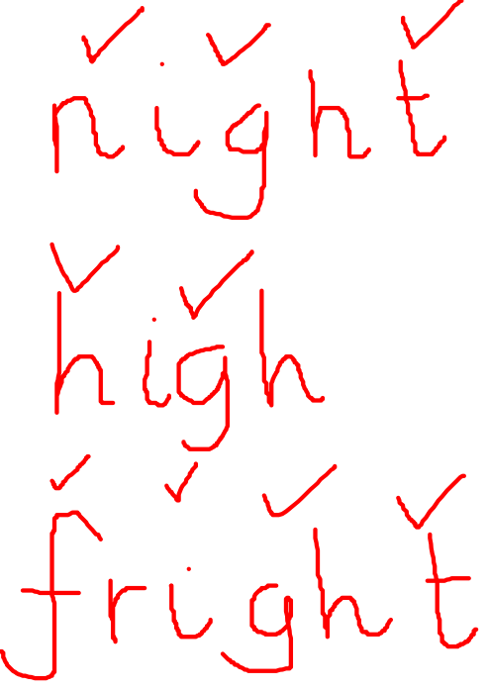
Notes:
Let’s use our Fred fingers, n-igh-t 3 sounds, h-igh 2 sounds, f-r-igh-t 4 sounds.

Slide 11
Commentary:
2: Fly high
3: Fred talk time! H-igh, b-r-igh-t, n-igh-t, f-r-igh-t
4: igh, three letters, one sound, special friends, igh
5: My turn – igh. Your turn. My turn – Fly high. Your turn.
6: Now let’s play our game. When it wiggles tell me if it’s igh, or fly high. If you don’t have the wiggle don’t worry, ask someone to point and if you don’t have someone there, that’s ok too, have a practice at being super speedy and point when you say it. ‘ee’ or what can you see?
7: It’s time for some green words – let’s use Fred talk to help us sound them out. H-igh, n-igh-t, b-r-igh-t.
8: Let’s practice writing our sound - igh
9: Can you write some words with today’s sound? Night, high, fright. Tick and fix on the next slide
10: Let’s use our Fred fingers, n-igh-t 3 sounds, h-igh 2 sounds, f-r-igh-t 4 sounds.

