Slide 1
Learning Intention – To find pairs of numbers that give an answer to an equation.

Slide 2
In Algebra, it uses letters or symbols to represent missing values.
Use inverse operations to find these missing values:
35 + y = 62
6a = 84

Slide 3
Use inverse operations to find these missing values:
35 + y = 62
62 – 35 = 27.
y = 27
6a = 84
84 ➗ 6 = 14

Slide 4
An equation is a mathematical expression that has an equals symbol.
An equation must always balance. The expression on one side of the equal sign must make the same value as the expression (or answer) on the other side.

Slide 5
Equations can have more than one variable (missing number). When there is more than one variable in an equation, there are different pairs of numbers which will balance the equation.

Slide 6
How many different two-digit numbers can be made using the digit cards – 1,2,3,4 and 5?
e.g. 12, 13, 14, 15.

Slide 7
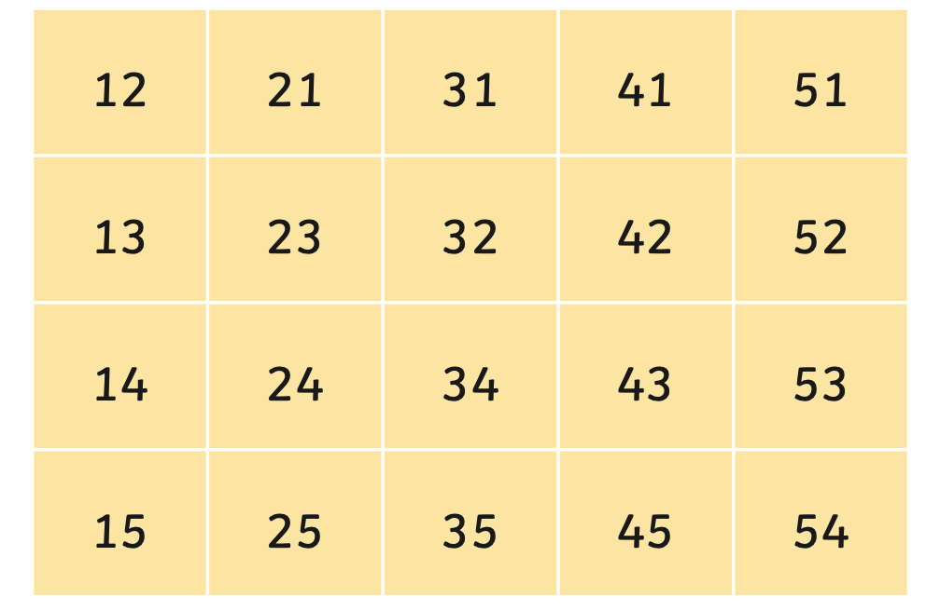
When finding all the different possibilities, is is easier if you:
Use a system for finding all of the possibilities.
Organise your findings in an ordered list or table.
Have a way of deciding when all possibilities have been found.

Slide 8
Now have a go at the worksheet using the strategies you have practiced.

