Slide 1
Finding fractions of amounts
This fraction is one half
$$\frac{1}{2}$$
Numerator - how many parts or groups we are counting
Denominator - how many parts or groups there are altogether
So one half of 4 = 2
$\frac{1}{2}$of 4 = 2

Slide 2
Finding fractions of amounts
This fraction is one quarter
$$\frac{1}{4}$$
Numerator - how many parts or groups we are counting
Denominator - how many parts or groups there are altogether
So one quarter of 4 = 1
$\frac{1}{4}$of 4 = 1

Slide 3
Finding fractions of amounts
This fraction is one third
$$\frac{1}{3}$$
How many groups or parts will there be?

Slide 4
Finding fractions of amounts
This fraction is one third
$$\frac{1}{3}$$
3 groups
So $\frac{1}{3}$ of 3 = 1

Slide 5
Finding fractions of amounts
Find a third of an amount (a number)
$\frac{1}{3}$ of 6 =

Slide 6
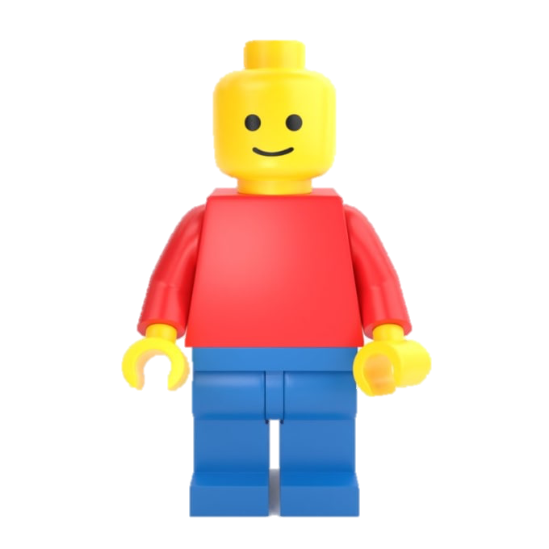
Finding fractions of amounts
Find a third of an amount (a number)
$\frac{1}{3}$ of 6 =

Slide 7
Finding fractions of amounts
Find a third of an amount (a number)
$\frac{1}{3}$ of 6 = 2

Slide 8
Finding fractions of amounts
Find a third of an amount (a number)
$\frac{1}{3}$ of 6 = 2

Slide 9
Finding fractions of amounts
Find a third of an amount (a number)
$\frac{1}{3}$ of 12 =

Slide 10
Finding fractions of amounts
Find a third of an amount (a number)
$\frac{1}{3}$ of 12 =

Slide 11
Finding fractions of amounts
Find a third of an amount (a number)
$\frac{1}{3}$ of 12 = 4

Slide 12
Try the questions on the worksheet.
Remember: you need equal groups.

