Slide 1
To find the tempo of a piece of music.

Slide 2
What is tempo?
Have a talk with someone about what you think tempo is. You could write down some ideas below.
Tempo

Slide 3
Have a listen to these piece, does this change you ideas about tempo?

Slide 4
Tempo is how quick a piece of music is
Tempo
How might a fast tempo make us feel about the music?
What about if the tempo was slow?

Slide 5
Have a listen to these pieces music again.
For each piece of music tell me what kind of tempo it has.
Fast? Slow? A mix?
Does the tempo stay the same the whole way through the song?
You can write your ideas down or share them verbally with someone at home.

Slide 6
The Supremes – Stoned Love

Slide 7
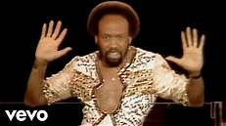
Earth, Wind & Fire – Boogie Wonderland

Slide 8
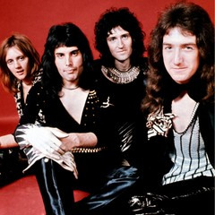
Queen – We Will Rock You

