Slide 1
Learning intention: To identify that most living things live in habitats and explain what a habitat and microhabitat is.
Microhabitat quiz

Slide 2
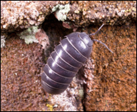
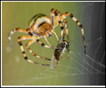
1. Where does a woodlouse get its food?
from the air
from the rotting wood
from the soil
2. This spider catches flies in its web and eats them. Where is the best place for the spider to build a web?
in the soil
on the outside of a house
inside a house

Slide 3
3. Grace found a pile of old leaves. Where will she find the most minibeasts?
on the leaves
under the leaves
in the air
4.Jack dug up some soil and found lots of earthworms. What type of place do earthworms like?
dark
light
frozen

Slide 4
5. Ellis turned over an old log and saw lots of woodlice. What do woodlice need to live?
just food
just air
food, water, air and warmth
6. The place where minibeasts live is called a micro-habitat. What does micro mean?
very big
very small
very large

Slide 5
Check your answers:
1. b
2. c
3. b
4. a
5. c
6.b

