Slide 1

Learning intention To tell the time to every minute

Slide 2
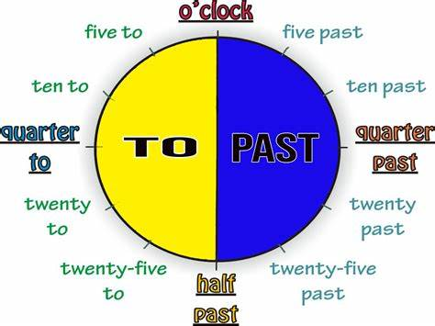

Slide 3
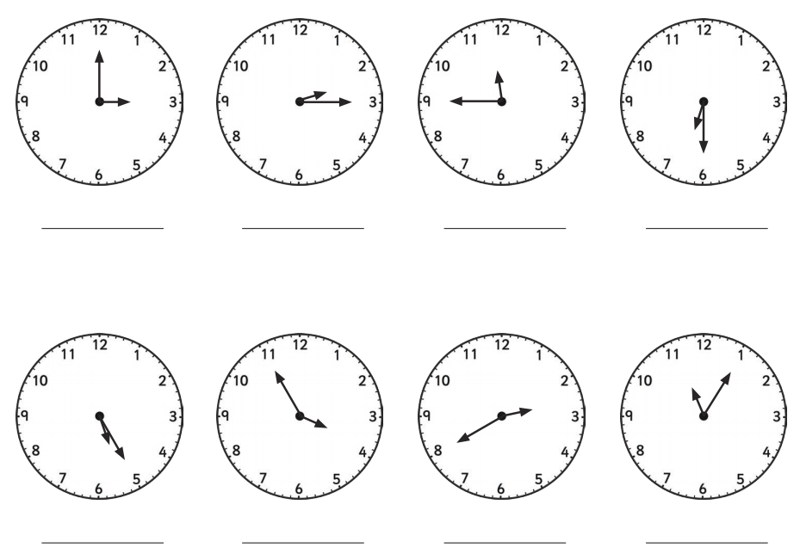
Recap What times do these clocks show?
3 o’clock quarter past 2 quarter to 12 half past 6
25 past 5 5 to 4 twenty to 3 five past eleven

Slide 4
Today we're going to look at how to tell the time to the nearest minute.
It is the same as telling the time to the nearest 5 minutes except we use all 60 minutes, not just the 5 minute times.

Slide 5
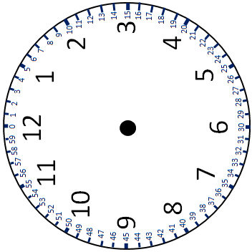
13 minutes past 4

Slide 6
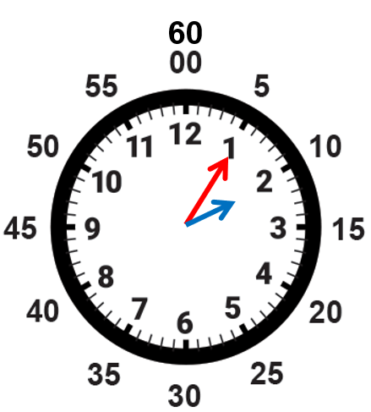
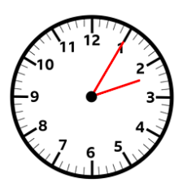
However you don’t always have the numbers from 0 – 60 on a clock. There is not enough room! But you know the minutes are there even if you can’t see them! These clocks all say 5 past 2 even though you can’t always see the minute numbers.

Slide 7
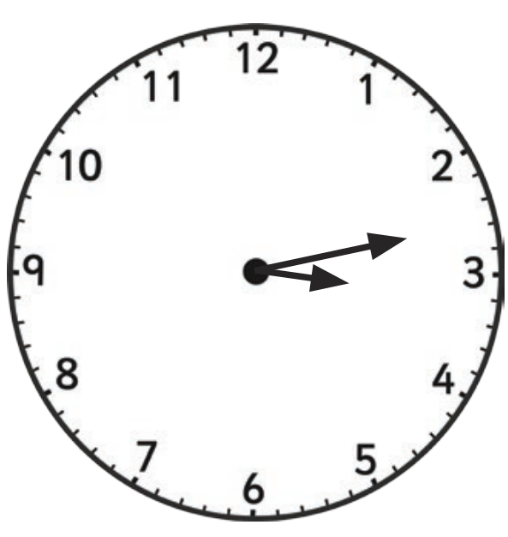
What is the time?
10 minutes past 3 13 minutes past 3 2 minutes past 3

Slide 8
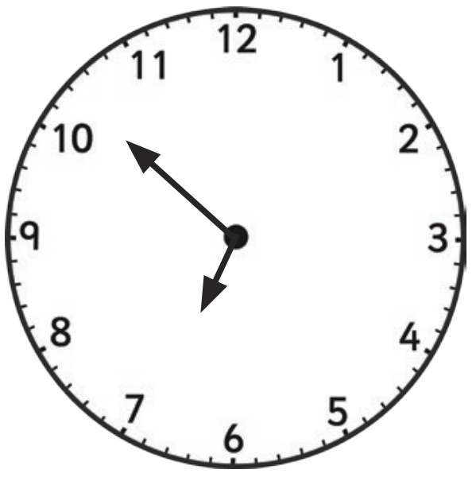
What is the time?
7 past 10 8 minutes to 7 10 to 7

Slide 9
Find the sheet ‘telling time to the nearest minute’ and complete the questions

