Slide 1
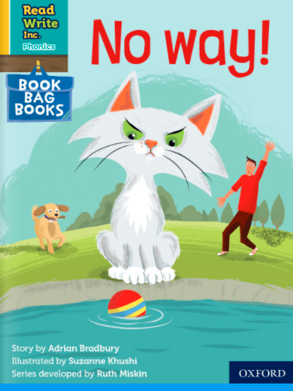
You are going to read the story ‘No Way!’
In this story you will hear words with the sound:
ay
Words with the ay sound are:
play
way
day
Can you write two words with ay sound? Ask an adult to check your spelling.
Look at the picture. What can you see? What will happen in the story?

Slide 2
Let’s read these words together. These are words you will come across in the story
Green words Red words
strict are
fetch want
chucks
brings
dripping
chilly
snugg les

Slide 3
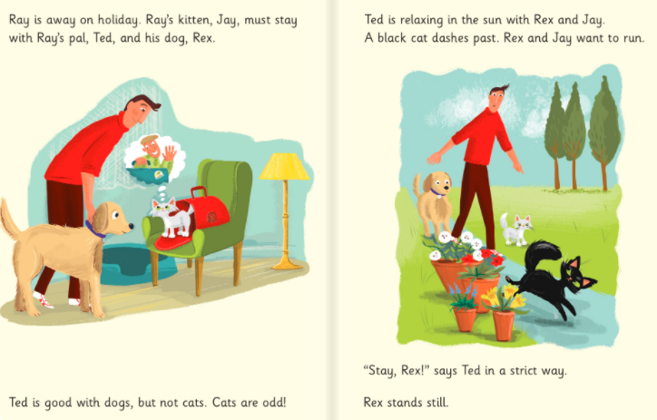
What does Ted think about Cat’s?
Where is Ted relaxing?
Who is he relaxing with?
Who runs past?

Slide 4
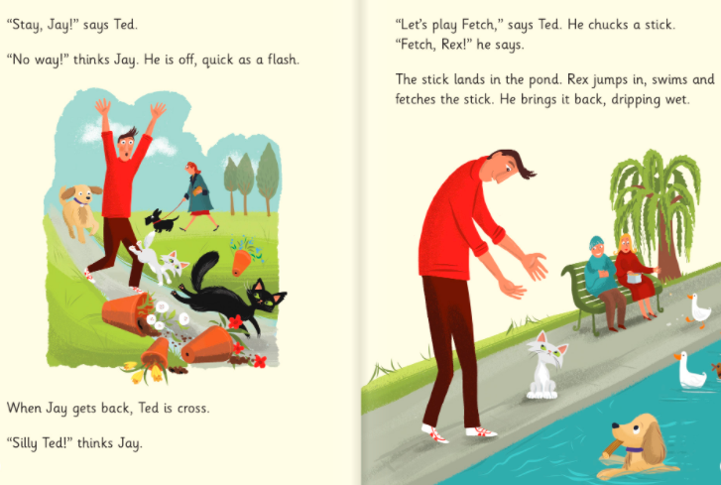
Who runs off?
Who fetches the stick?

Slide 5
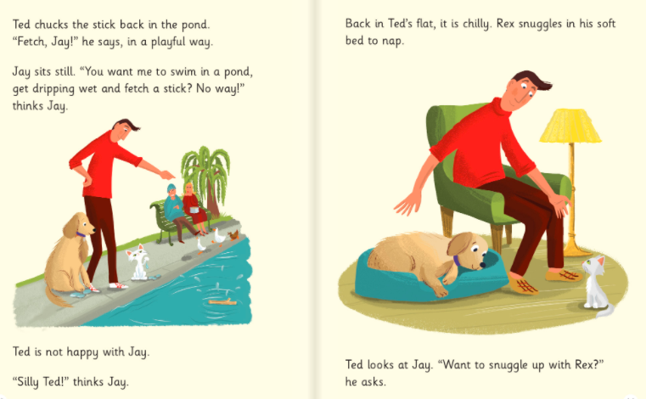
Why doesn’t Jay want to fetch the stick?
Where is it chilly?

Slide 6
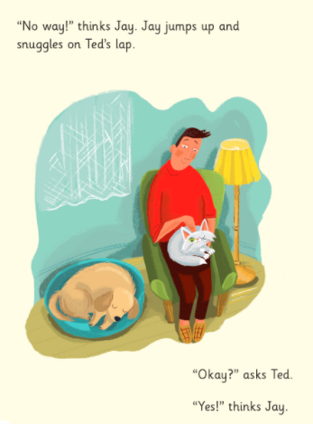
Where does Jay snuggle up?
Why do you think he didn’t snuggle up in Rex’s bed?

Slide 7
Recap questions
Why is Jay staying with Ted?
Why is Ted cross when Jay runs off?
What does Rex do in the pond?
Why doesn’t Jay want to fetch the stick?
Were you surprised that Jay snuggled up on Ted’s lap?

