Slide 1
Learning Intention
To use descriptive language

Slide 2
What is descriptive language?
Adjectives
Adjectives are words that describe what you can sense about a noun including
sight, sound, smell, taste, touch, and how they feel.
We use these to make our writing more exciting for the reader.
We will be focusing on using adjectives today.

Slide 3
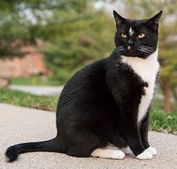
Using adjectives
black fur
pointy ears
yellow eyes
soft fur
white paws
long tail

Slide 4
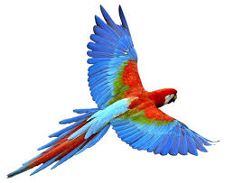
Now it’s your turn. Can you talk to someone at home and share your adjectives about this animal.
What does the macaw sound like?
What does the macaw look like?
Here are some examples red wings sharp beak

Slide 5
