Slide 1
Learning intention: To learn about World Wildlife day.

Slide 2
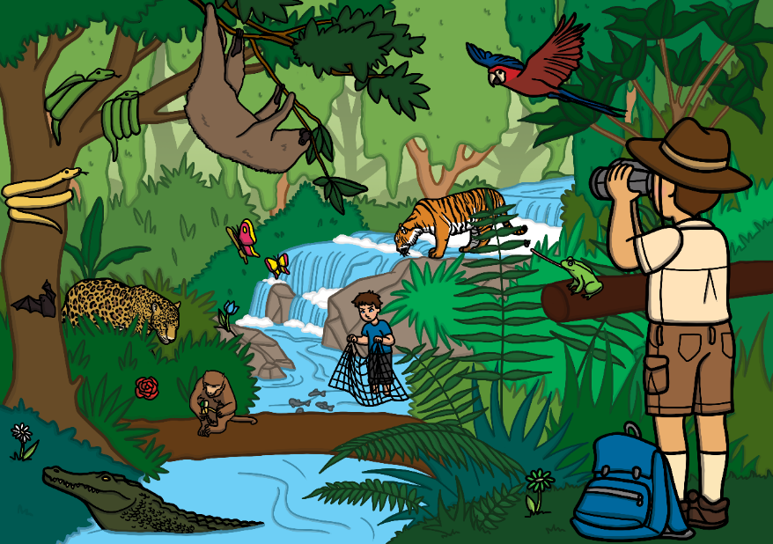
What Is World Wildlife Day?
World Wildlife Day is on the 3rd March 2021. It is a day to celebrate the world’s wild animals and plants. It is a day to think about how we can help all plants and animals, especially those that may be endangered.

Slide 3
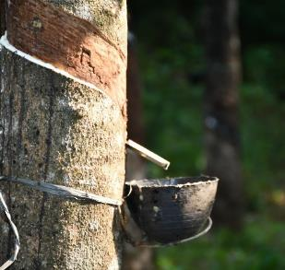
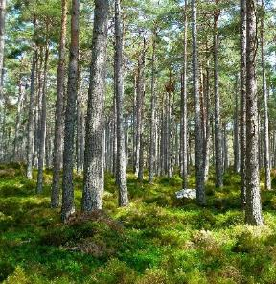
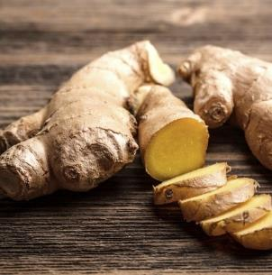
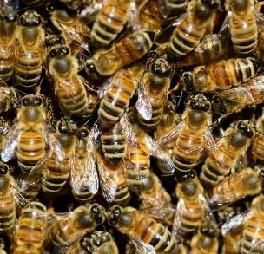
What do Forests and Woodlands Provide?
Click on a feature to find out more about what forests and woodlands provide…
rubber trees
trees
ginger
bees

Slide 4
Ginger Root (medicine)
Ginger is a plant that can be used as a natural medicine for many different illnesses.
Uses of Ginger
Ginger root can be used to treat many stomach problems, such as:
indigestion
vomiting
feeling sick
back

Slide 5
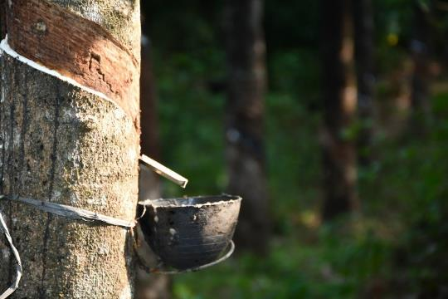
Rubber Trees (material)
Rubber trees started in the Amazon rainforest but are now in many areas of the world. They provide natural rubber.
Uses of Rubber Trees
Rubber trees can be tapped so that latex rubber can be taken from the tree and used to make things, such as:
tyres
gloves
balloons
back

Slide 6
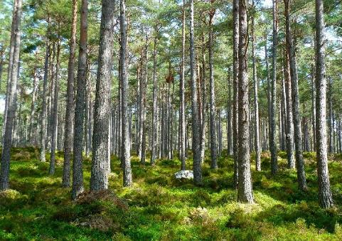
Trees (material)
Trees can be used for many things. They can provide materials and also make sure the planet is healthy.
Wood from trees can be used to make many things, such as:
buildings
furniture
paper
toys
Logs from trees can be used as firewood.
Trees take in carbon dioxide and give out oxygen for us to breathe.
back

Slide 7
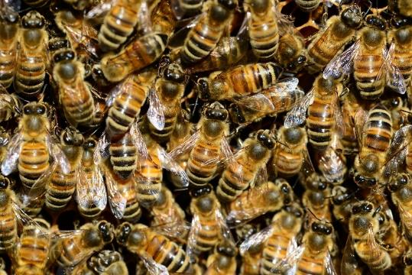
Bees
Bees work hard to make honey in their stomach.
Once the honey has been made, they make a honeycomb.
Bees provide honey, that we can use as food.
Bees carry pollen on their legs which they take to other plants.
back

Slide 8
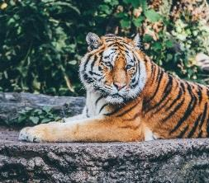
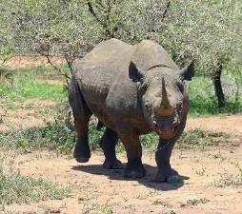
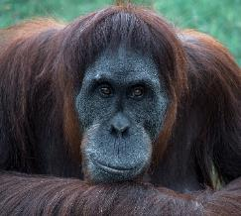
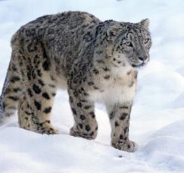
What do these living things have in common?
Click on an image to find out more.
All of these living things are endangered.
Next Section

Slide 9
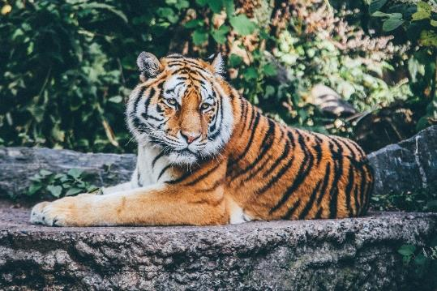
Tiger (Endangered)
Tigers are the one of the closest species to extinction.
Threats to the Tiger
Wild tigers are hunted for their body parts which can be sold for a lot of money across Asia.
back

Slide 10
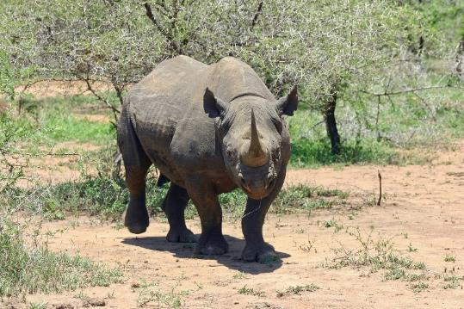
Black Rhino (Endangered)
The black rhino is found mostly in southern African countries.
Black rhinos like to live alone and eat leaves, shoots and plants.
Threats to the Black Rhino
Humans are the only predators of the black rhino.
Rhinos are killed for their horns
back

Slide 11
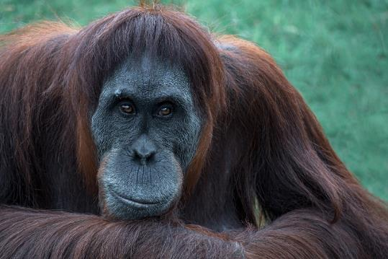
Orangutan (Endangered)
Orangutans are found in rainforests in Southeast Asia.
They spend most of their time in trees, using their strong arms to swing from branch to branch.
Orangutan homes are being destroyed to make room for palm oil trees.
Orangutans are often hunted by humans. They are either killed or kept as pets.
back

Slide 12
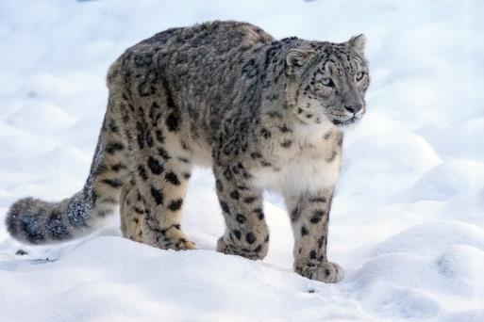
Snow Leopard (Endangered)
Snow leopards are often referred to as ‘mountain ghosts’ because they are rarely seen.
Snow leopards are captured and killed for their fur, bones and body parts.
back

Slide 13
Task:
Tell an adult what you have learnt about World Wildlife Day.

